Slide 1


Slide 2
SEX Differences In The Brain?
Do They Matter?
Donald Stein, PhD
Professor

Slide 3
Why Should We Be Concerned About Sex Differences?
Until very recently, the majority of laboratory studies were performed in male rats or mice.
The female hormonal cycle can influence the effects of many drugs or other treatments.
Having to study both males and females can double the time and cost of most laboratory studies.
Subtle differences in behaviors are often missed and this oversight can affect conclusions about treatment effects.

Slide 4
Lost In Translational Biology: Understanding Sex Differences To Inform Studies Of Diseases Of The Nervous System.
Pearse, RV, Et Al Brain Res, 1722, 2019
While ethnic and geographical genomic variation plays a role in differential human biology, the greatest biological variability is between males and females.
Virtually every neurodegenerative and neuropsychiatric disease shows some variation between males and females.
Males and females differ in the prevalence, expression and symptoms of: Alzheimer’s disease, Parkinson’s, Multiple Sclerosis, Autism disorders, Pain and many others.
There are often substantial sex differences in response to many classes of drugs.
Male and female brains are not the same in both structure and function.

Slide 5
Comparing Males and Females
Age at time of testing or doing procedures is a critical variable because of maturational factors at both ends of the developmental spectrum.
Sex differences seen at one age may not be apparent at another.
Females may differ from males only on some days of the estrous cycle (e.g. in brain injury outcome).
Women on contraceptives could have different outcomes than those not and both could be different from men.
Drug doses can vary across estrous cycle.

Slide 6
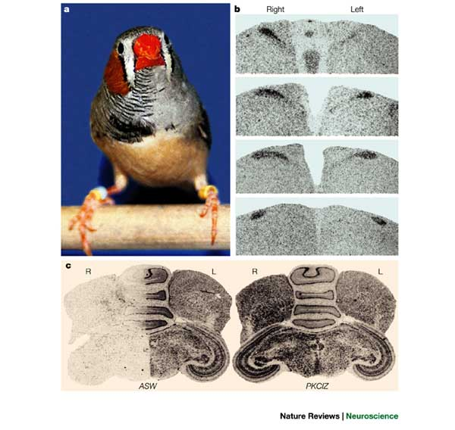
Even Birds Show Sex Differences In Brain Structure And Function

Slide 7
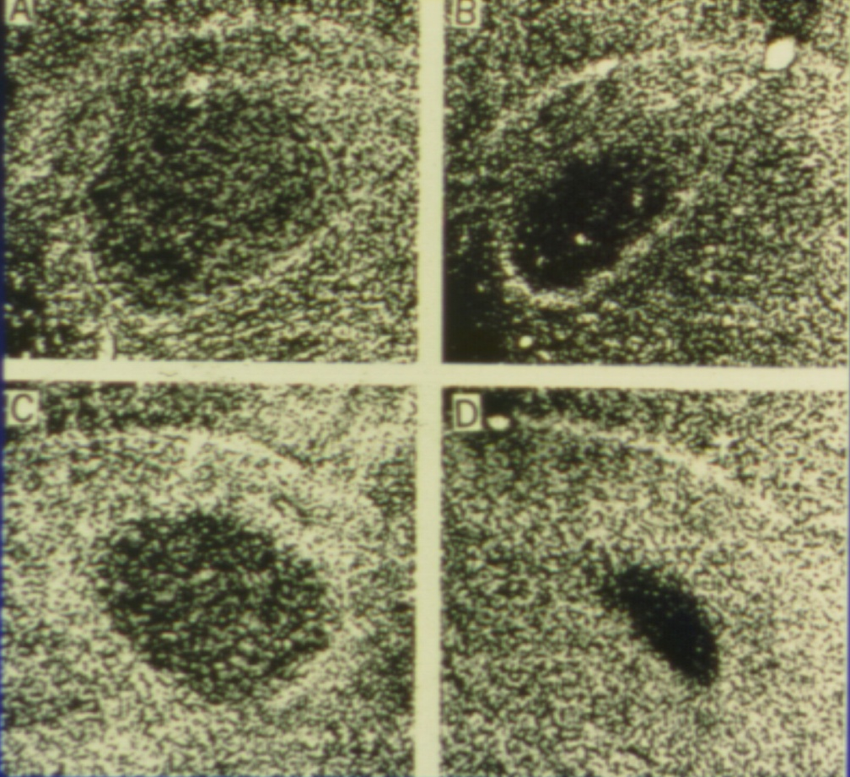
Sexual Dimorphism in a Vocal Control Area (Robust Nuc. of the Archistriatum) of the Songbird
Male
Female
Canary
Zebra-finch
F. Nottebohm & A. Arnold (1976) Science, 194, 211

Slide 8
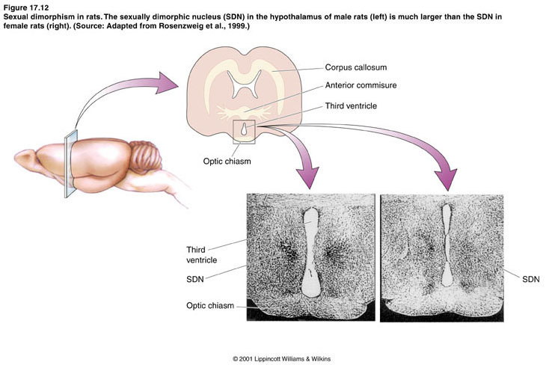
Structural Differences in Male & Female Rodent Brains

Slide 9
What Do Imaging Studies Reveal About Sex Differences In The Brain?

Slide 10
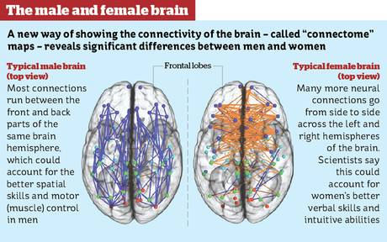
Are Male and Female Brains ‘Wired’ Differently?

Slide 11
Sex Differences In The Structure Of The Human Brain?
Ingalhalikar, M, et al, PNAS, 2014, v111
Males have better motor and spatial abilities, but females have superior memory and social cognition skills.
There are more connections between the 2 hemispheres of the brain in females.
Overall, results suggest that male brains are structured to facilitate connectivity between perception and coordinated action.
Female brains are designed to facilitate communication between analytical and intuitive processing modes.

Slide 12
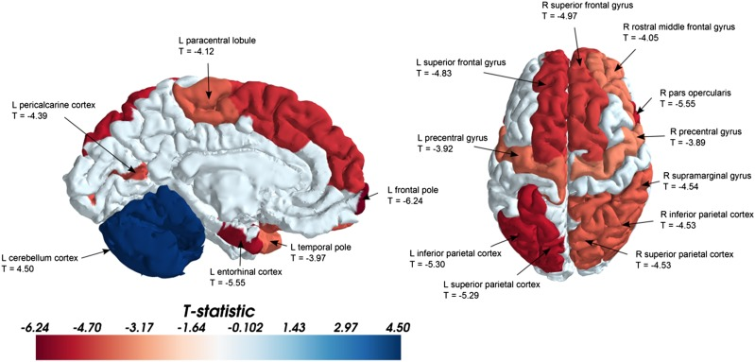
Sex differences in the structural ‘connectome’ of the human brain
Ingalhalikar, M, et al, PNAS, 2014, v111
Representative regions of the brain that have a higher PC at a significance level of P < 0.001. Red indicates a higher PC in the females, and blue indicates a higher PC in males (mainly localized to the cerebellum). Representative regions and their corresponding T values are shown in the figures. These tests revealed that although multiple regions have higher PCs in females, the cerebellum has a higher PC in males. L, left; R, right.

Slide 13
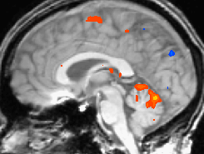
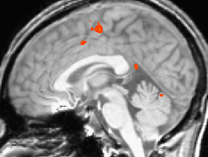
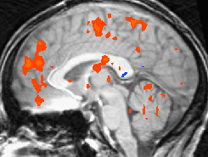
Uh Oh! Individual Differences In Brain Mapping. Any Implications??
Three Individuals performing the same finger-tapping task—note variability in activation.
Where is it localized? What are the implications?

Slide 14
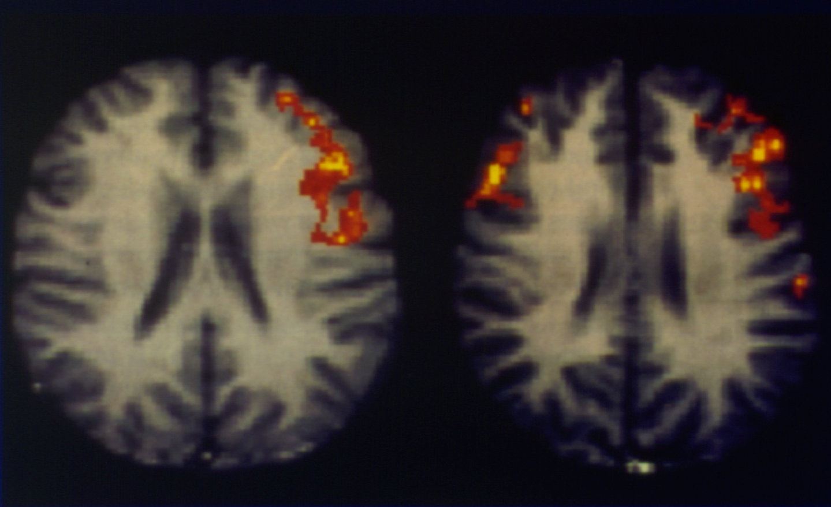
Activation of brain regions during a rhyming task
Males
Females
B.A. Shaywitz et al. (1995) Nature, 373, 608.

Slide 15
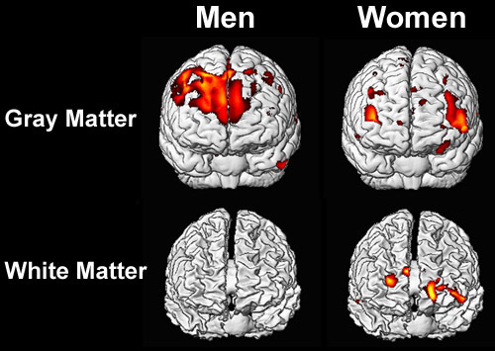
Sex Differences In Thinking About SEX

Slide 16
Nature Versus Nurture?

Slide 17
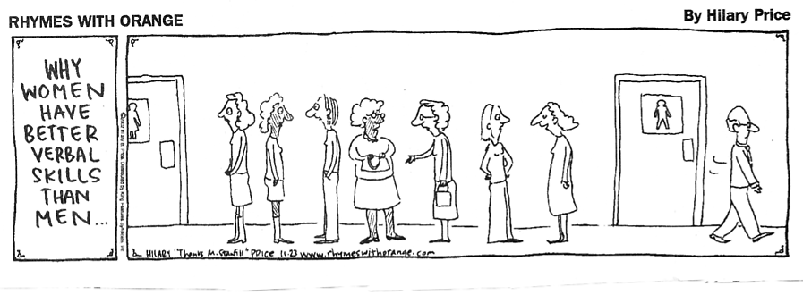
On The Other Hand, What About Environmental Factors”?
A Current Theory On Why Women Have Better Language Skills Than Men

Slide 18
Misconceptions About Sex Differences And The Brain
Sex differences are small and unreliable therefore not worth considering.
Sex differences (in brain function) are rare and due to a few extreme cases….not at all typical.
Differences within sex are more important than between sex.
Differences are only due to estrogen during development.
Neural mechanisms underlying behavior are identical for males and females.

Slide 19
Some Environmental Factors Contributing To Male Female Differences
Diet and body fat.
Frequency and duration of Exercise.
Types of testing to measure deficits
ER responses to injury.
Sensitivity to drugs before, during and after an injury.
Hormonal status prior to, and at injury.
Women uniquely experience distinct life stages marked by levels of circulating sex hormones, as well as by physiological changes that are nonexistent in men.

Slide 20
Sex Differences In Brain Anatomy?
Nerve cells tend to be larger in women; especially in left hemisphere, but males tend to have more cells.
Women are more frequently right handed but have better language skills than males.
Women survive brain injuries better than males.

Slide 21
Sex Differences In Metabolic Dys)function: Implications For Treatments
Mitochondrial metabolic dysfunction is a common feature of CNS injury.
Mitochondrial metabolism and cell death signaling are different in males and females. That is, biomarkers used to assess damage may not be the same in males and females.
Evidence suggests males predominantly use proteins while females predominantly use lipids as a fuel source within mitochondria.
These differences may significantly affect how the brain recovers following injury. .

Slide 22
Its complicated, And Its Not Just About Neurons:
Sex Differences In Glia Reactivity After Cortical Brain Injury.
Males have a higher density of immune cells in the wound area than females.
Males also have a higher density of healthier neurons in the lesion edge than females.
These findings indicate that male and female mice have different inflammatory responses after a cortical injury, and suggest that sex differences in reactive gliosis can contribute to the differences seen in neuroinflammatory diseases and brain injury.

Slide 23
Sex Differences In The Outcome of Brain Injury May Can Be Mediated By Sex Hormones

Slide 24
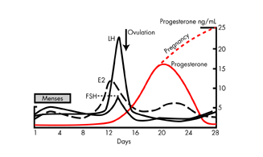
HORMONAL CYCLING

Slide 25
Sex differences In Patients With Moderate to Severe Head Injuries
Berry, C et al J. Trauma, 67, 2009
A total of 72,294 patients with moderate to severe TBI were studied.
Women compared to males:
  Had significantly less complications.
  Shorter hospital length of stay.
  Shorter ICU stay.
  Substantially reduced mortality in women
  Similar results reported in two other studies involving about 250K patients.

Slide 26
What About Stroke
And Stroke Incidence?

Slide 27
STROKE IMPACT
1.8 million new strokes per year in industrialized countries
Third leading cause of death
  (1st: heart disease, 2nd: all cancers)
  Death rate 54.3 for 2003
  Every 45 seconds someone has a stroke.
Over 2.4 million stroke survivors
Leading cause of adult disability
Less than 5% of patients receive any treatment other than rehab

Slide 28
MALES AND FEMALES DIFFER IN STROKE INCIDENCE AND SURVIVAL
Hurn, Vanucci, Hagburg, Stroke, 2005 v36
Overall incidence of stroke is lower in women across cultural and ethnic backgrounds.
This effect extends beyond menopause.
At cellular level female cells live longer than male cells and are less subject to cytotoxicity.
Male mice more subject to ischemia and concussive injuries than females.

Slide 29
SOME SEX DIFFERENCES IN STROKE OUTCOMES
Ischemic events are more frequent in men.
Women are less likely to have a stroke in early and mid-adulthood than men.
Stroke rates do not equalize until women are over 75.
Women respond better to tPA treatment.
Incidence of speech disorders after stroke is higher in women if injury is to the left frontal cortex, while the opposite is true for males.
After arriving in ER women experience greater time delay in stroke treatment than men & are more likely to receive anti-anxiety meds than blood pressure meds or aspirin.

Slide 30
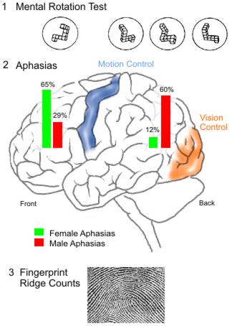
Are There Functional Sex Differences
In Response To Stroke?

Slide 31
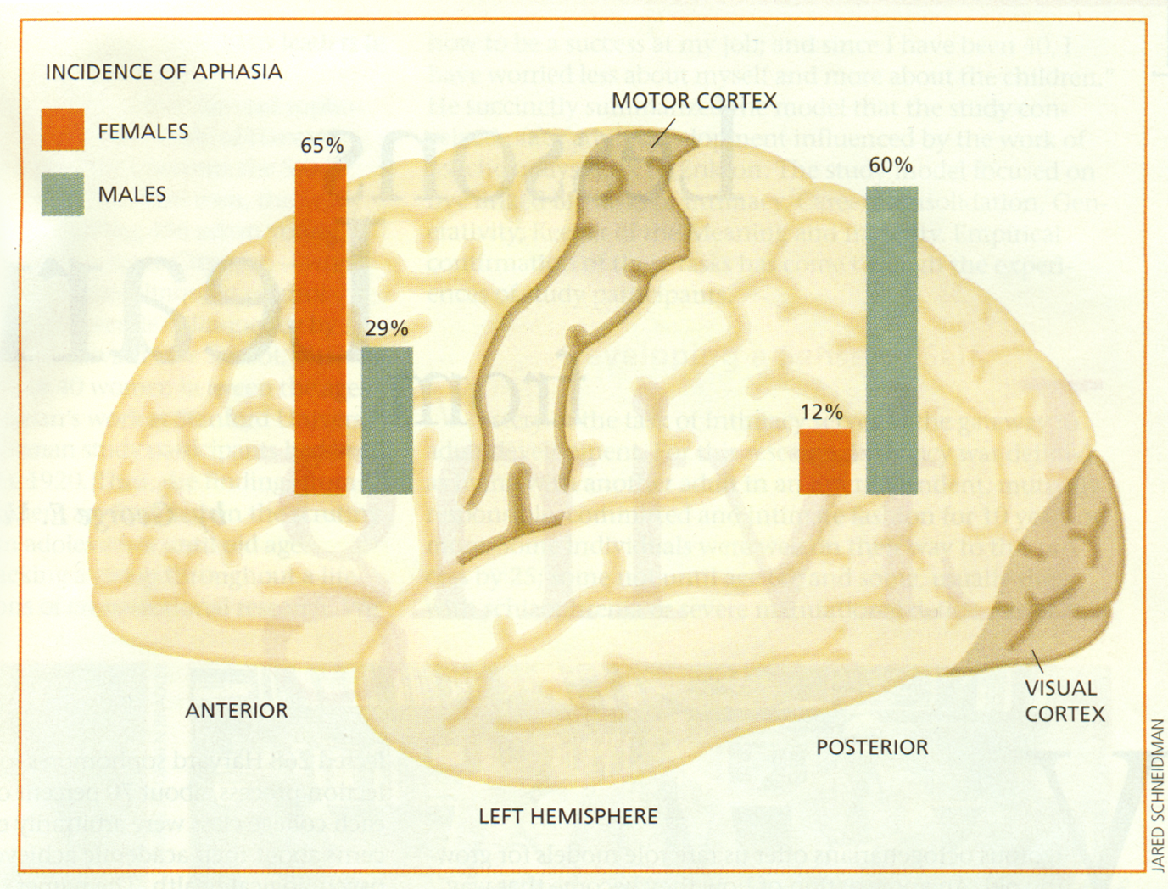
Potential Sex Differences In Aphasia Outcome

Slide 32
Sex Differences In Brain Injury
Males and females do not differ in spatial learning tasks but following entorhinal cortex injury, females do much better than males on retention of spatial learning tasks (Roof et al 1993).
In low birth weight children @ 2 years of age, females do much better than males “in all areas of social and developmental testing (Hindmarsh, et al 2000)
In children with intracranial hemorrhage, girls significantly outperform boys on all tests (Raz, et al 1995).
Girls with blunt TBI do significantly better on all verbal testing compared to boys (Donders and Hoffman 2002).

Slide 33
Sex Differences in Recovery 1 Year After Traumatic Brain Injury
Women’s language skills are better than males one year after traumatic brain injury.
Women have) greater attentionskills and working memory than males one year after traumatic brain injury.

Slide 34
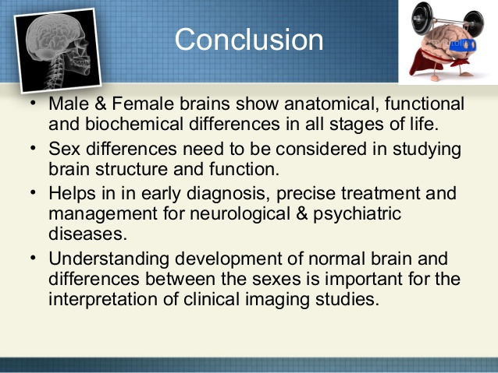

Slide 35
Suggested Readings
Lost in translational biology: Understanding sex differences to inform studies of diseases of the nervous system. Pearse,RV and Young-Pearse TL, Brain Res. 2019,v.1722
Sex differences in the brain: implications for behavioral and biomedical research. Choleris E, et al 2018, Neuroscie Biobehavioral Rev, v85,126-145
Sex differences in traumatic brain injury: what we know and what we should know. Gupte, R et al, 2019, J. Neurotrauma, v36, 3063-3091
Traumatic brain injury in women across lifespan. Neurobiol Dis
2022. M Blaya , A Raval , HM Bramlett

Slide 36
END

Slide 37
Sex Differences In Brain Inflammatory Responses To Ischemic Injury
Clinically, male infants are more vulnerable to ischemic insults and suffer more long-term deficits than females.
Male and female mice were given 60-min of hypoxia at post-natal day 10 (P10). Stroke outcomes were measured 1, 3, 7, and 30 days after stroke. Inflammatory responses were measured.
RESULTS: On day 1 of HIE, no difference in infarct volumes or seizure scores was seen between male and female neonates.
However, female neonates showed smaller infarct size and fewer seizures compared to males 3 days after HIE. Females also had less brain tissue loss and behavioral deficits compared to males in the later stage of injury.
Male mice had higher levels immune cell activation and the inflammatory response was higher compared to females at day 3.
                J Neuroinflammation. 2015

