Slide 1
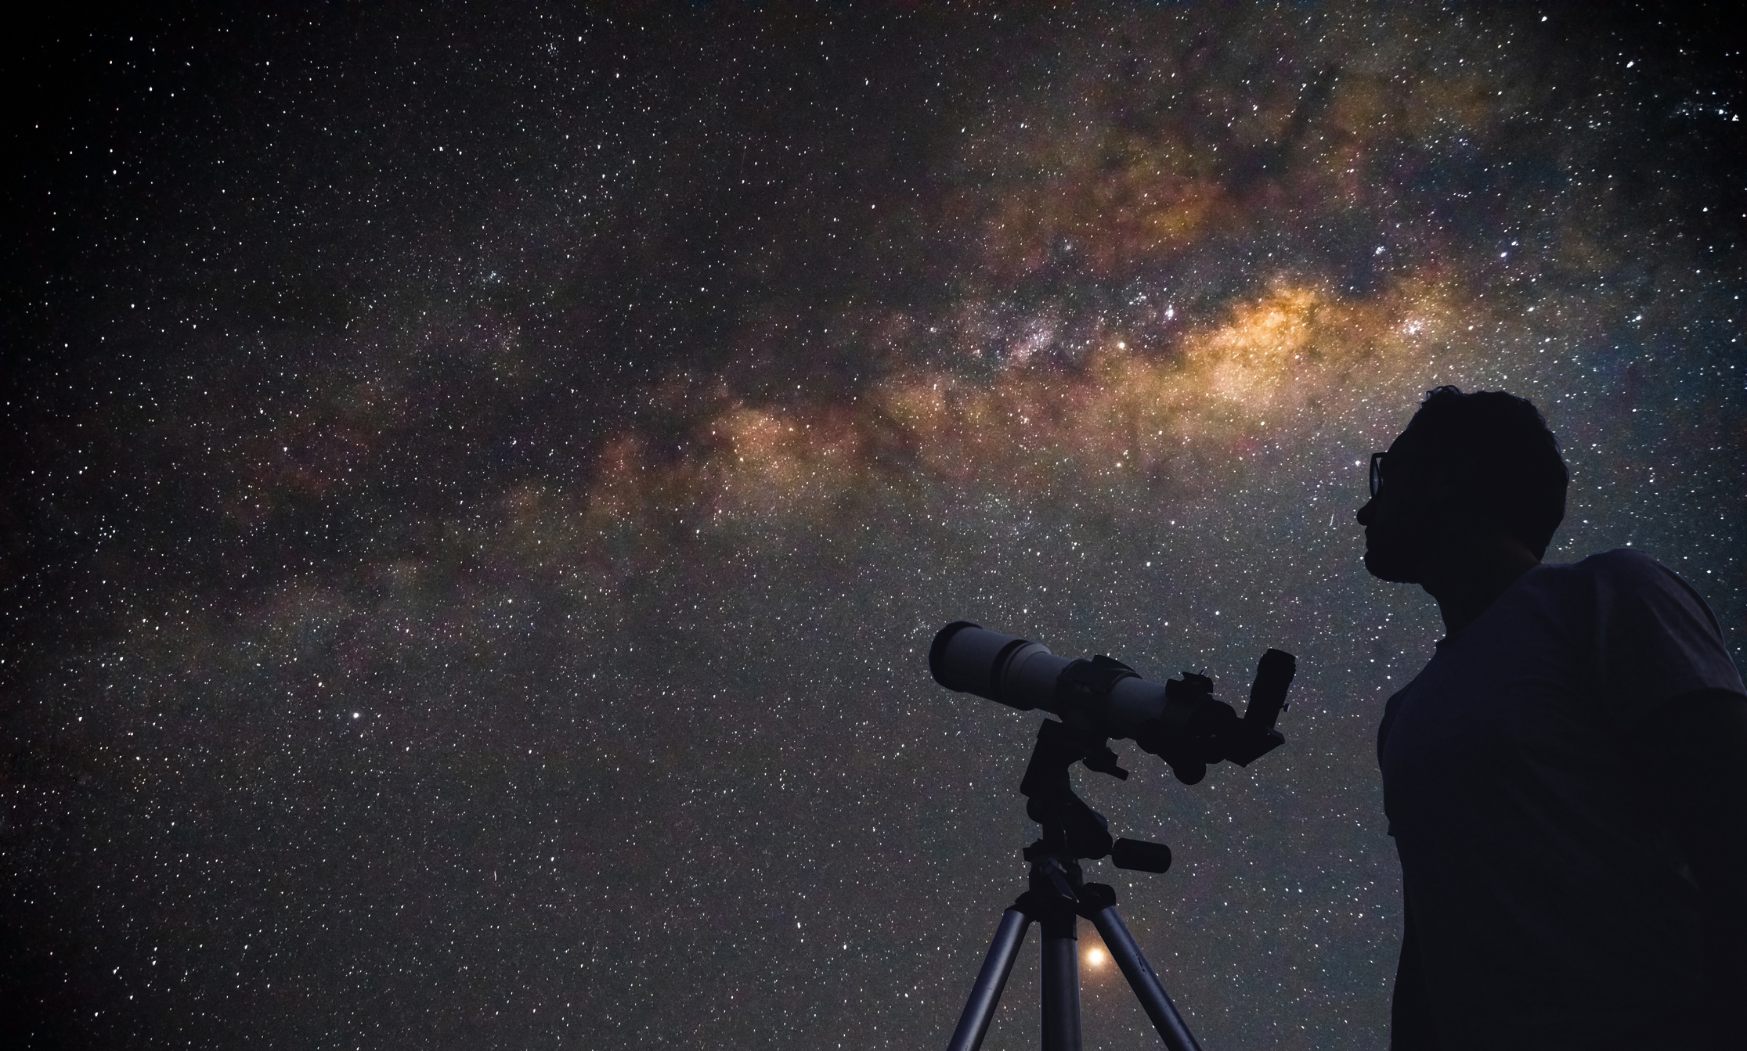
Cosmic Connections:
An Introduction to Astronomy
And
Maine’s Magnificent Night Skies
Midcoast Senior College
Russell F. Pinizzotto, Ph.D. (Russ)
Unit 01
Orientation to Maine’s Magnificent Night Skies

Slide 2
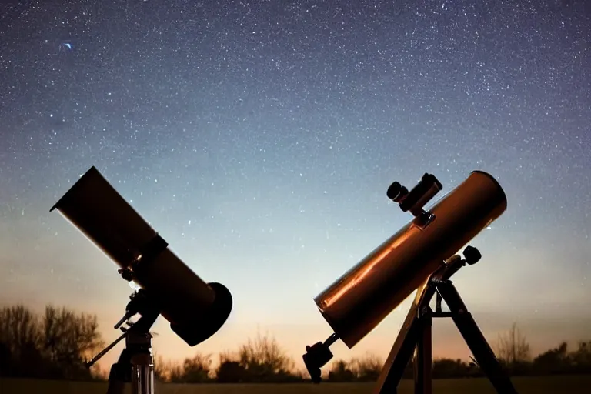
Russell F. Pinizzotto, Ph.D. (Russ)
B.S. Chemistry, Caltech
Engr. Degree, UCLA
Ph.D., UCLA
M.S. Astronomy, Swinburne University of Technology
President, Southern Maine Astronomers
AstroLeague Master Observer
AstroLeague Binocular Master Observer
AstroLeague Galaxy Groups and Clusters Observing Program Coordinator
AstroLeague Herschel II Observing Program Coordinator
Midcoast Senior College
Exploring the Universe Using Binoculars
Merrimack College, Wentworth Institute of Technology
Introduction to Astronomy

Slide 3
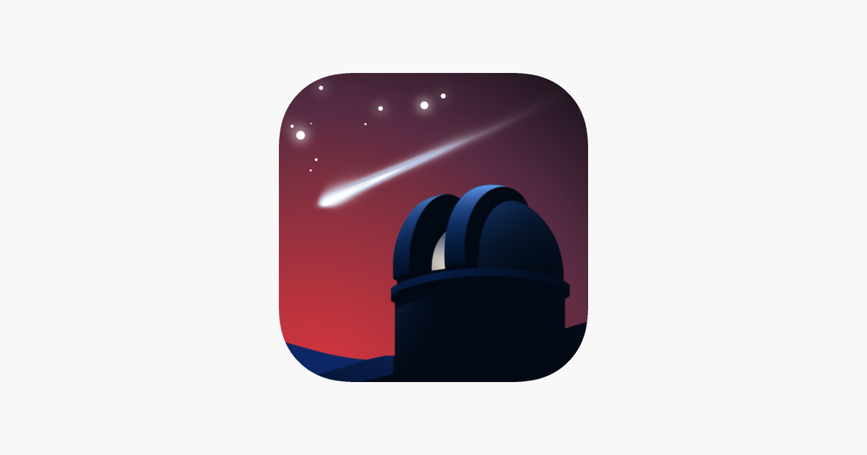
SkySafari

Slide 4


Slide 5
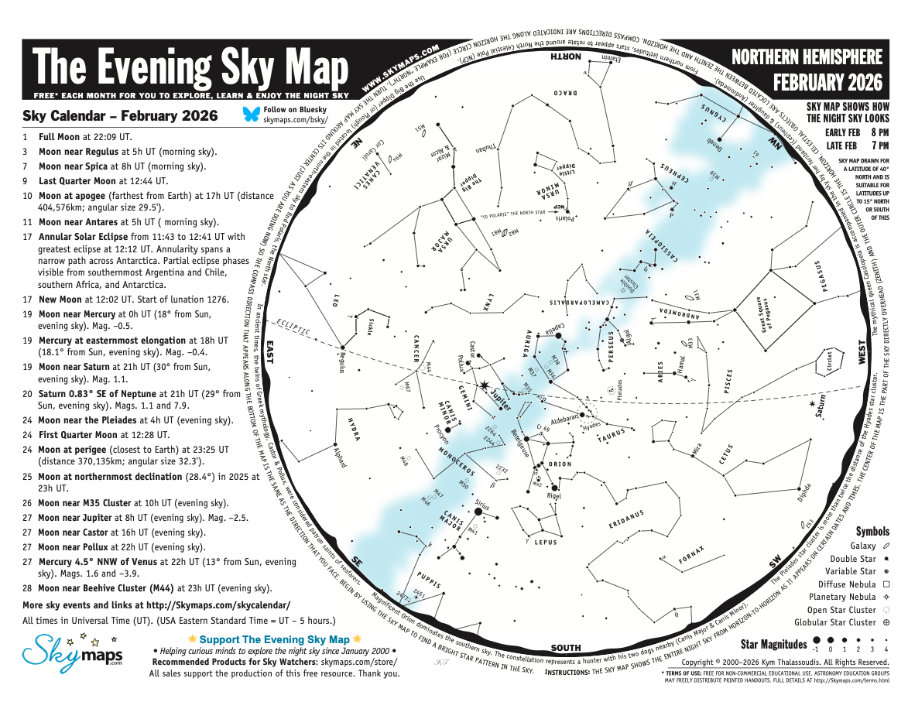

Slide 6
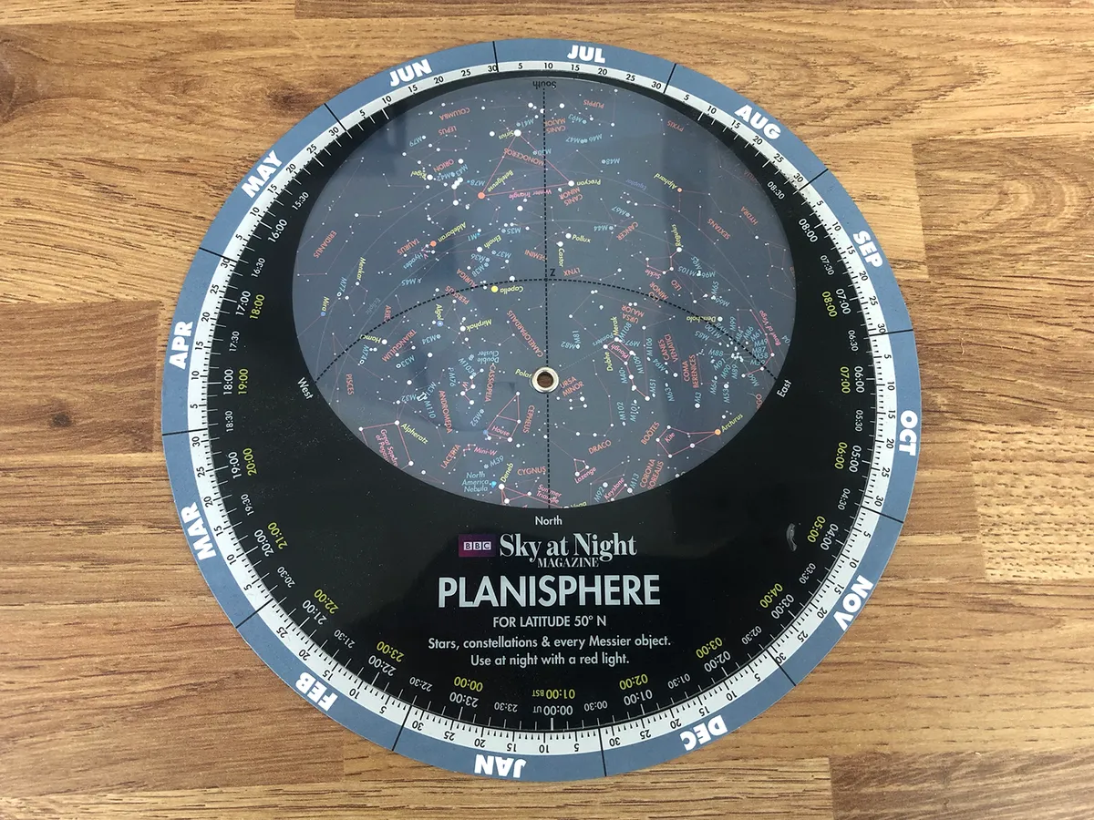

Slide 7
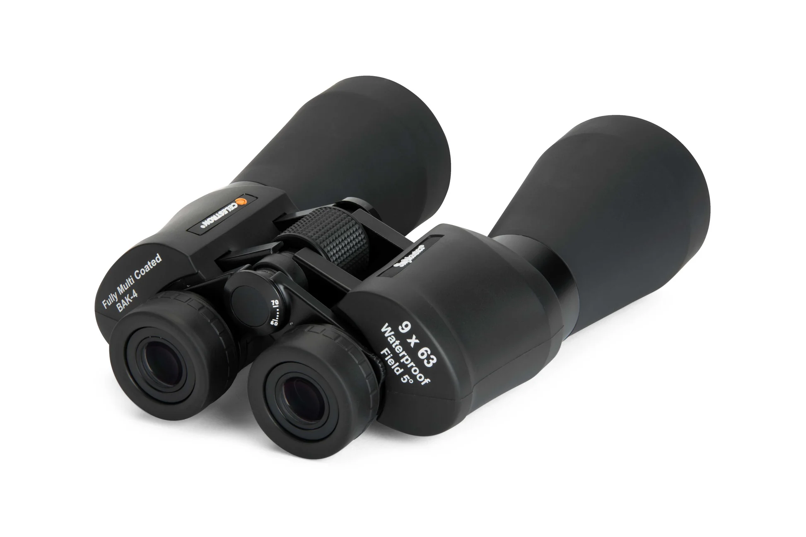

Slide 8
Constellations Throughout the Year by Month – 260130
Month Circumpolar Setting (West) South Rising (East)
January Ursa Major, Cassiopeia Pegasus Orion Leo
February Ursa Major, Cassiopeia Orion, Leo Bootes
March Ursa Major, Cassiopeia Orion, Leo Bootes
April Ursa Major, Cassiopeia Orion Leo Bootes
May Ursa Major, Cassiopeia Leo, Bootes Cygnus
June Ursa Major, Cassiopeia Leo Bootes, Sagittarius Cygnus
July Ursa Major, Cassiopeia Leo Bootes, Sagittarius Cygnus, Pegasus
August Ursa Major, Cassiopeia Bootes Sagittarius Cygnus, Pegasus
September Ursa Major, Cassiopeia Bootes, Sagittarius Cygnus (Zenith) Pegasus
October Ursa Major, Cassiopeia Sagittarius Cygnus, Pegasus
November Ursa Major, Cassiopeia Cygnus, Pegasus Orion
December Ursa Major, Cassiopeia Cygnus, Pegasus Orion Leo
Constellations you should know:
Ursa Major (Big Dipper) Circumpolar
Cassiopeia Circumpolar
Orion
Pegasus
Leo
Bootes
Cygnus
Sagittarius

Slide 9
Constellations and Stars Throughout the Year by Season – 260130
15 January 2026, 9 pm
Big Dipper at 4 o’clock Pointers ; Dubhe and Merak - Polaris
Leo rising Regulus
Orion in south Betelgeuse and Rigel
Pegasus setting Alpheratz
Milky Way from NW to SE
15 April 2026, 9 pm
Big Dipper at 1 o’clock Pointers ; Dubhe and Merak - Polaris
Bootes in east Arcturus
Leo in South Regulus
Orion setting Betelgeuse and Rigel
Milky Way from N to S to the W
15 July 2026, 9 pm
Big Dipper at 10 o’clock Pointers ; Dubhe and Merak - Polaris
Lyra high in east Vega
Bootes in south Arcturus
Leo setting Regulus
Milky Way from N to S to the E
15 October 2026, 9 pm
Big Dipper at 7 o’clock Pointers ; Dubhe and Merak - Polaris
Pleiades rising in northeast
Pegasus high in southeast Alpheratz
Lyra high in west Vega
Bootes setting in northwest Arcturus
Milky Way from NE to SW

