Slide 1
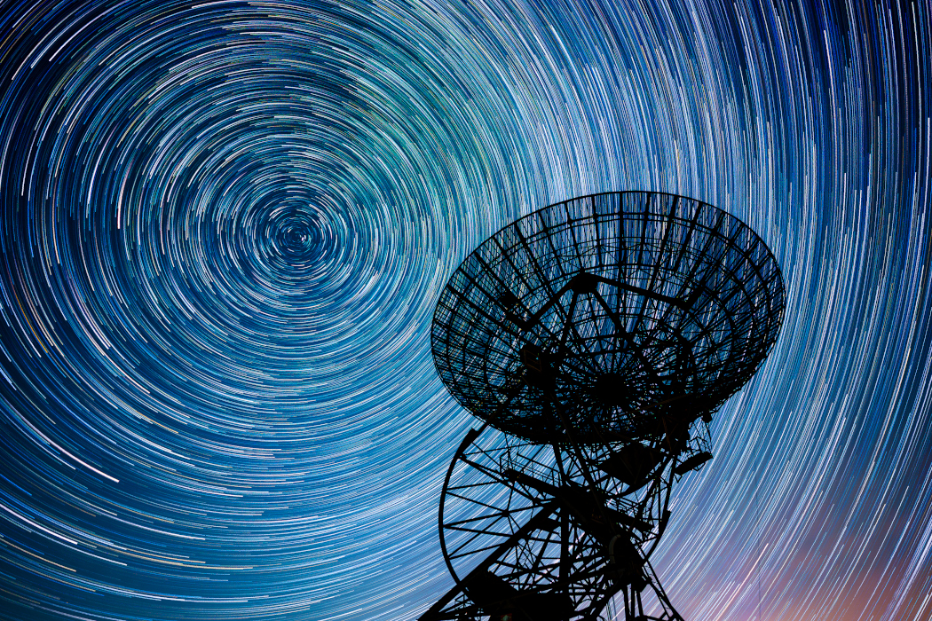
Cosmic Connections:
An Introduction to Astronomy
And
Maine’s Magnificent Night Skies
Midcoast Senior College
Russell F. Pinizzotto, Ph.D. (Russ)
Unit 02
Understanding Motion and the Celestial Sphere

Slide 2
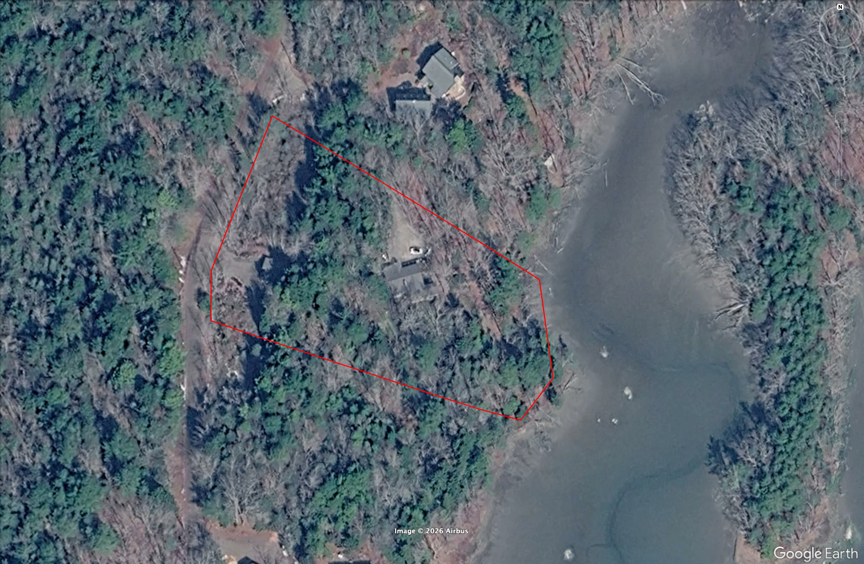
N

Slide 3
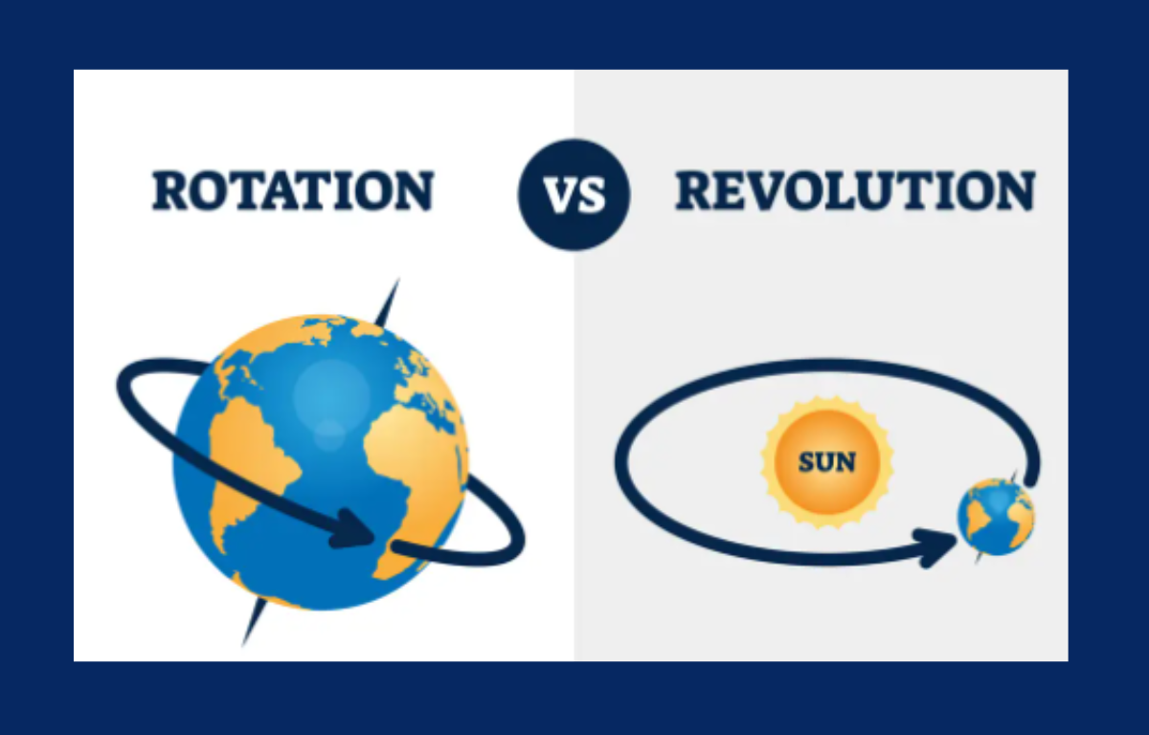

Slide 4
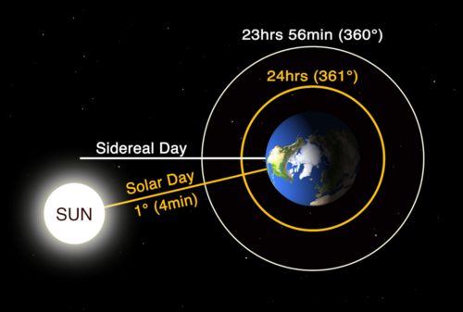

Slide 5
Let’s use SkySafari to do a few experiments!

Slide 6
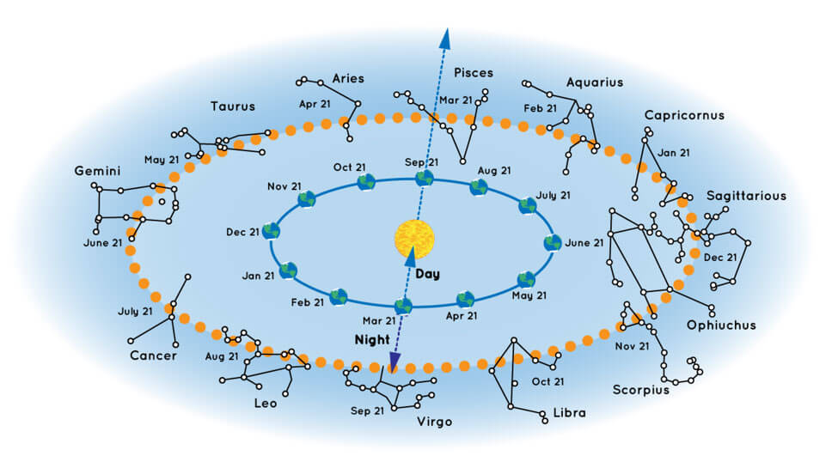

Slide 7
Let’s use SkySafari to do a few experiments!

