Slide 1
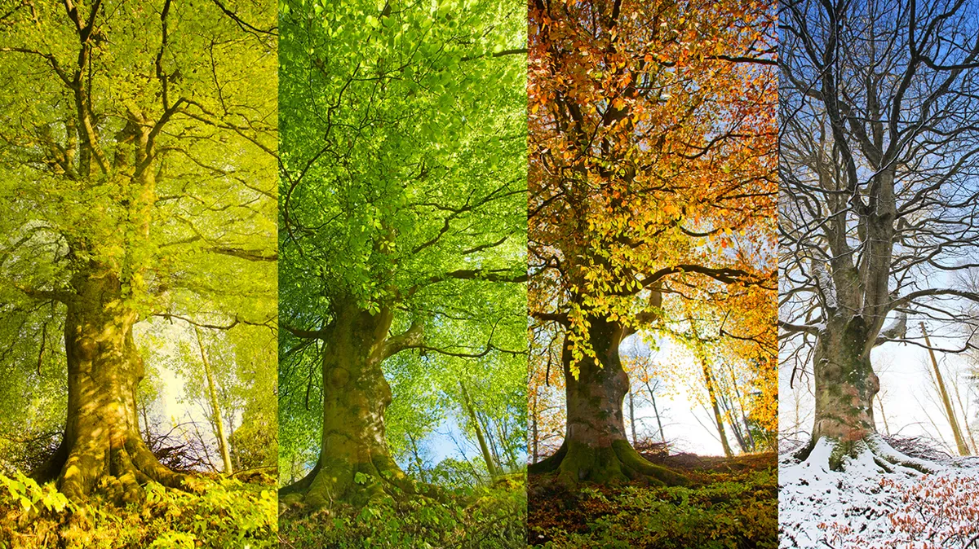
Cosmic Connections:
An Introduction to Astronomy
And
Maine’s Magnificent Night Skies
Midcoast Senior College
Russell F. Pinizzotto, Ph.D. (Russ)
Unit 03
Seasons and the Tilted Earth

Slide 2
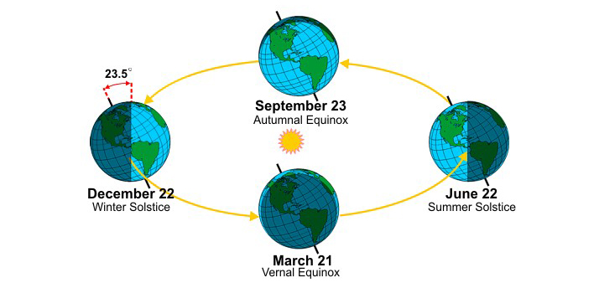

Slide 3
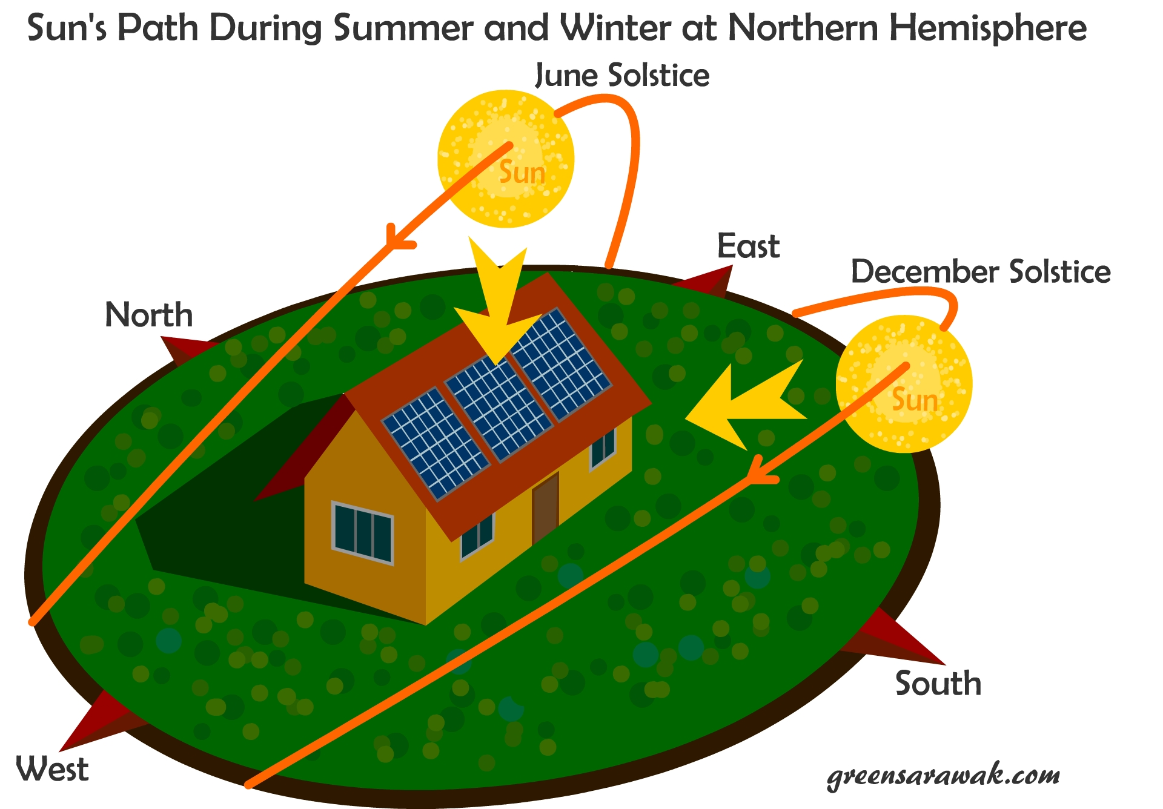

Slide 4
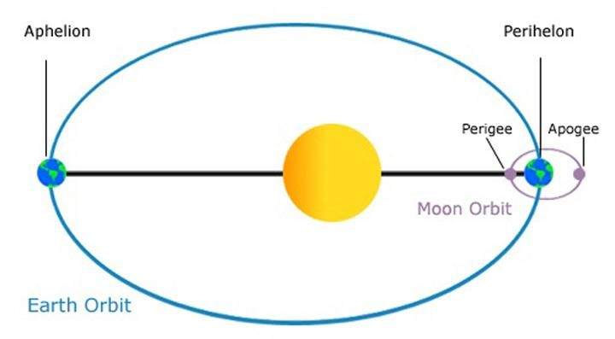

Slide 5
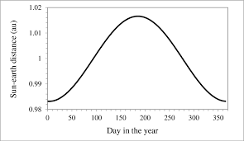

Slide 6
Let’s use SkySafari to do a few experiments!

