Slide 1
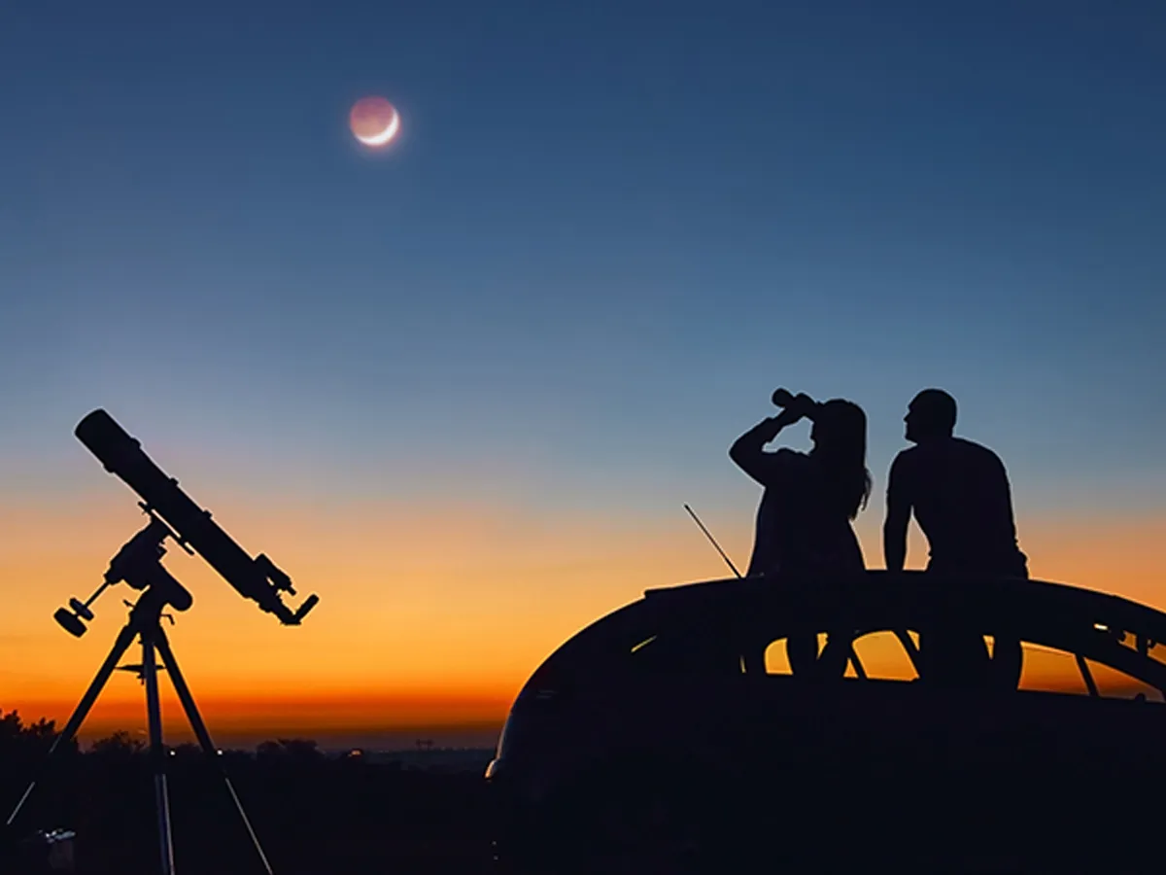
Cosmic Connections:
An Introduction to Astronomy
And
Maine’s Magnificent Night Skies
Midcoast Senior College
Russell F. Pinizzotto, Ph.D. (Russ)
Unit 04
The Moon: Phases and Patterns

Slide 2
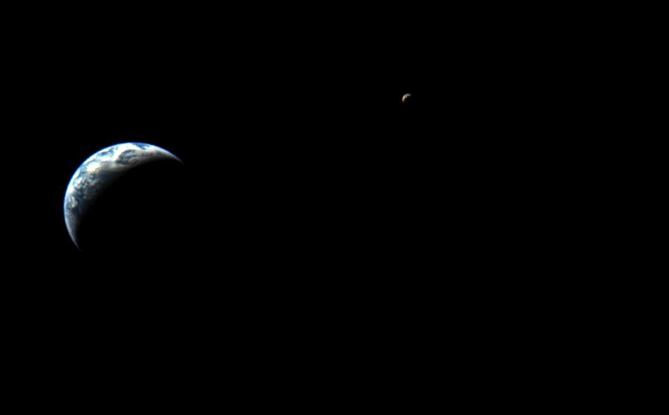

Slide 3
Earth and Moon to scale:
http://en.wikipedia.org/wiki/Image:Earth-Moon2.jpg

Slide 4
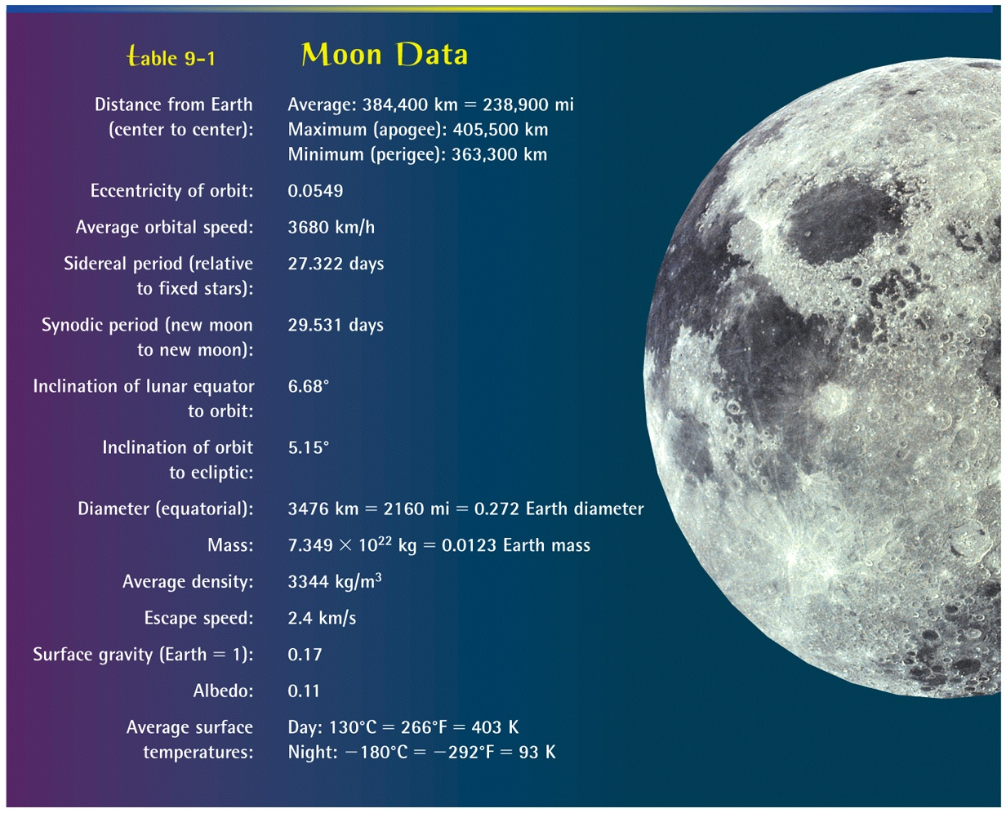

Slide 5
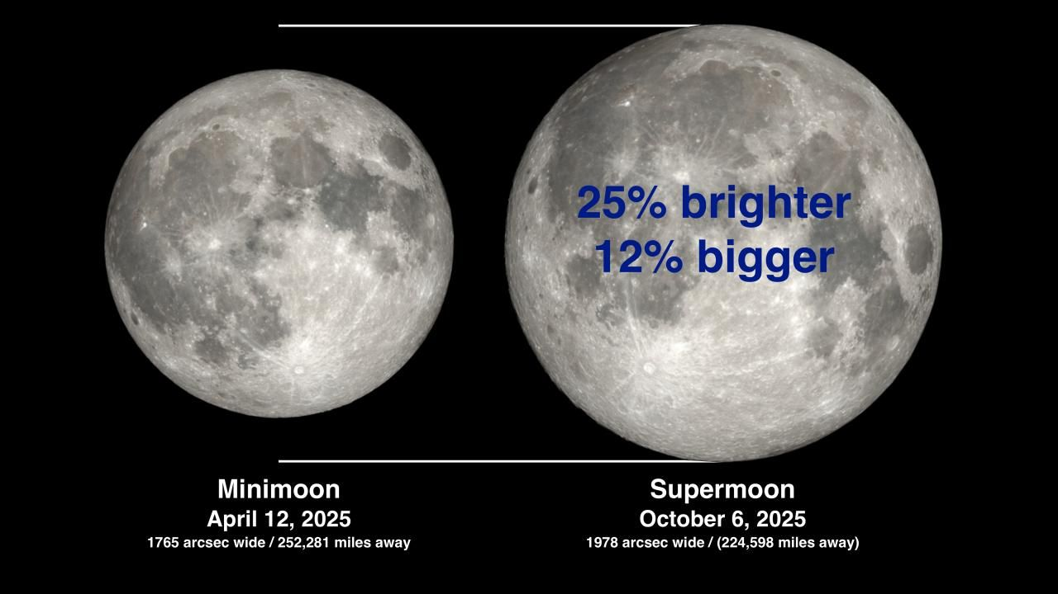

Slide 6
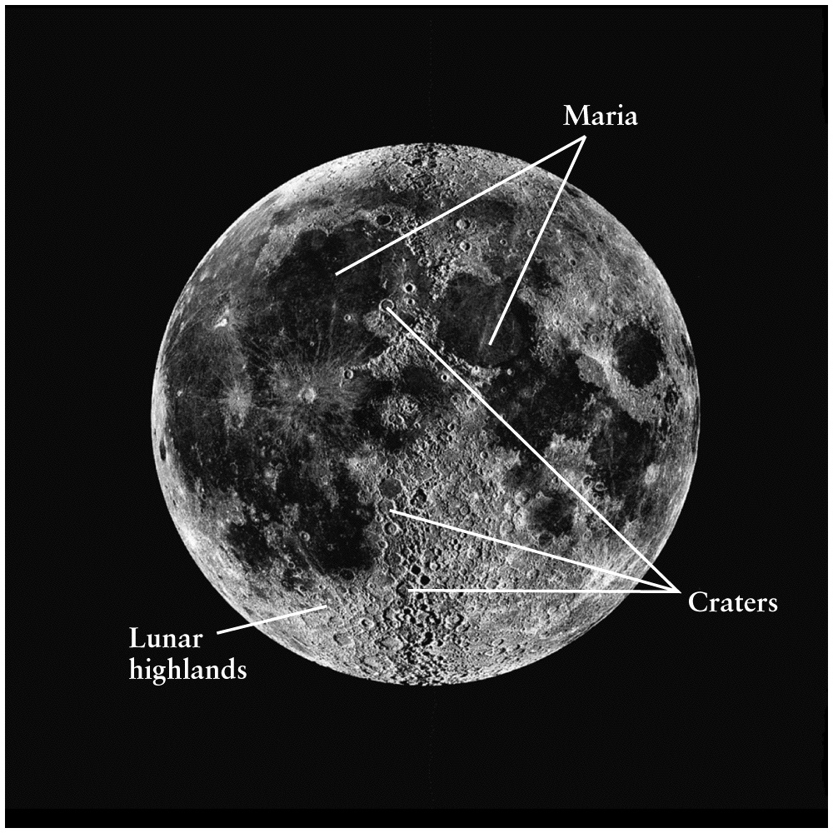

Slide 7
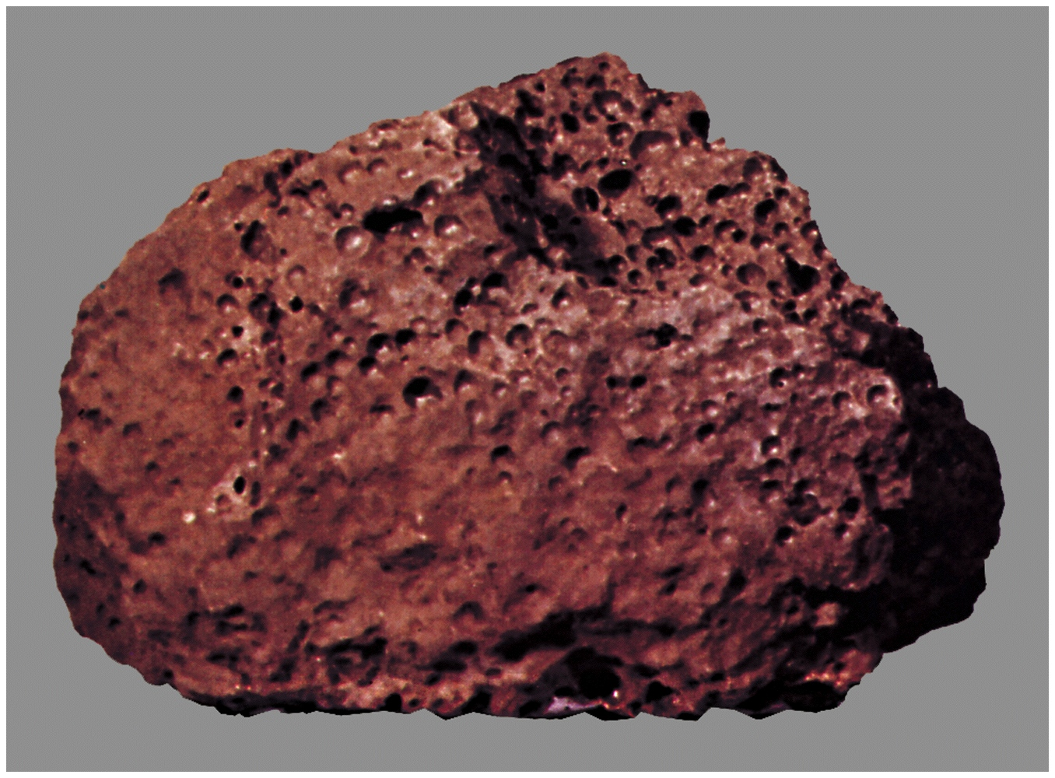

Slide 8
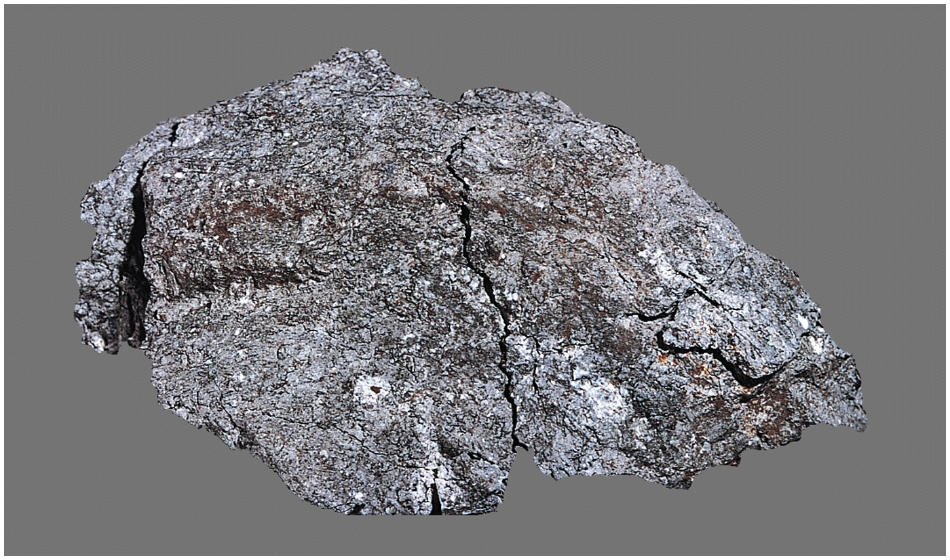

Slide 9
Moon – a few things to know
New Moon to New Moon
17 February 2026, 07:01 am to 18 March 2026, 9:23 pm
Full Moon to Full Moon
01 February, 5:09 pm to 03 March 2026, 06:38 am
Snow Moon Worm Moon
One lunation or synodic period – 29.5 days
One Earth orbit or sidereal period – 27.3 days
Phases
New Moon, Waxing Cresent, First Quarter, Waxing Gibbous, Full Moon
Waning Gibbous, Third Quarter, Waning Crescent, New Moon
08:00 pm

Slide 10
Lunar Libration
Lunar libration is the apparent wobbling motion of the Moon that allows us to see slightly more than 50% of its surface from Earth over time.
Libration allows astronomers to see up to 59% of the Moon's surface from Earth, even though it nearly always shows us the same face due to tidal locking.

Slide 11
Websites
Phases of the Moon
https://lsintspl3.wgbh.org/en-us/lesson/buac19-il-phasesmoon1/?as_guest=True&next=https://mainepublic.pbslearningmedia.org/resource/buac19-68-sci-ess-phasesmoon1/phases-of-the-moon/
Dial-A-Moon
https://svs.gsfc.nasa.gov/gallery/moonphase/
Space Out – 30 minute video
https://plus.nasa.gov/video/space-out-moon-phases/

Slide 12
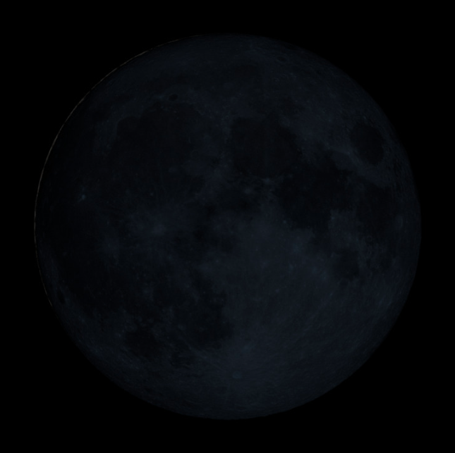
Day Zero, 19 November 2025
Nothing to see here!

Slide 13
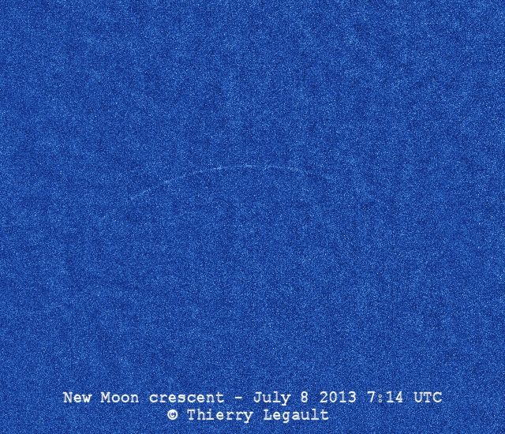

Slide 14
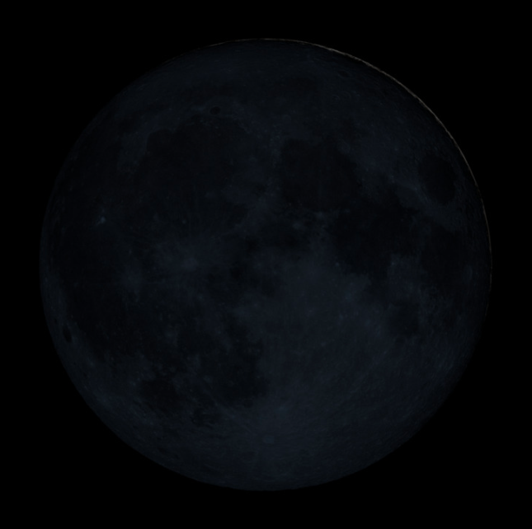
Day One, 20 November 2025
The start of an Islamic month is determined by the sighting of the new crescent moon after sunset. Muslims look for the hilal (crescent moon) on the 29th day of the current month; if it is sighted, the new month begins the next day. If it is not visible, the current month continues for another day, making it a 30-day month, and the new month begins after that.

Slide 15
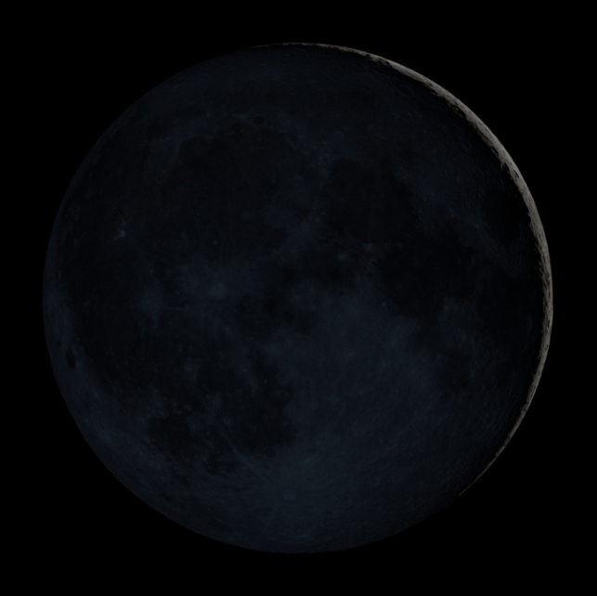
Day Two, 21 November 2025

Slide 16
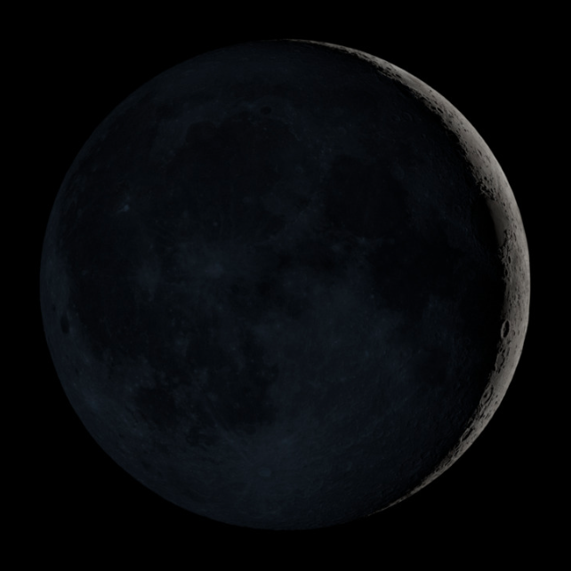
Day Three, 22 November 2025
Langrenus
Petavius

Slide 17
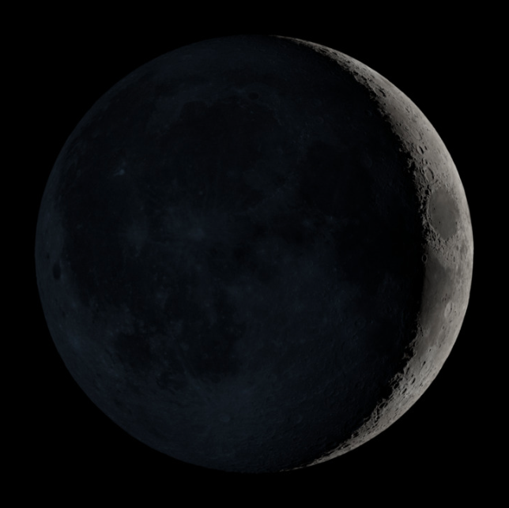
Day F0ur, 23 November 2025
Cleomedes
Mare Crisium

Slide 18
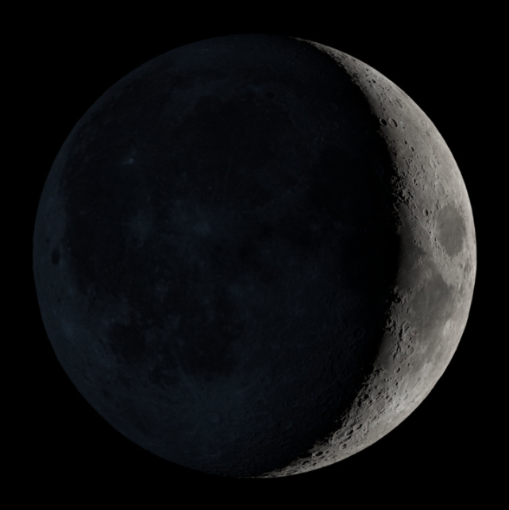
Day Five, 24 November 2025
Hercules and Atlas
Mare Fecunditatis

Slide 19
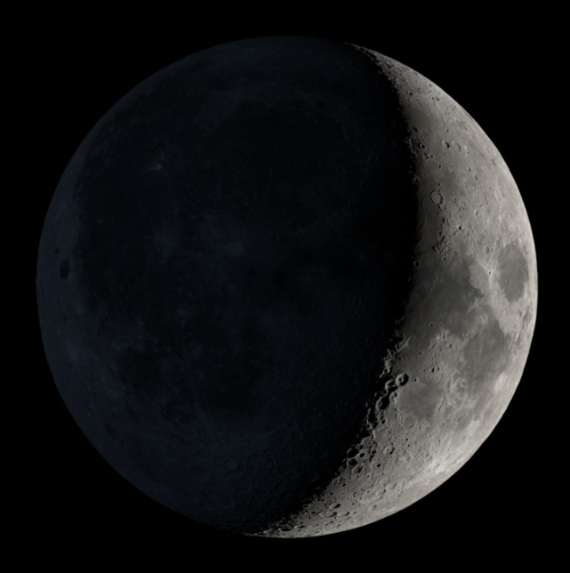
Day Six, 25 November 2025
Posidonius
Mare Tranquilitatis
Theophilus and Cyrillus
Mare Nectaris

Slide 20
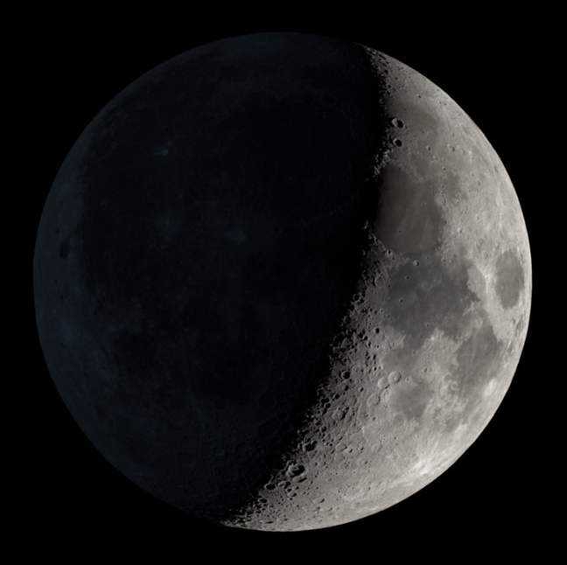
Day Seven, 26 November 2025
Aristoteles and Eudoxus
Mare Serenitatis
Apollo 17
Apollo 11

Slide 21
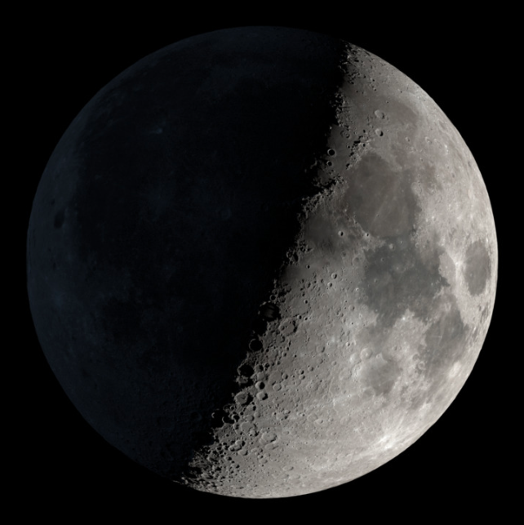
Day Eight, 27 November 2025
Mare Vaporum and Manilius
Albategnius
Walter

Slide 22
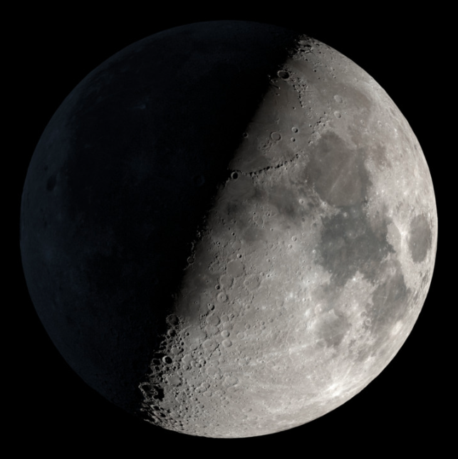
Day Nine, 28 November 2025
Plato
Mare Ibrium
Apennine Mountains

Slide 23
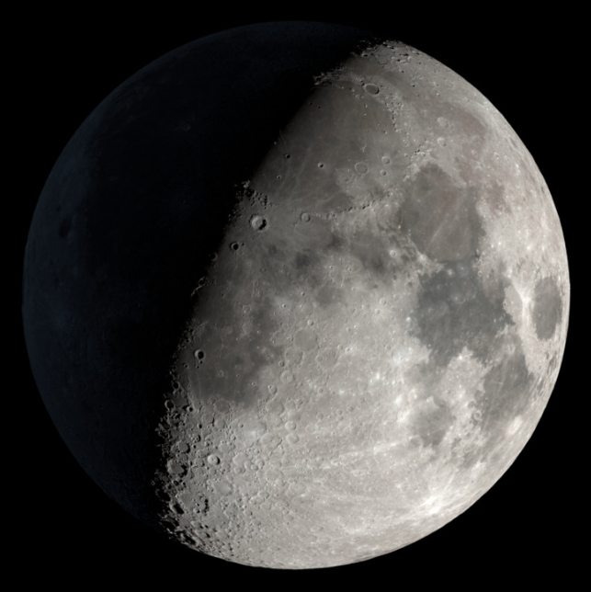
Day Ten, 29 November 2025
Copernicus
Mare Nubium
Tycho

Slide 24
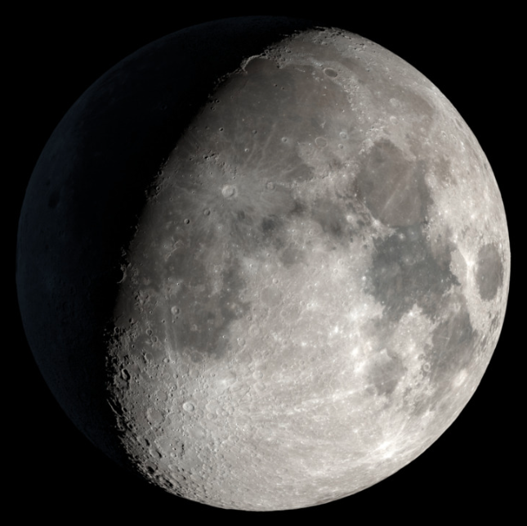
Day Eleven, 30 November 2025
Sinus Iridum
Mare Cognitum
Bullialdus

Slide 25
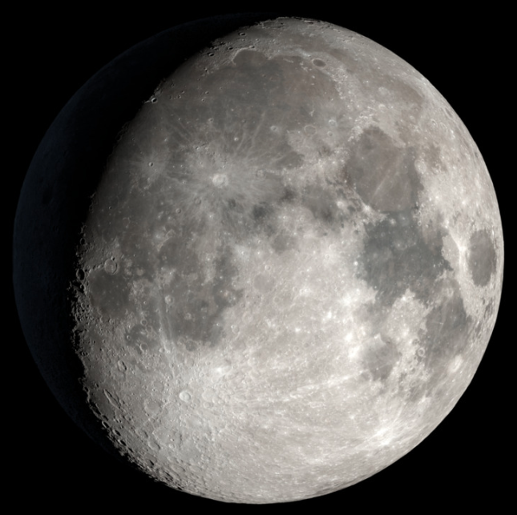
Day Twelve, 01 December 2025
Kepler
Gassendi
Mare Humorum

Slide 26
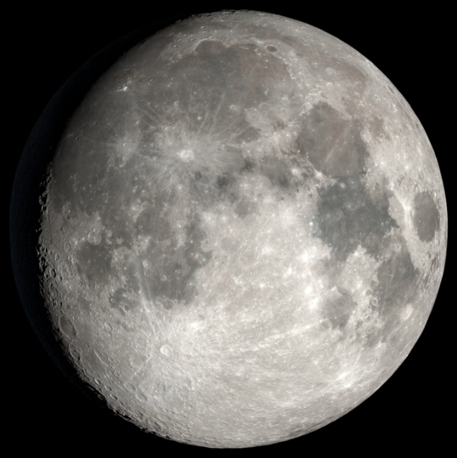
Day Thirteen, 02 December 2025
Aristarchus
Oceanus Procellarum
Schickard

Slide 27
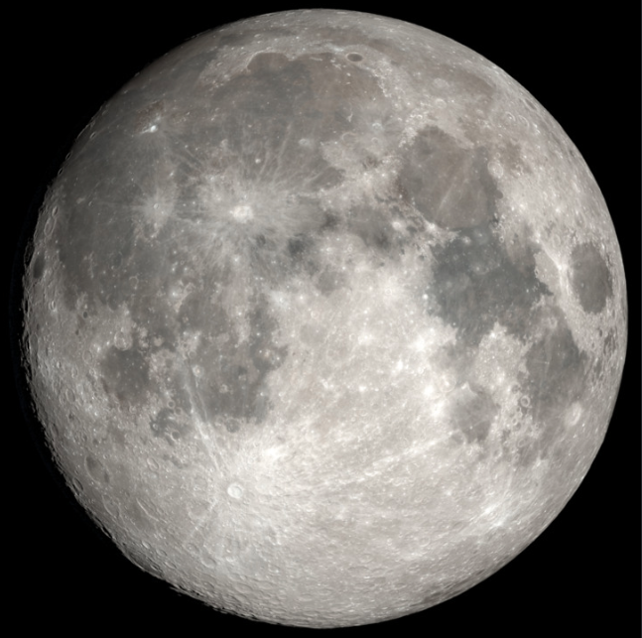
Day Fourteen, 03 December 2025
Mare Frigoris
Mt. Pico and Mt. Piton
Grimaldi

Slide 28
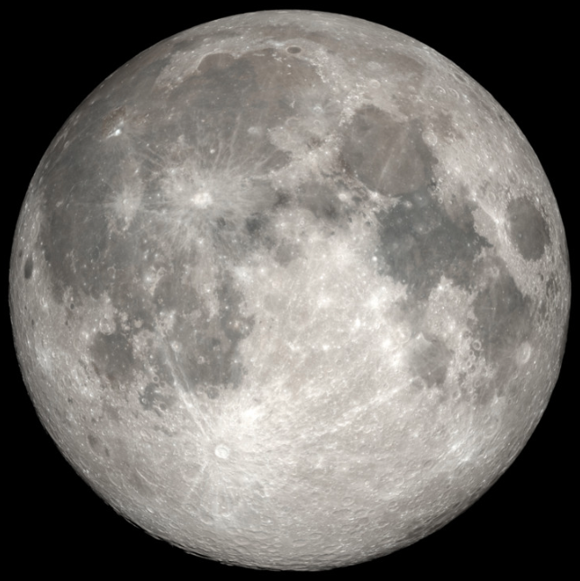
Day Fifteen, 04 December 2025
Rays from
Tycho
Copernicus
Kepler

Slide 29
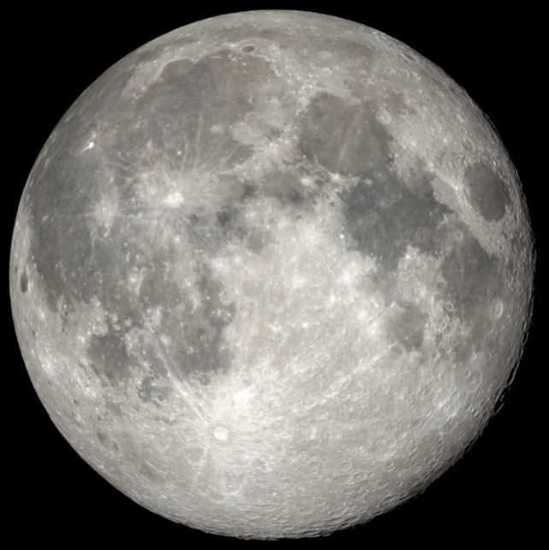
Day Sixteen, 05 December 2025
Apollo 12 •
Apollo 14

Slide 30
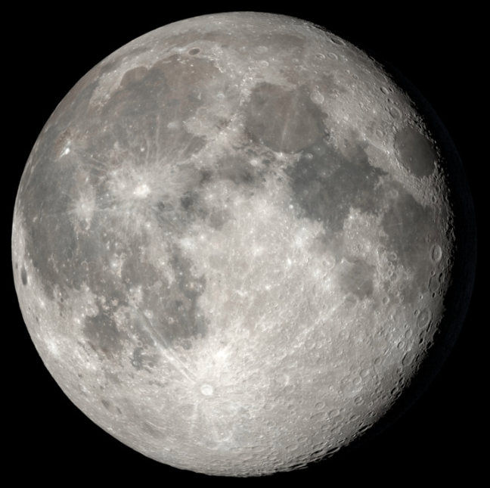
Day Seventeen, 06 December 2025
Cleomedes, Burckhardt, and Geminus
Apollo 15 •
Furnerius

Slide 31
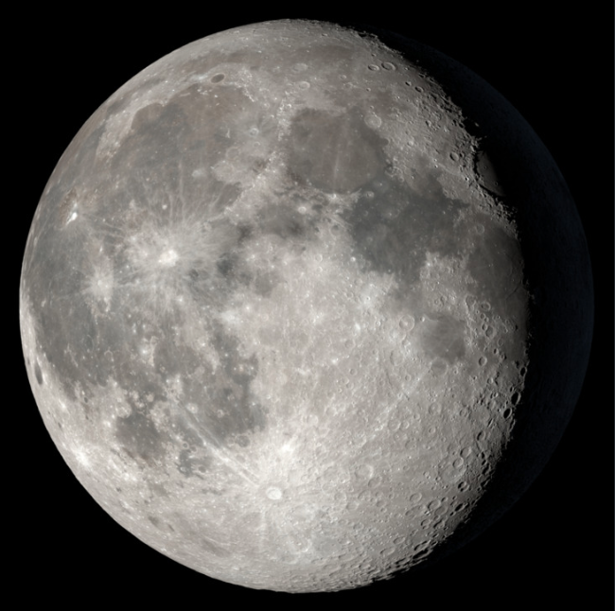
Day Eighteen, 07 December 2025
Boundary of Mare Crisium
Jansen and Fabricius

Slide 32
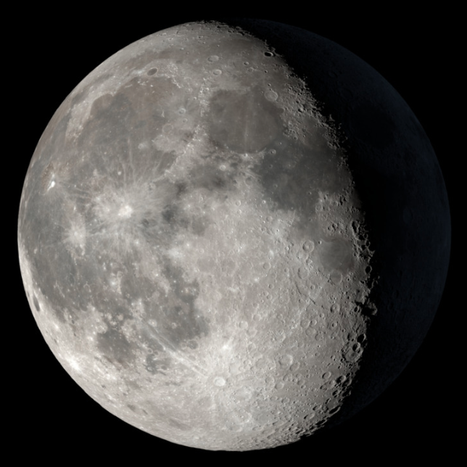
Day Nineteen, 08 December 2025
Apollo 16 •
Gutenberg
Maurolycus

Slide 33
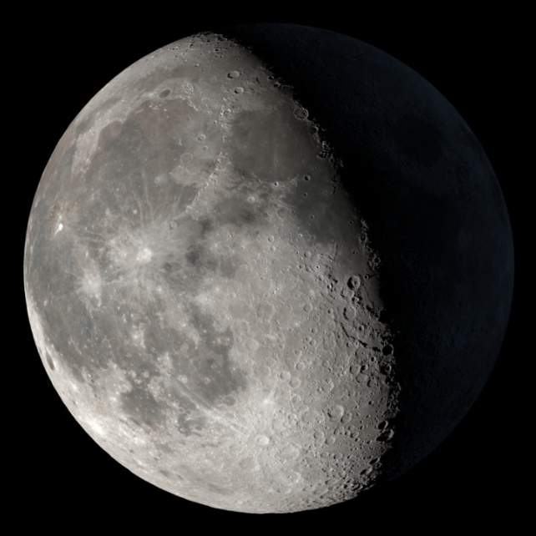
Day Twenty, 09 December 2025
Bessel Ray
Catherina
Altai Scarp

Slide 34
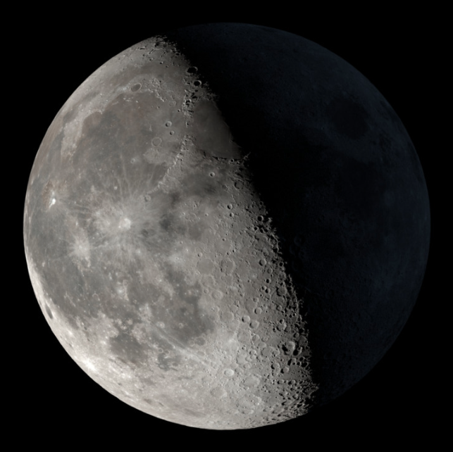
Day Twenty-one, 10 December 2025
W. Bond and Archytas
Archimedes
Agrippa and Godin

Slide 35
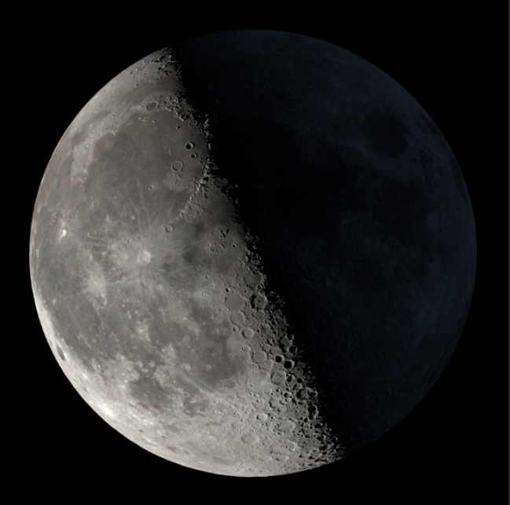
Day Twenty-two, 11 December 2025
Mare Ibrium
Albategnius

Slide 36
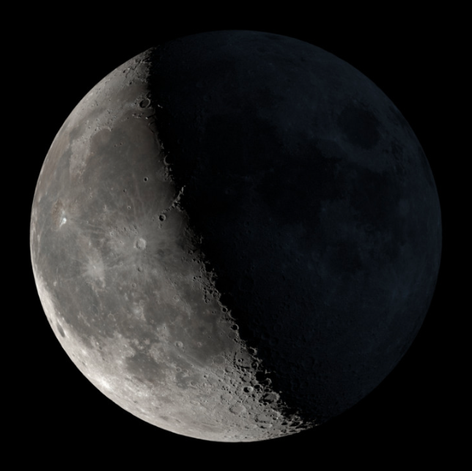
Day Twenty-three, 12 December 2025
Apennines across Terminator
Eratosthenes
Clavius

Slide 37
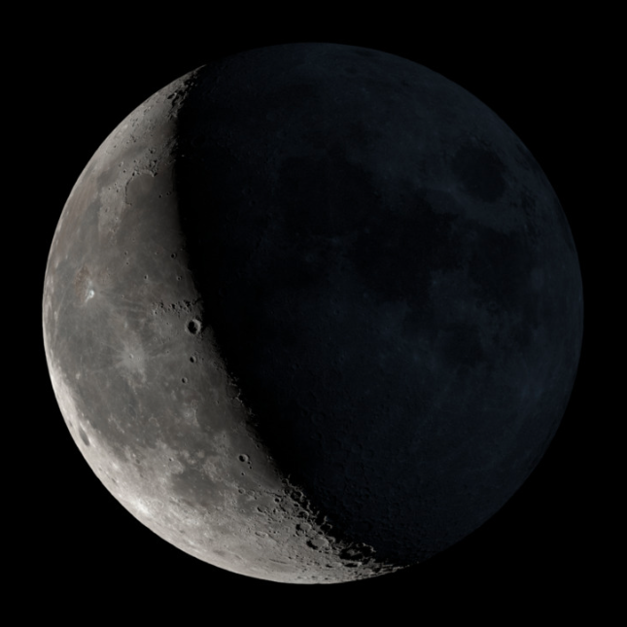
Day Twenty-four, 13 December 2025
Mountains above Copernicus

Slide 38
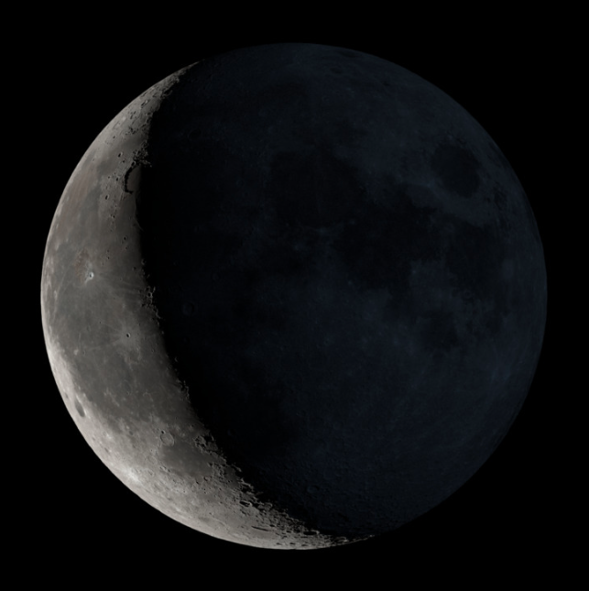
Day Twenty-five, 14 December 2025
Sinus Iridum
Aristarchus
Kepler

Slide 39
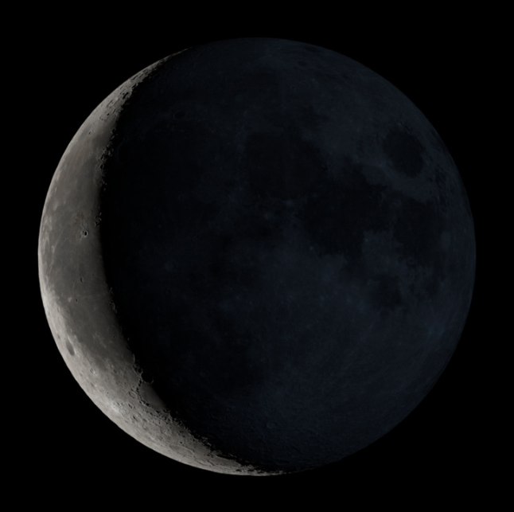
Day Twenty-six, 15 December 2025
Northern Highlands
Southern Highlands

Slide 40
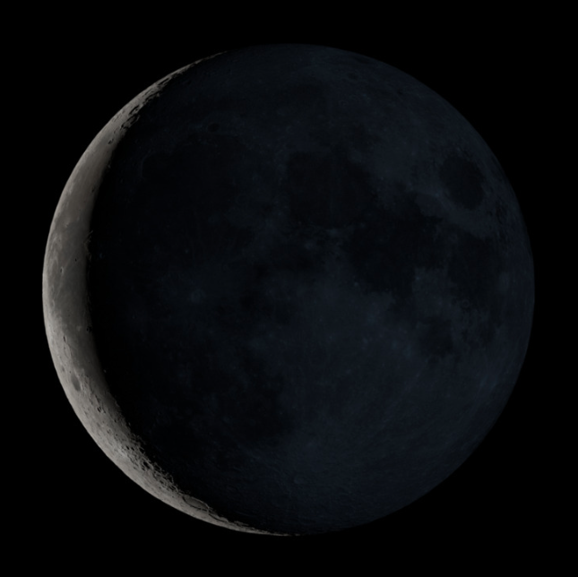
Day Twenty-seven, 16 December 2025

Slide 41
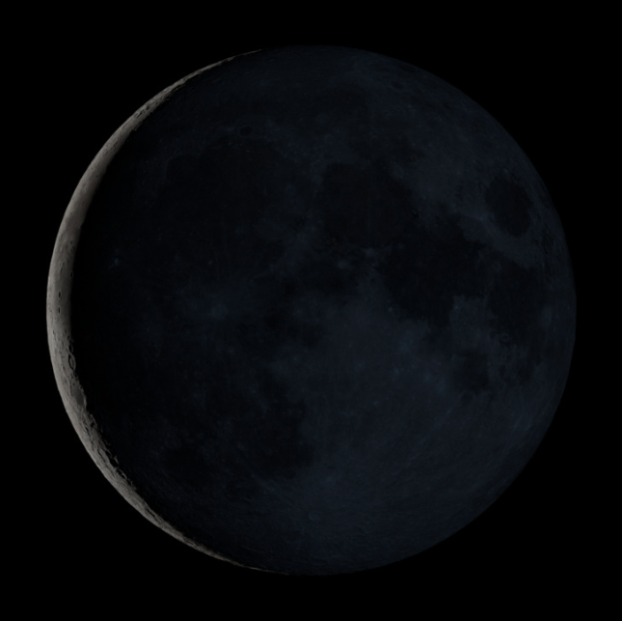
Day Twenty-eight, 17 December 2025

Slide 42
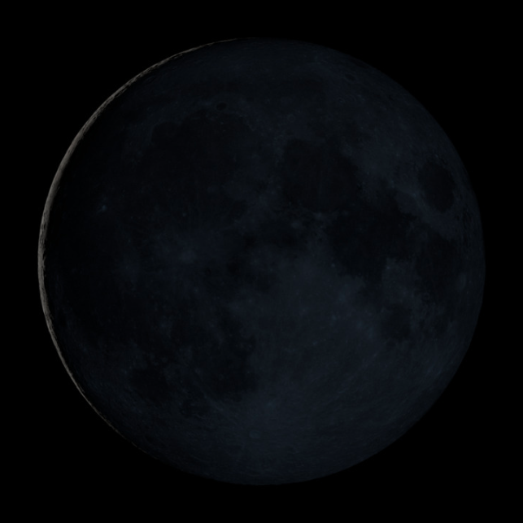
Day Twenty-nine, 18 December 2025

Slide 43
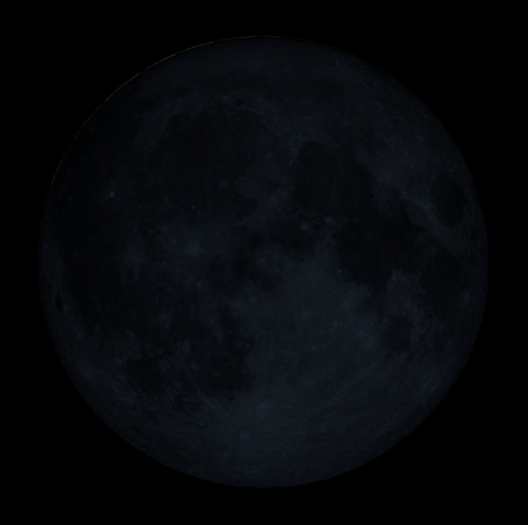
Day Zero, 19 December 2025
Nothing to see here!

Slide 44
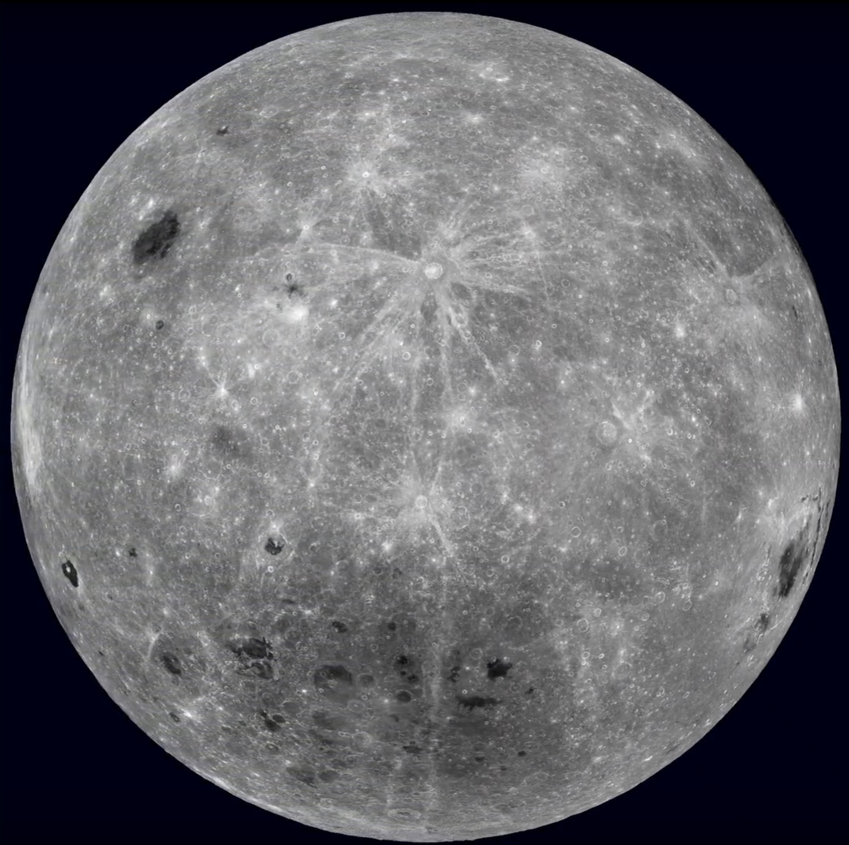

Slide 45
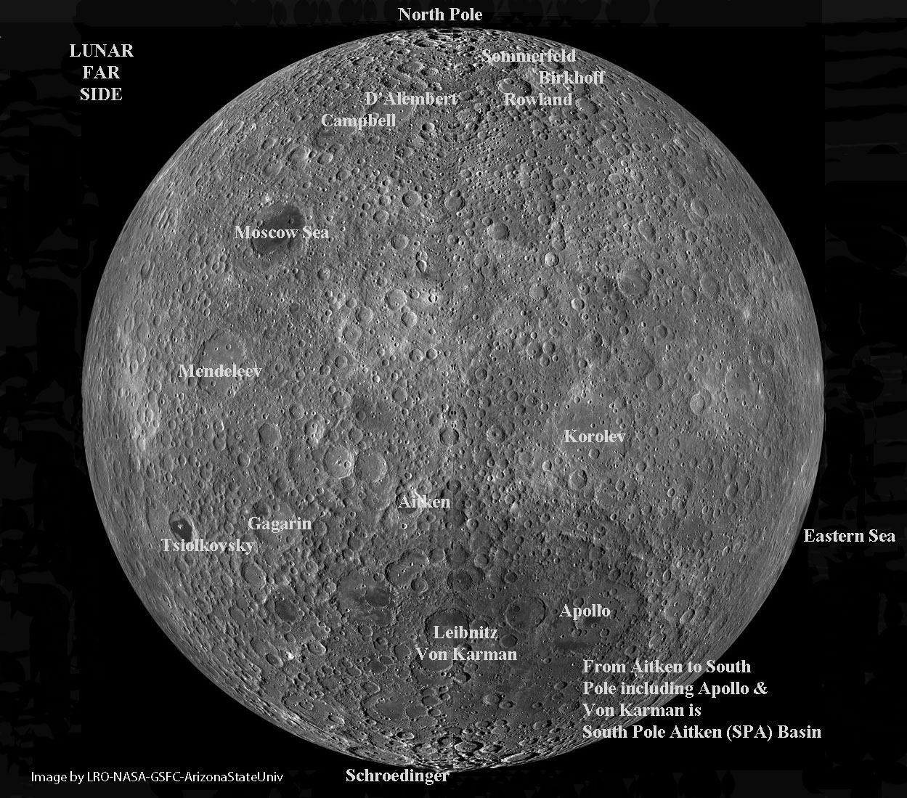

Slide 46
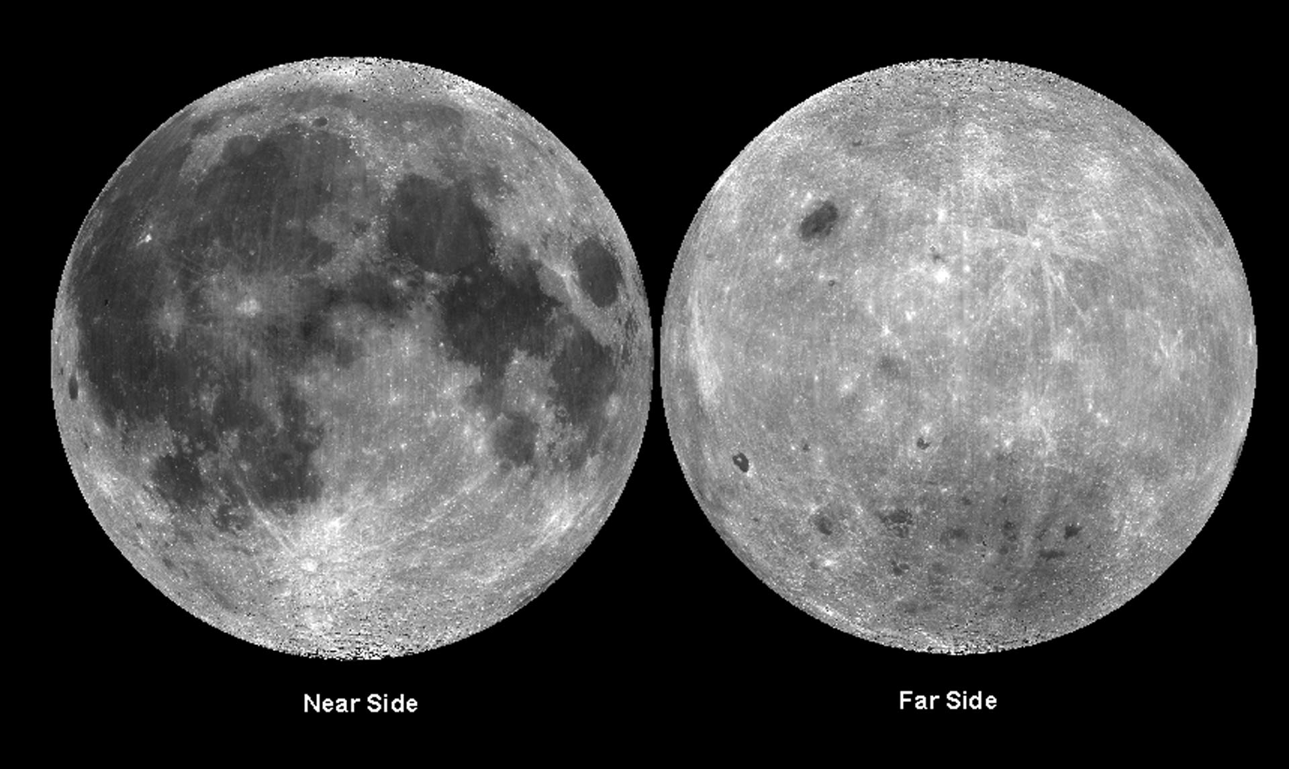

Slide 47
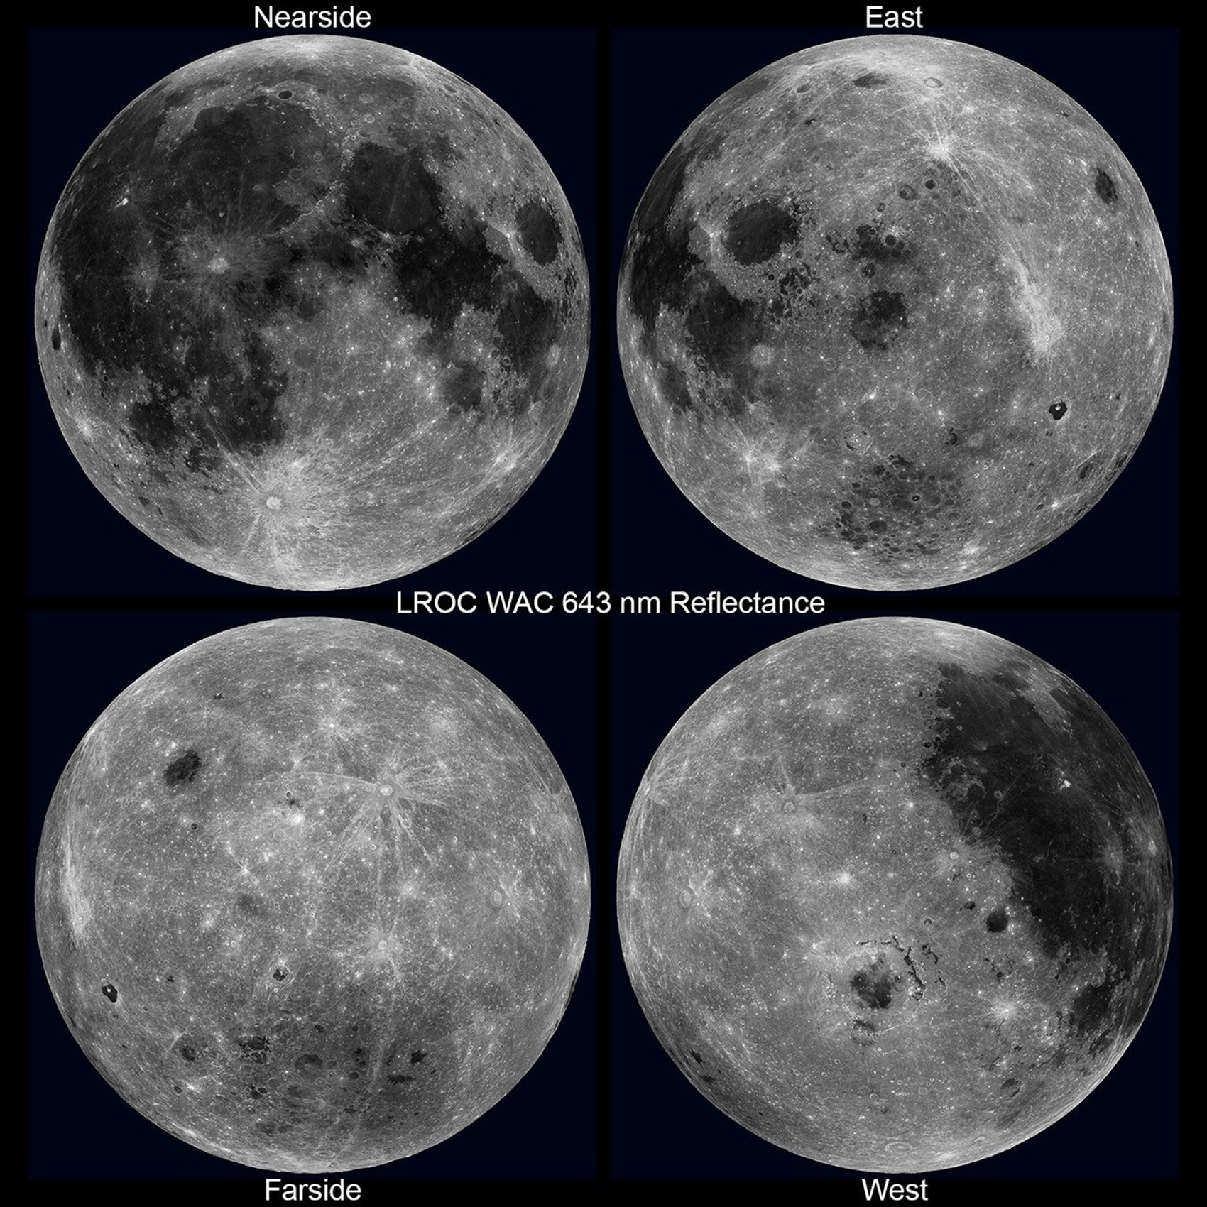

Slide 48
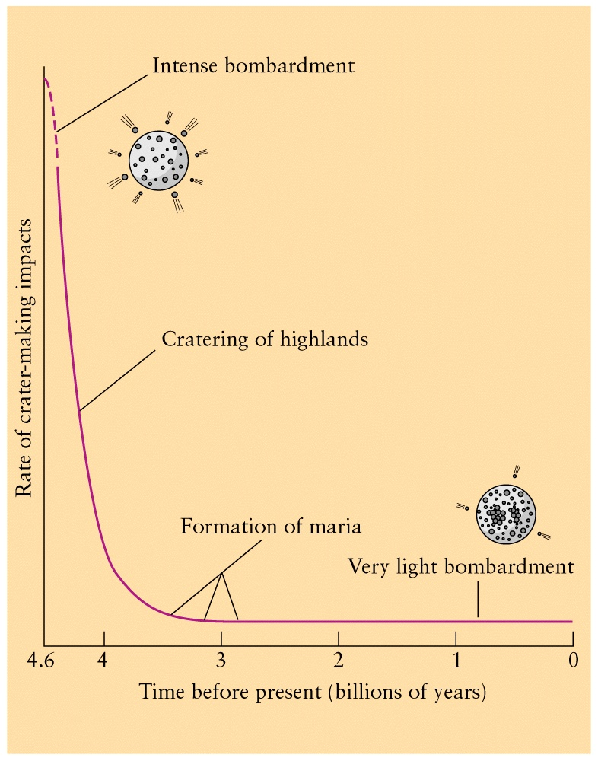

Slide 49
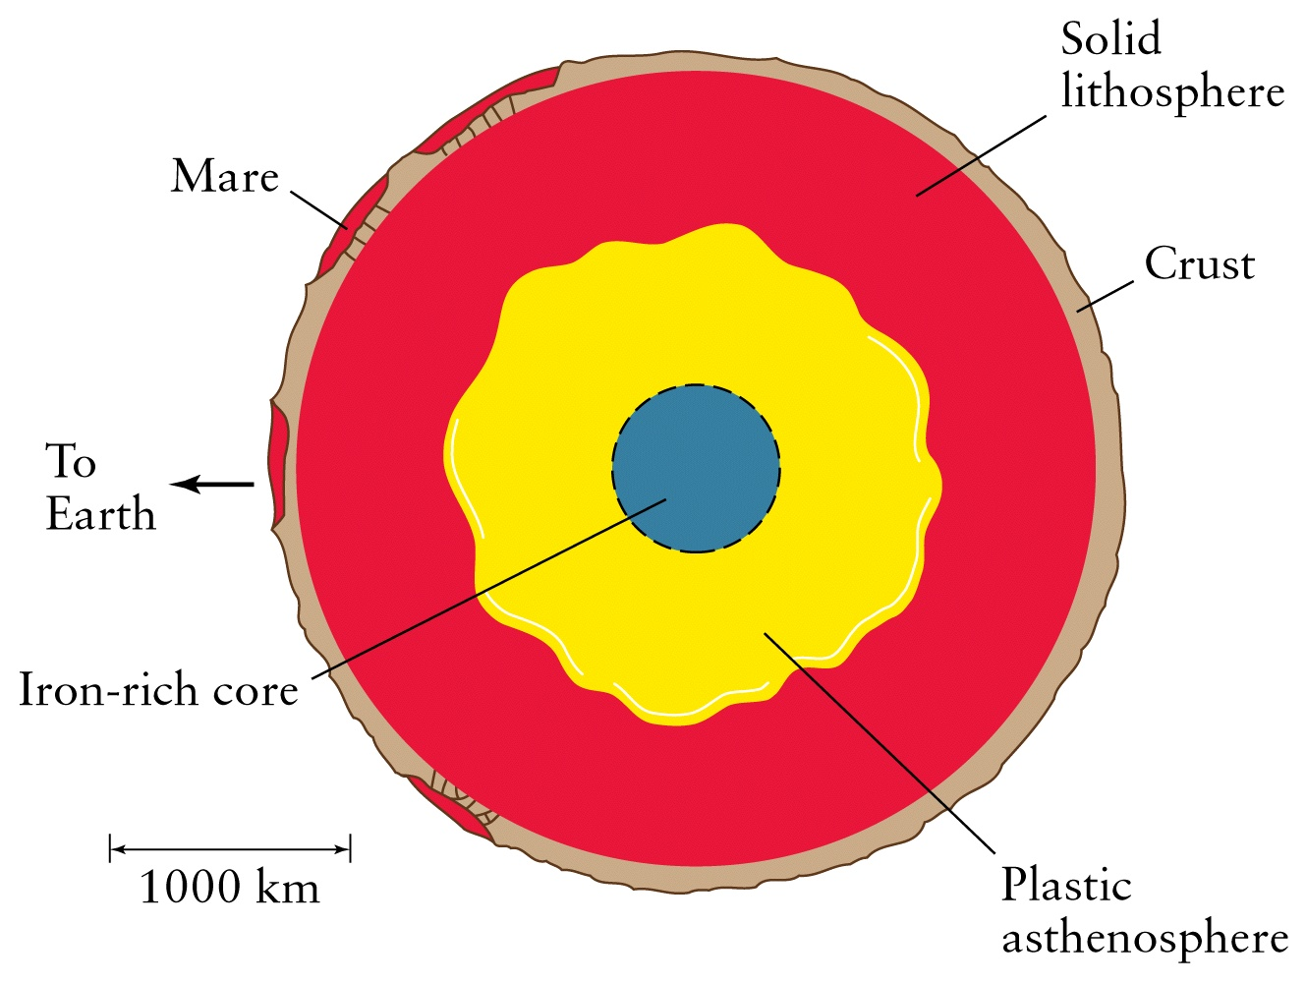

Slide 50
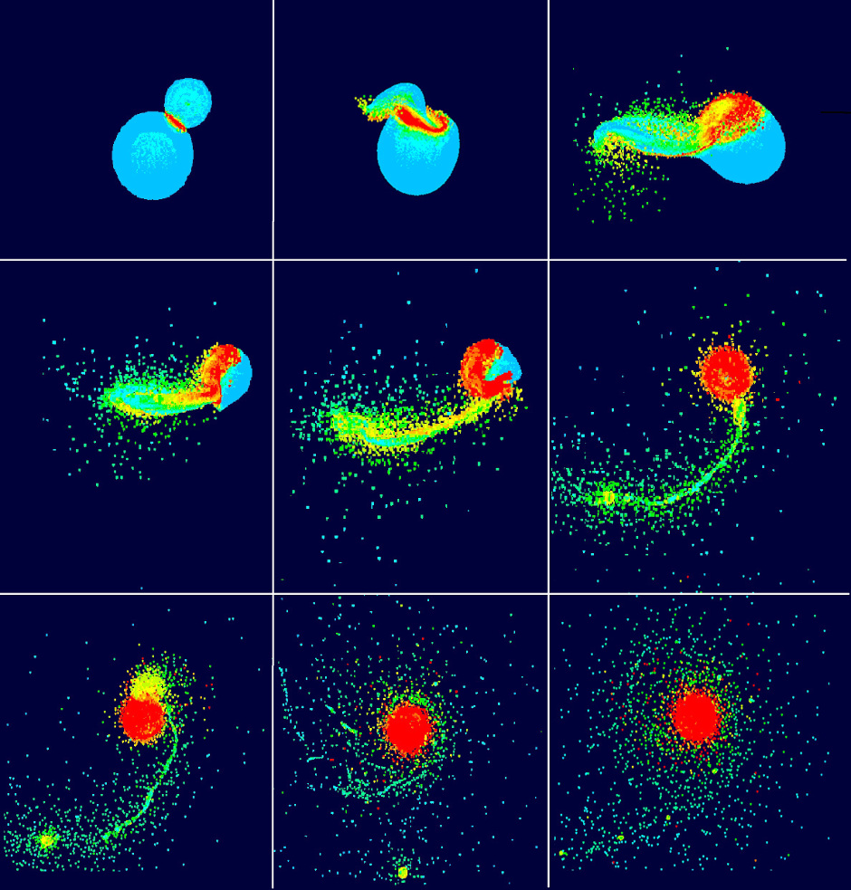

Slide 51


Slide 52
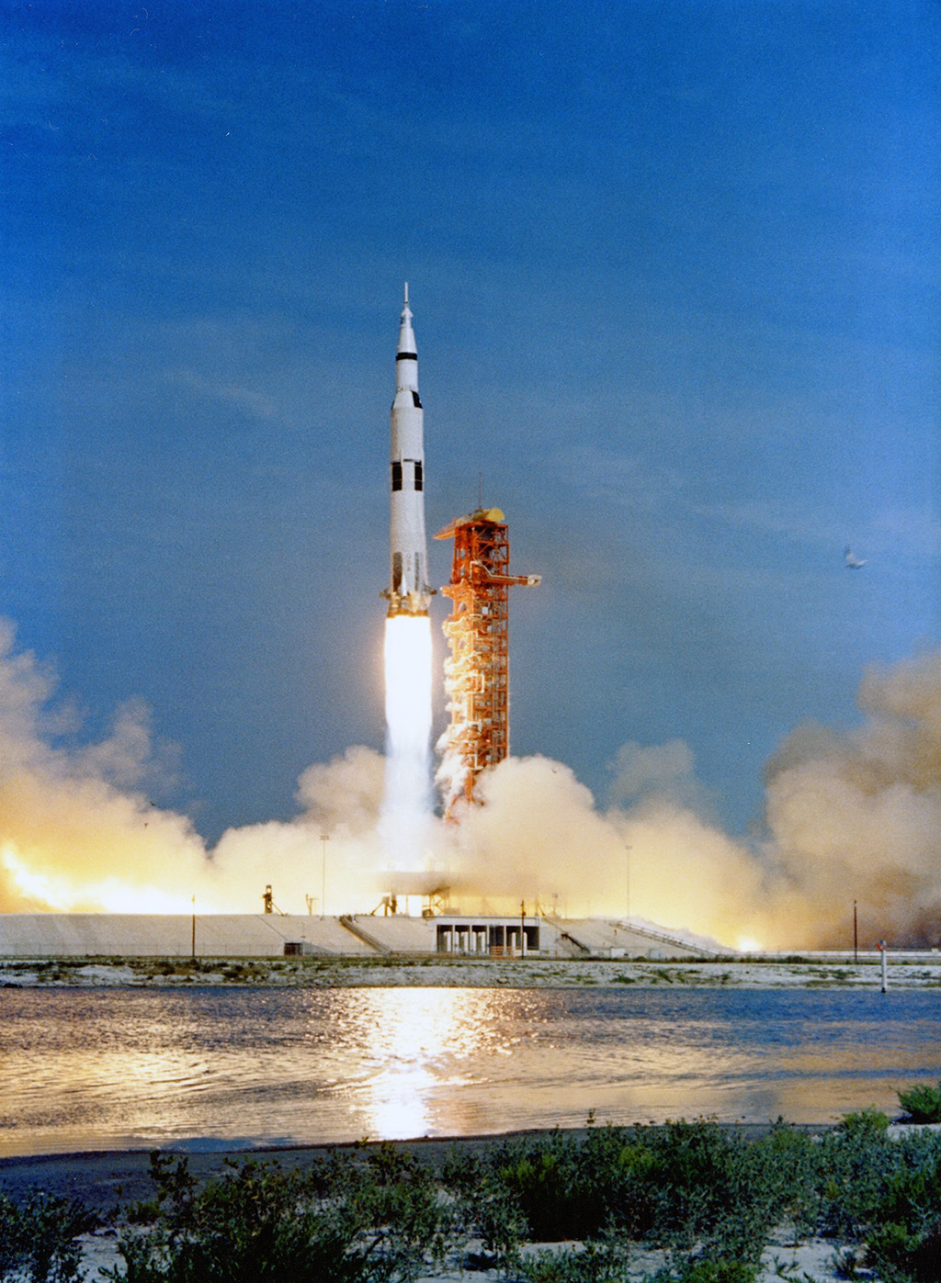
Apollo 11 Launch – 16 July 1969

Slide 53
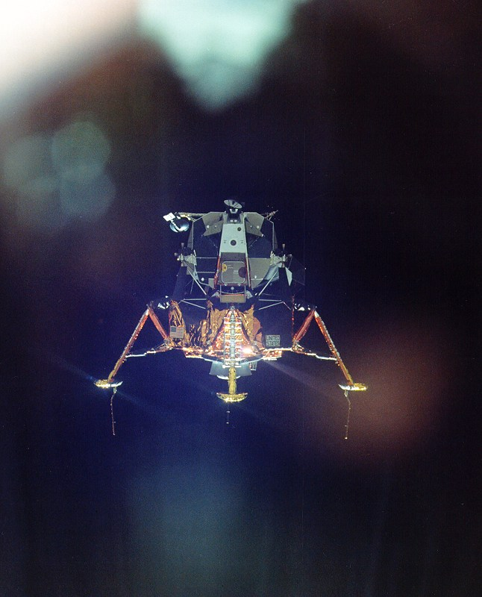
Apollo 11 Lunar Lander – The Eagle

Slide 54
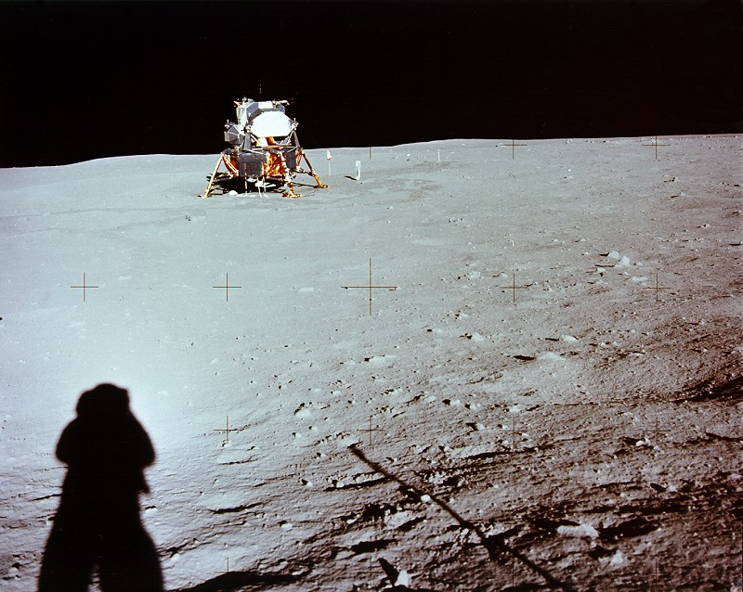
Apollo 11 Lunar Lander – The Eagle – 20 July 1969

Slide 55
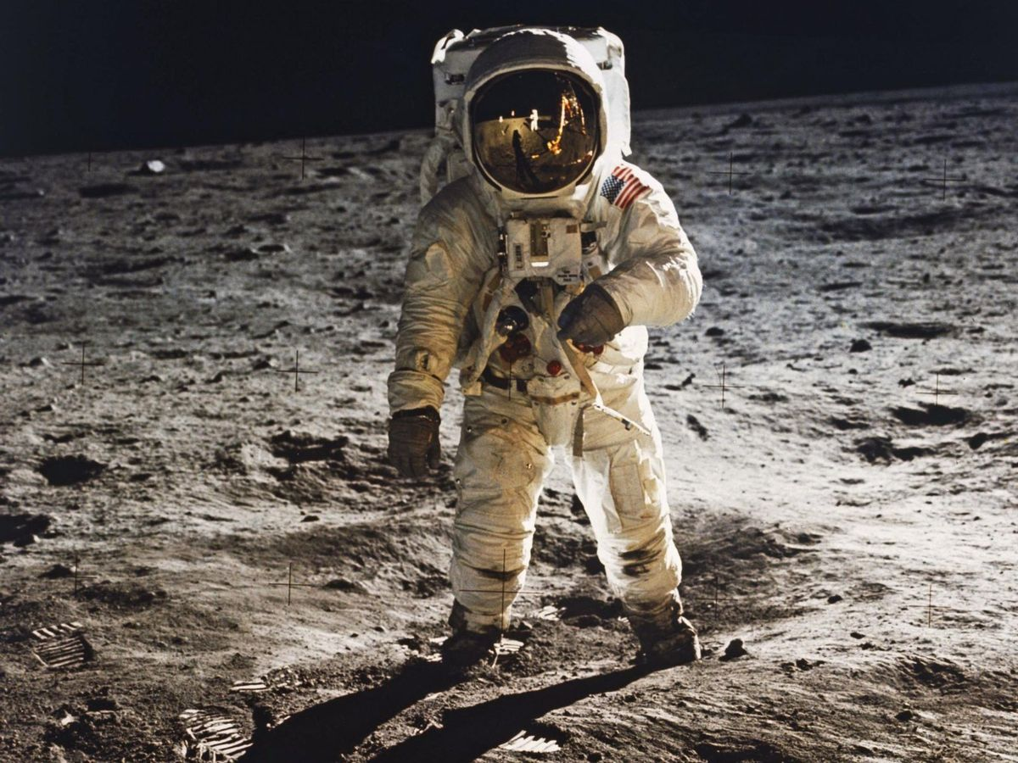

Slide 56


Slide 57
July 20, 1969—Apollo 11 | Neil Armstrong
 | Edwin “Buzz” Aldrin
Nov. 19, 1969—Apollo 12 | Charles (Pete) Conrad
 | Alan Bean
Feb. 5, 1971—Apollo 14 | Alan Shepard
 | Edgar Mitchell
July 30, 1971—Apollo 15 | James Irwin
 | David Scott
Apr. 21-23, 1972—Apollo 16 | Charles Duke
 | John Young
Dec. 11-13, 1972—Apollo 17 | Eugene Cernan
 | Harrison Schmitt
Twelve astronauts have walked on the moon, the last in 1972. Here are the names of those astronauts listed chronologically by the date of their walk.
20 July 1969 Neil Armstrong & Edwin (Buzz) Aldrin (Michael Collins)
19 Nov 1969 Charles (Pete) Conrad & Alan Bean (Dick Gordon)
05 Feb 1971 Alan Shepard & Edgar Mitchell (Stu Roosa)
30 July 1971 James Irwin & David Scott (Al Worden)
21 Apr 1972 Charles Duke & John Young (Ken Mattingly)
11 Dec 1972 Eugene Cernan and Harrison Schmitt (Ron Evans)

Slide 58

Apollo Landing Sites

Slide 59
This was a companion to the plaque left by Armstrong and Aldrin on the first visit to the lunar surface left a plaque:
“Here Men From Planet Earth First Set Foot Upon the Moon. July 1969 A.D. We Came in Peace For All Mankind.”
Harrison Schmitt was the last man to set foot on the moon. He and Cernan left behind a plaque that reads:
“Here Man completed his first exploration of the Moon, December 1972 A.D. May the spirit of peace in which we came be reflected in the lives of all mankind.”

Slide 60

Artemis II and SLS
06 March 2026
Artemis III – 2028?

Slide 61


Slide 62


Slide 63


Slide 64


