Slide 1
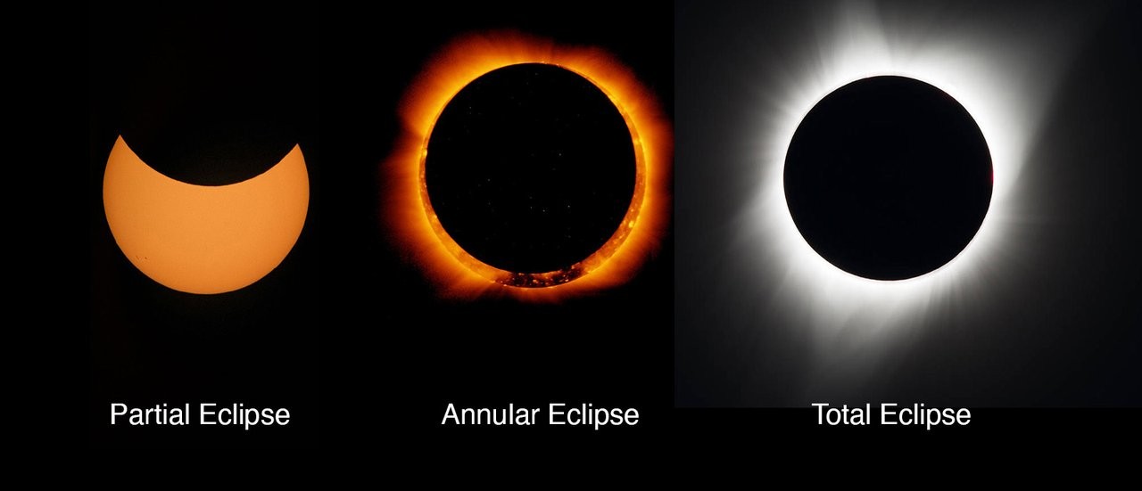
Cosmic Connections:
An Introduction to Astronomy
And
Maine’s Magnificent Night Skies
Midcoast Senior College
Russell F. Pinizzotto, Ph.D. (Russ)
Unit 05
Tides and Eclipses

Slide 2
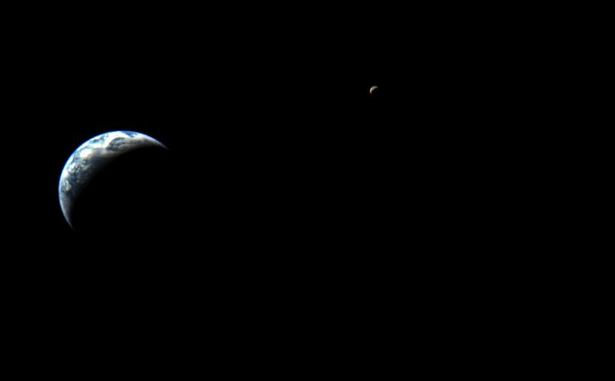

Slide 3
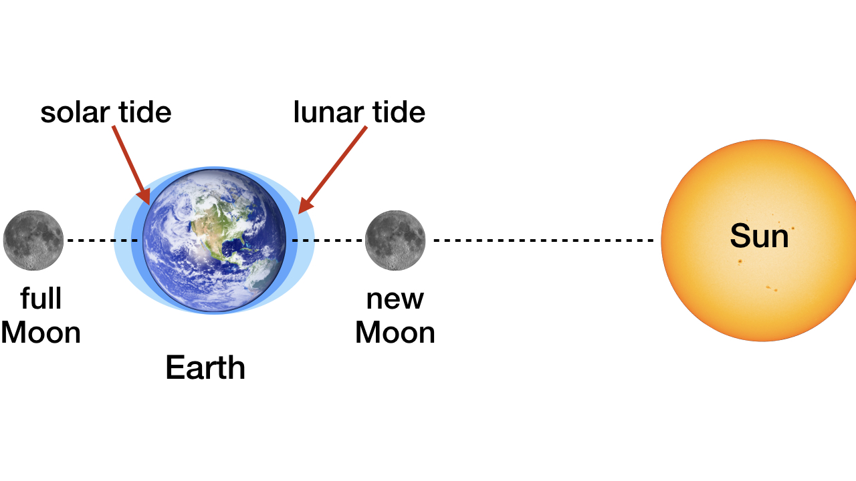

Slide 4
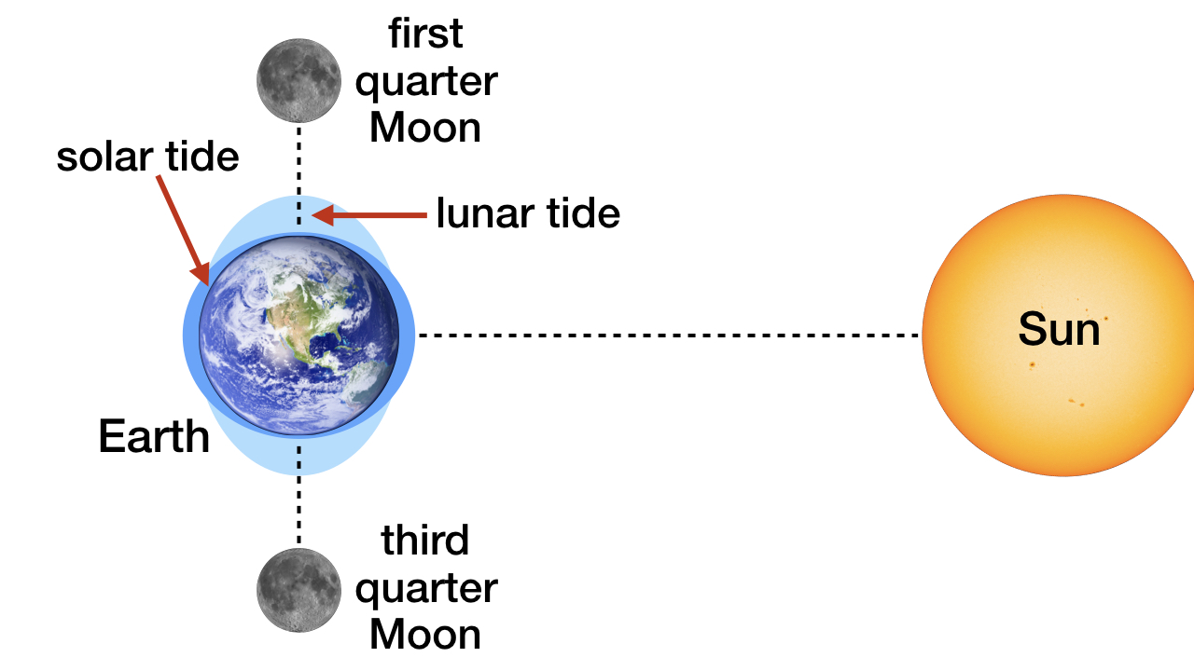

Slide 5
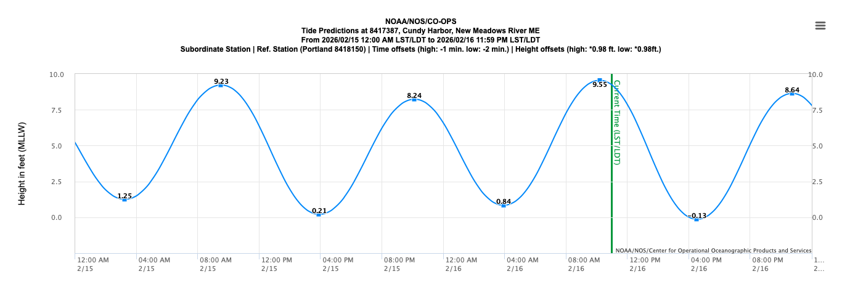

Slide 6
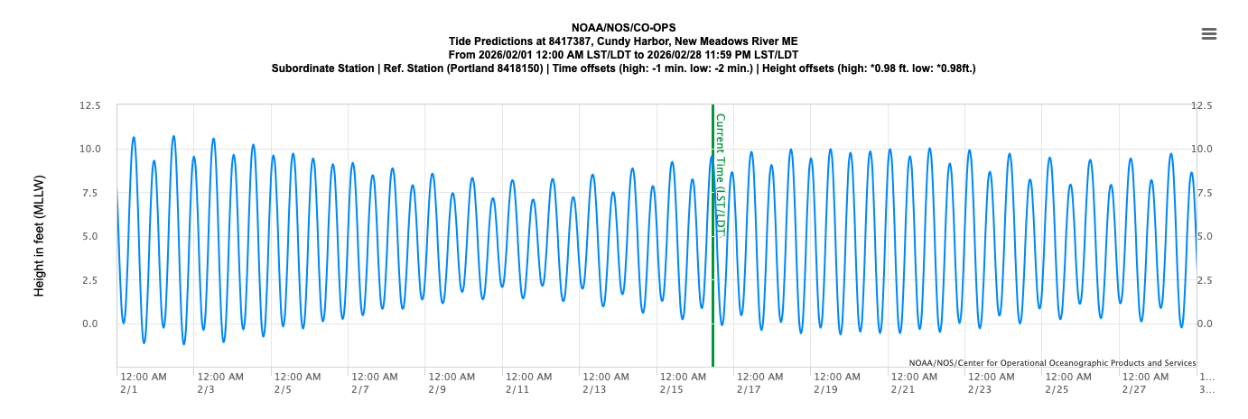

Slide 7
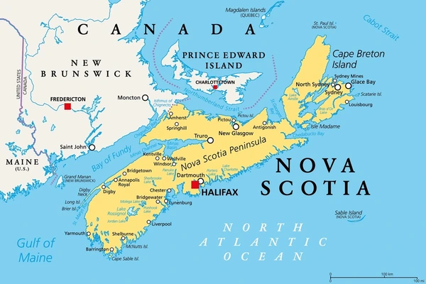

Slide 8
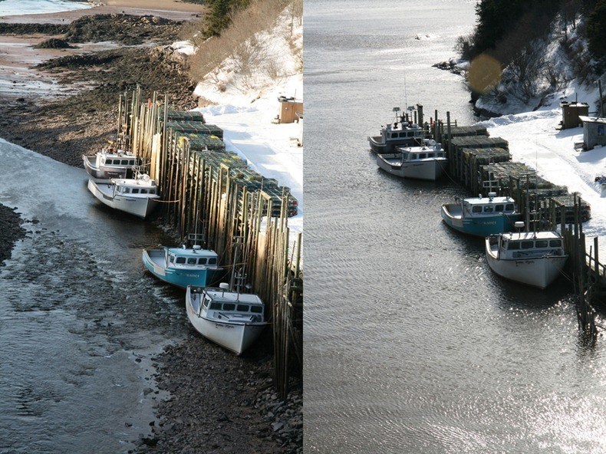
Tides in the Bay of Fundy

Slide 9
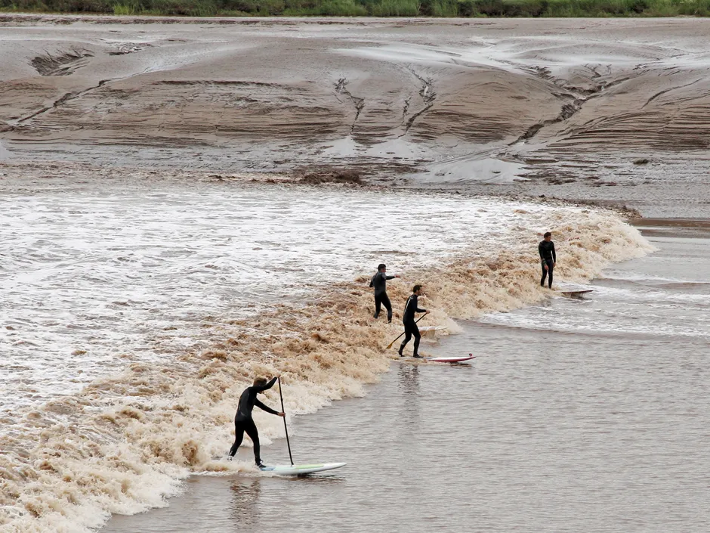
Tidal Bore
Moncton,N. B.

Slide 10
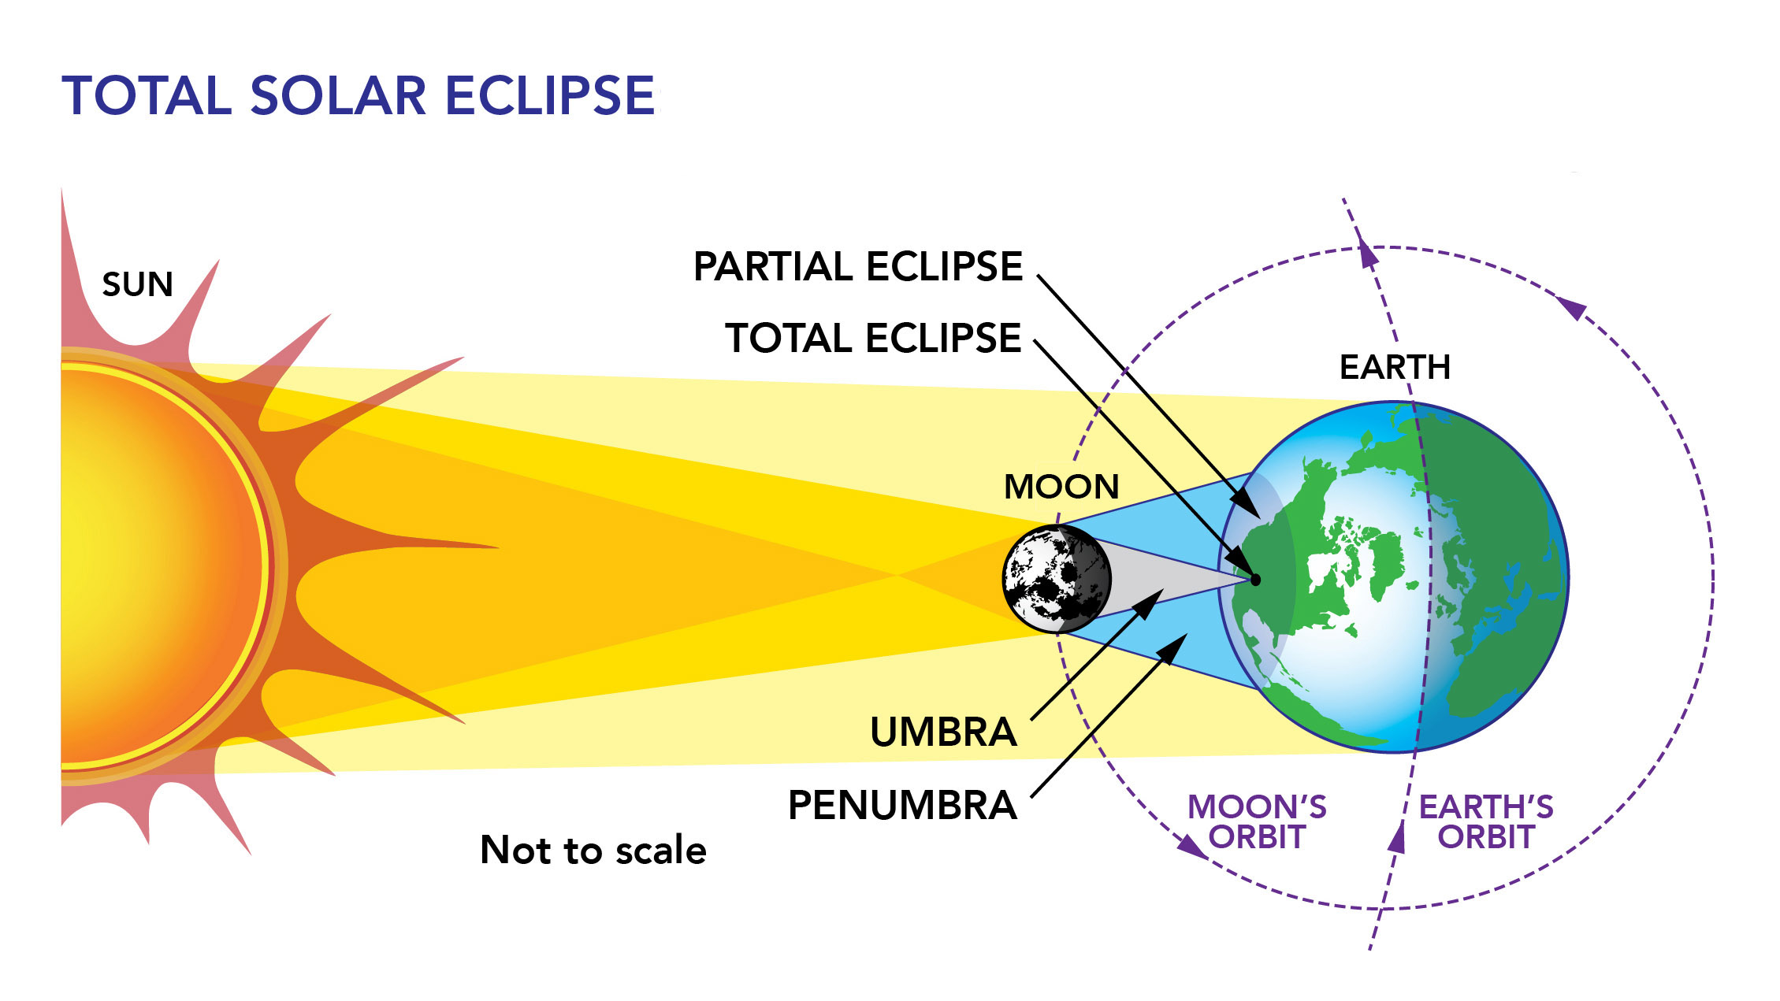

Slide 11
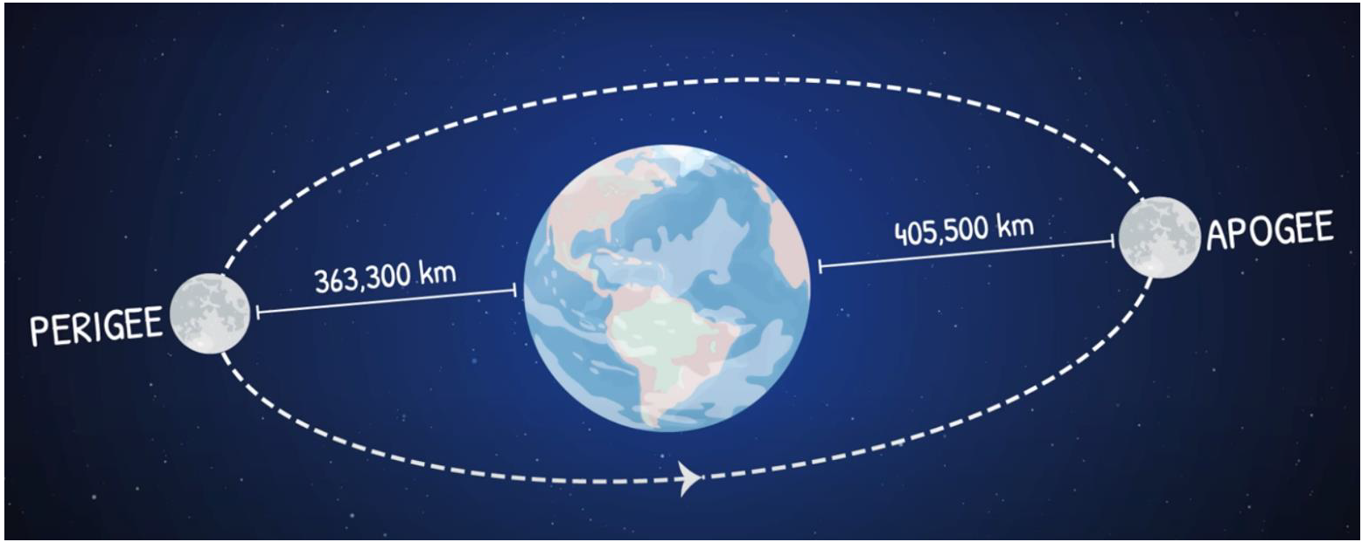

Slide 12
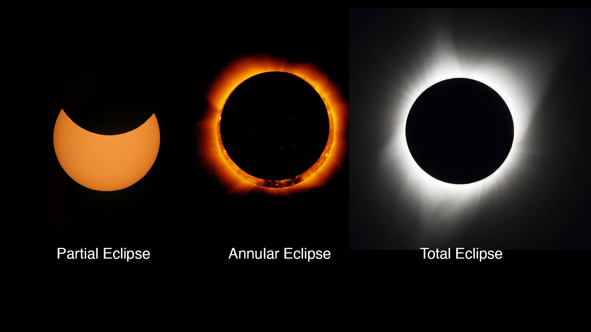

Slide 13
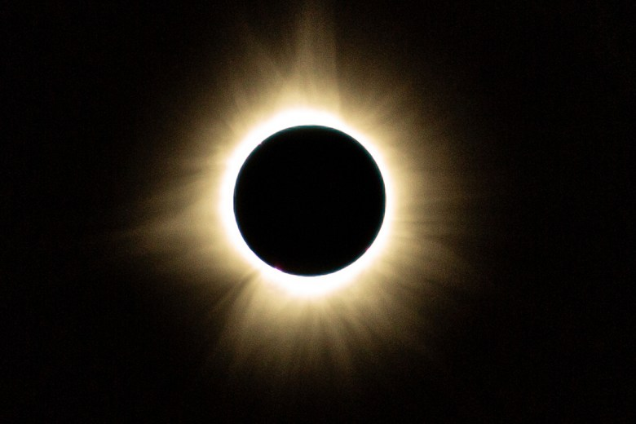
Greenville, Maine – 08 April 2024
Bangor Daily News

Slide 14
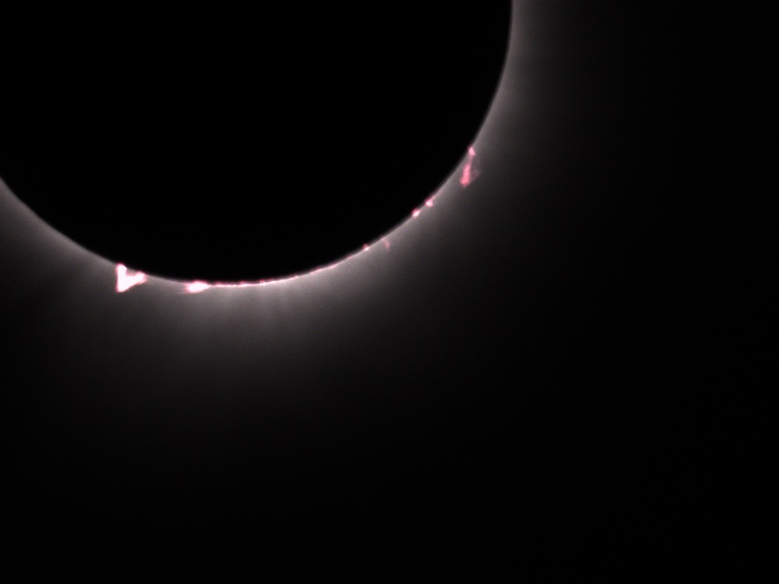
Mid-T +1 min
Patton, Maine – 08 April 2024
Photo by RFP

Slide 15
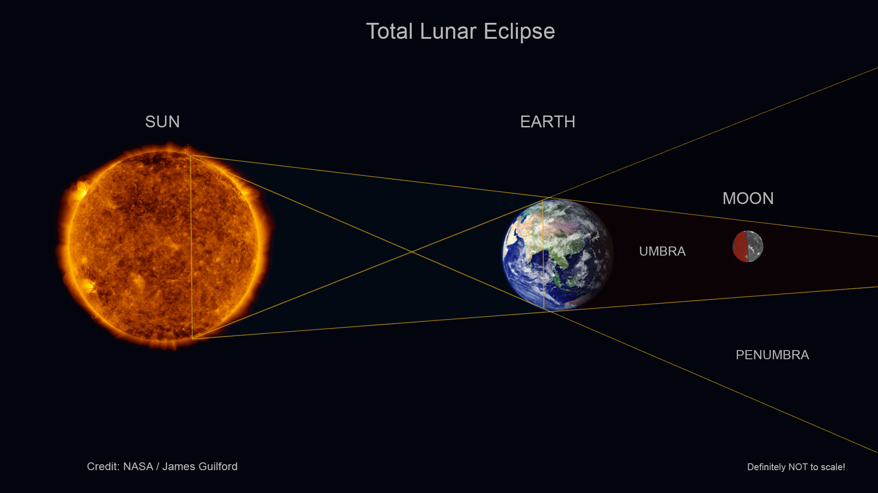

Slide 16
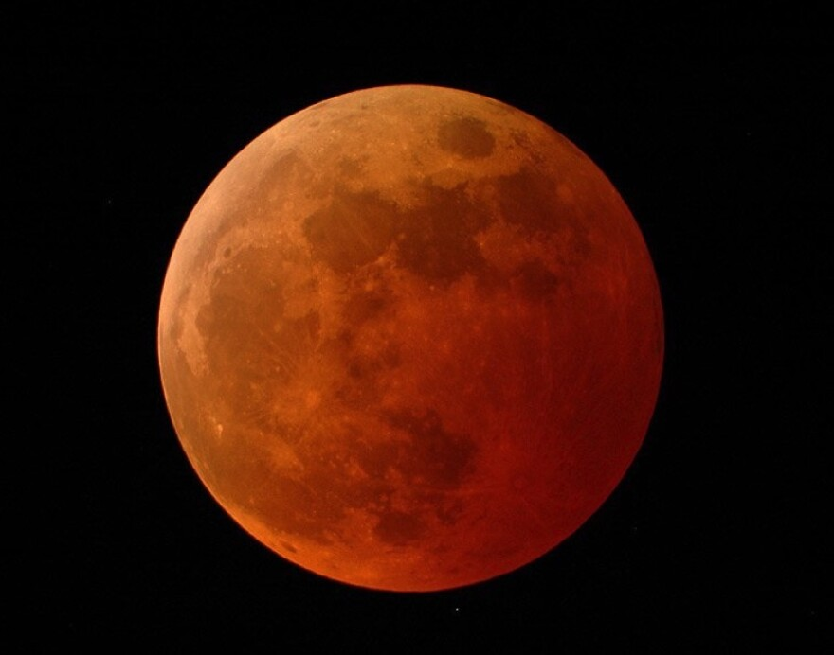

Slide 17
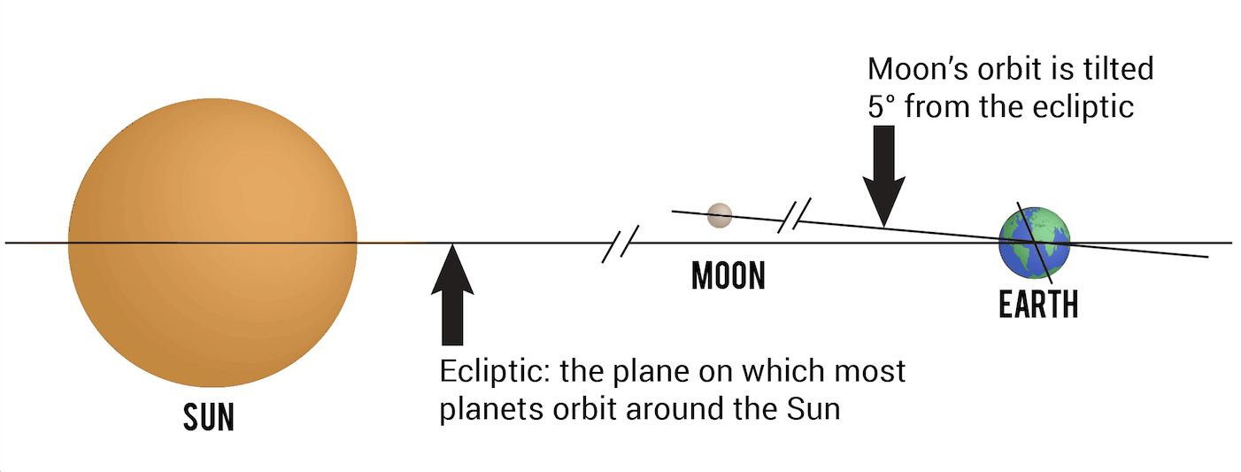

Slide 18
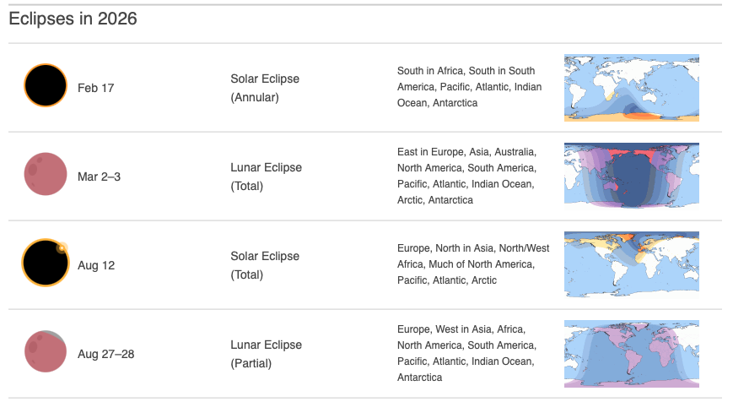

Slide 19
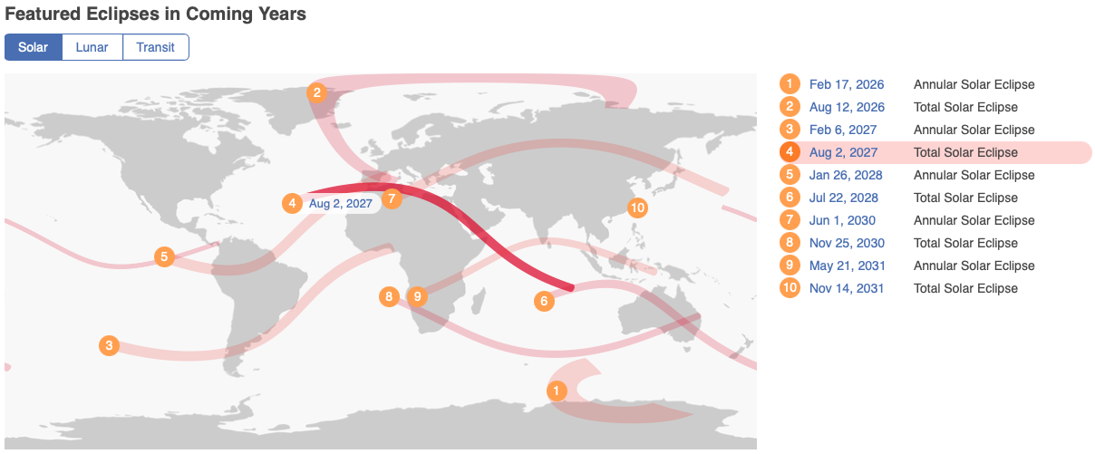

Slide 20
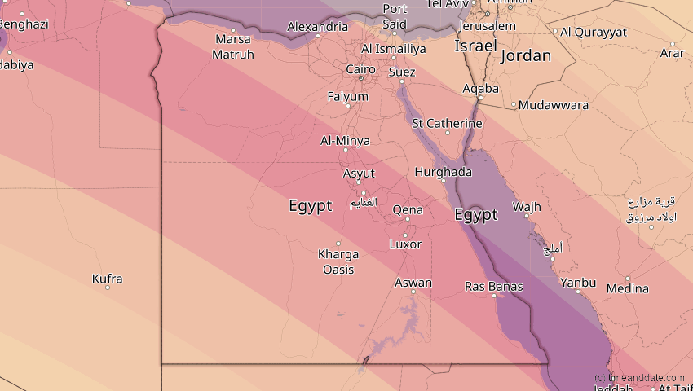

Slide 21


Slide 22
Comparison Table
Event | Alignment | Moon Phase | Visibility
Solar Eclipse | Sun-Moon-Earth | New Moon | Small path on Earth
Lunar Eclipse | Sun-Earth-Moon | Full Moon | Entire night side of Earth
Spring Tide | Linear (Straight) | New / Full | Worldwide Oceans
Neap Tide | L-Shape (90°) | 1st / 3rd Quarter | Worldwide Oceans

Slide 23
Resource List
Interactive Eclipse Map: TimeAndDate.com Eclipse Map - See when the next one hits your city.
Real-Time Tide Tracker: NOAA Tides & Currents
Video: NASA | Understanding Tides
Cundy’s Harbor Tides: https://tidesandcurrents.noaa.gov/noaatidepredictions.html?id=8417387

