Slide 1
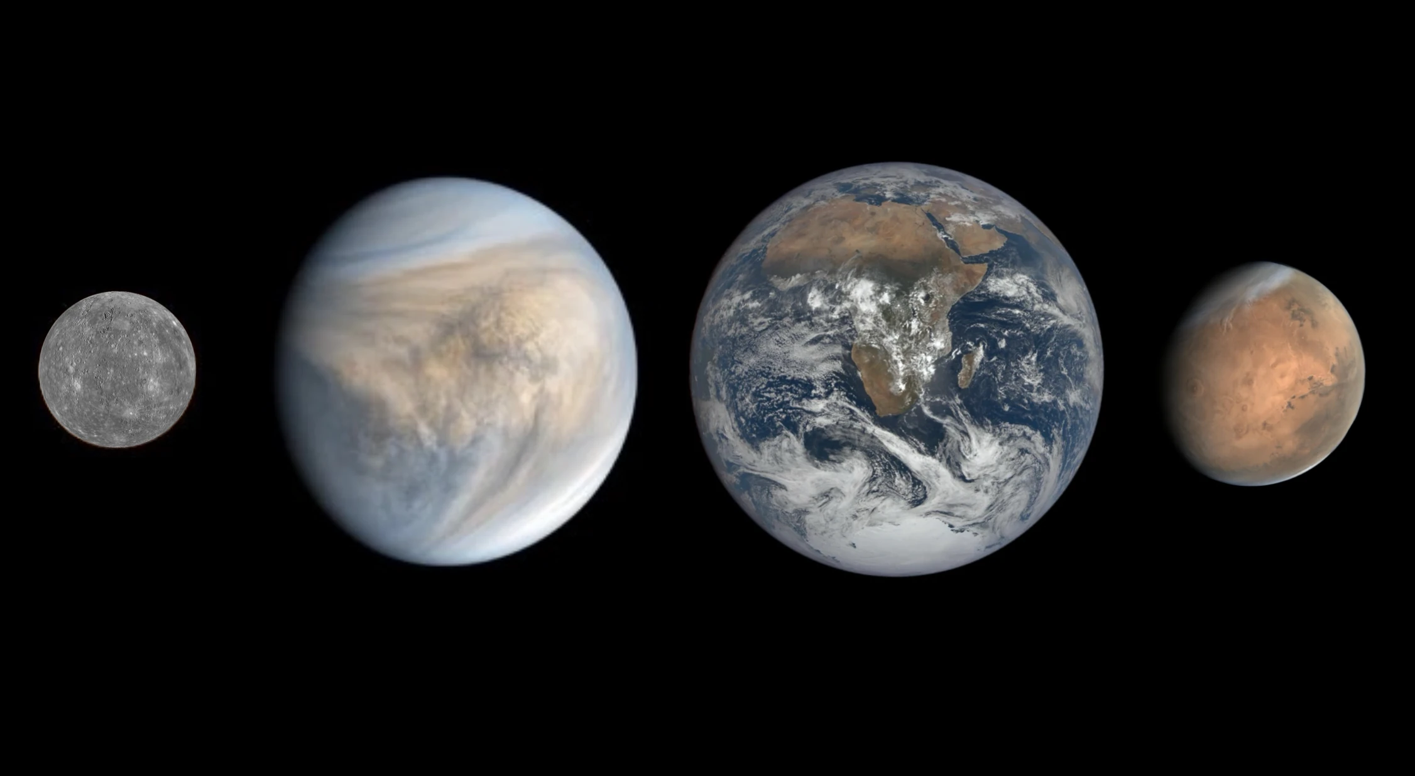
Cosmic Connections:
An Introduction to Astronomy
And
Maine’s Magnificent Night Skies
Midcoast Senior College
Russell F. Pinizzotto, Ph.D. (Russ)
Unit 06
The Inner Solar System

Slide 2
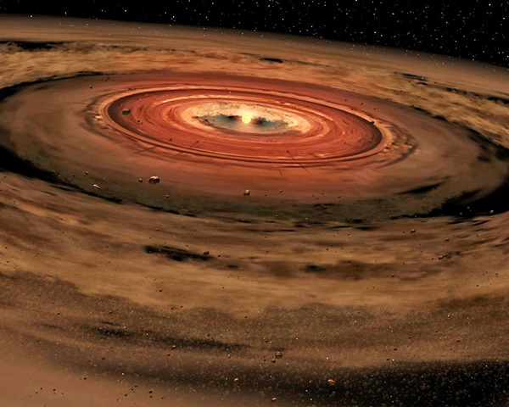

Slide 3
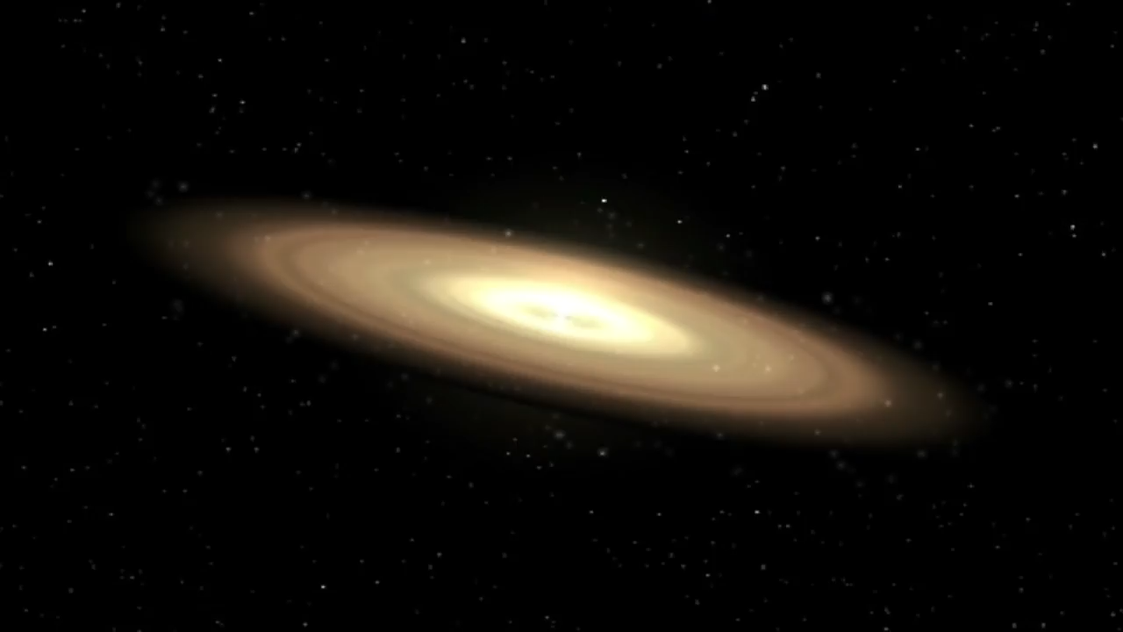

Slide 4
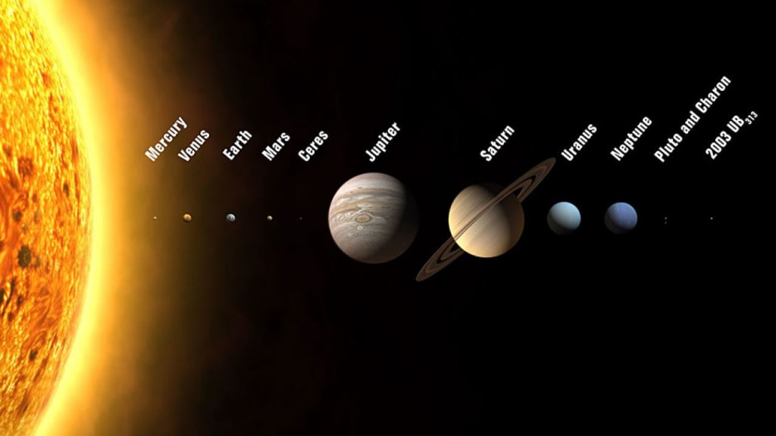

Slide 5
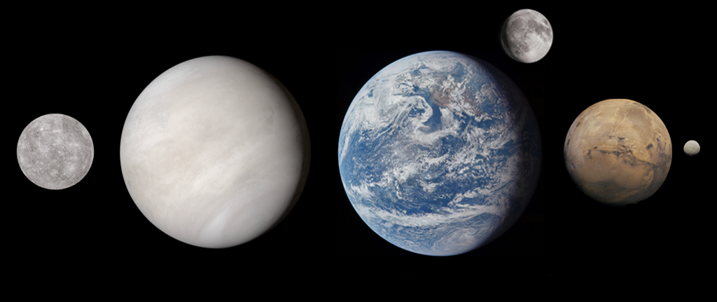

Slide 6
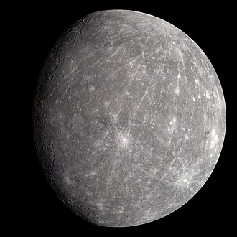
Mercury
by MESSENGER, 2008

Slide 7
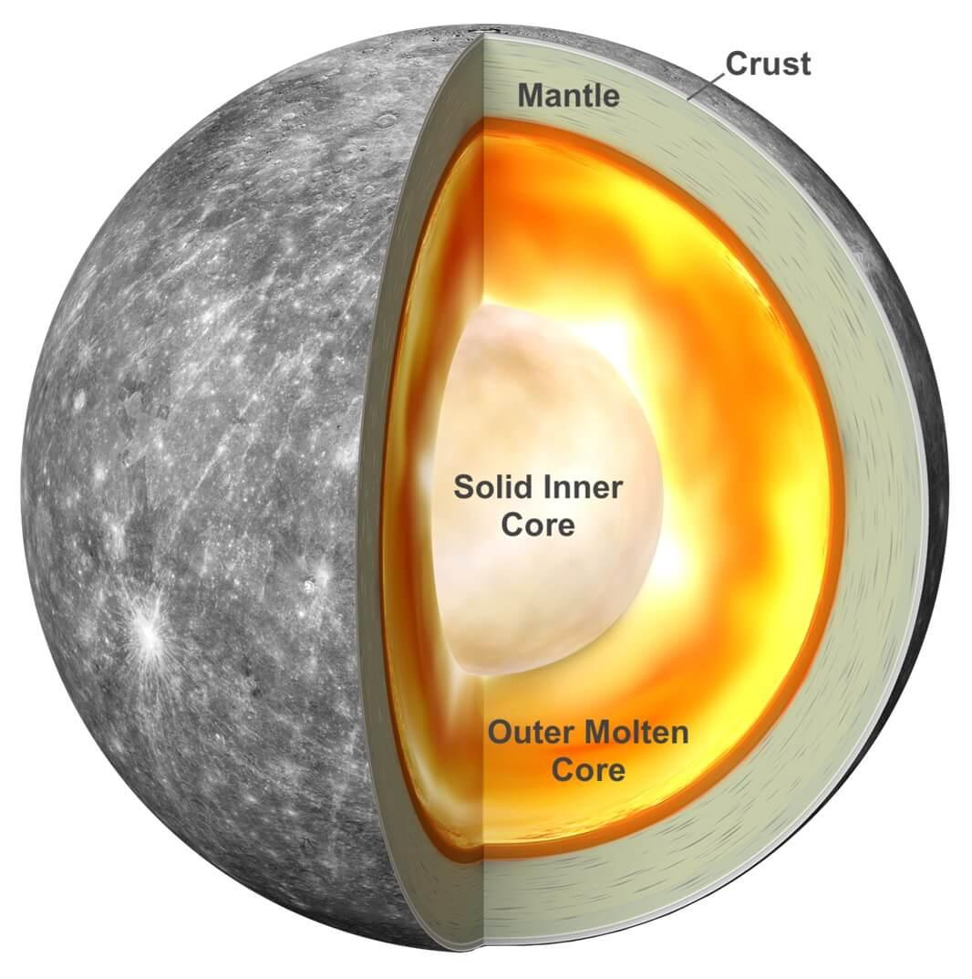

Slide 8
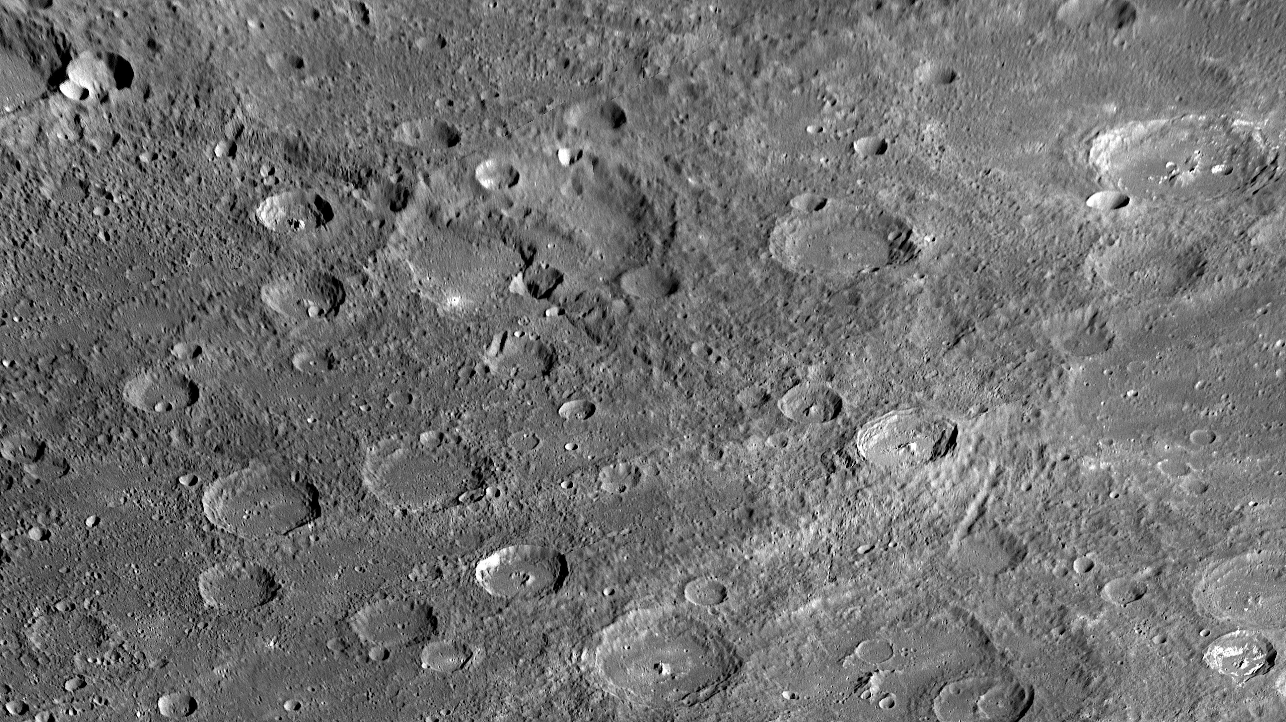

Slide 9
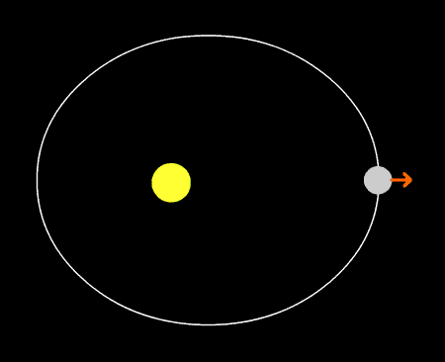
Mercury’s Orbit
3:2 Spin Resonance
88 day orbit, 176 day solar day

Slide 10
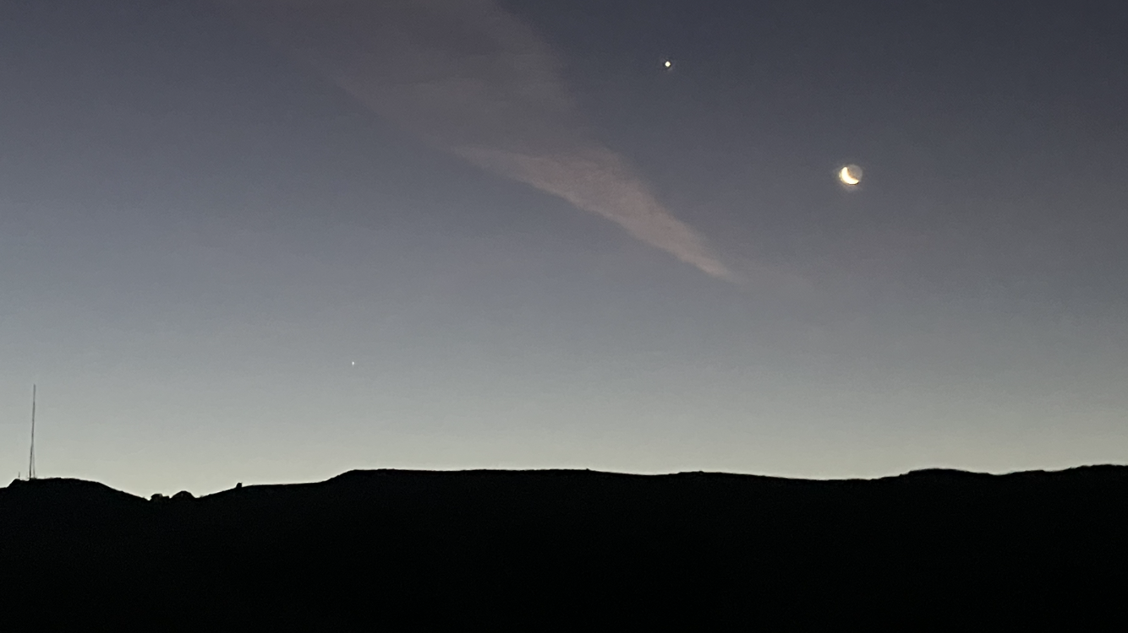

Slide 11
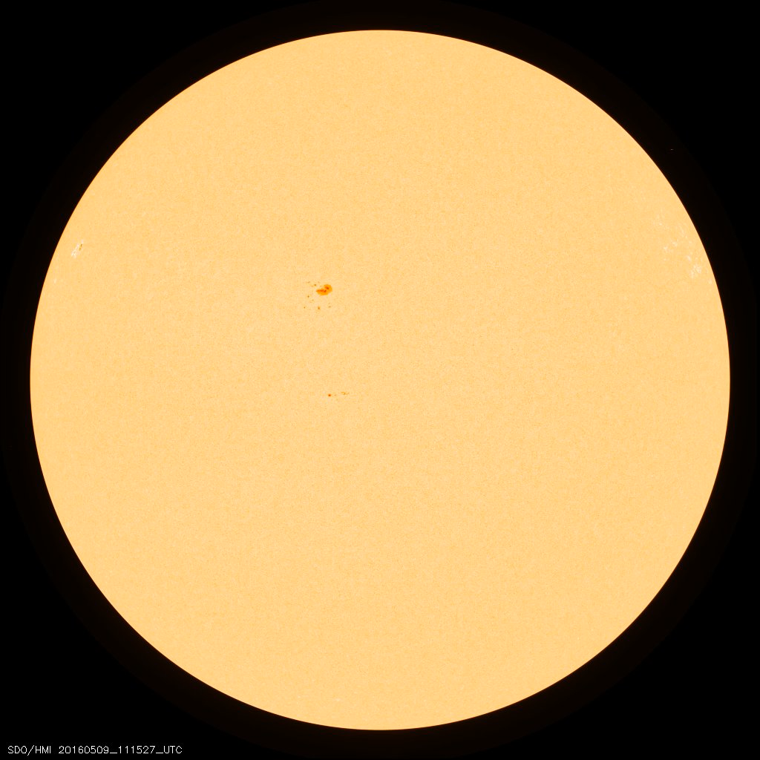
Mercury Transit 2016

Slide 12
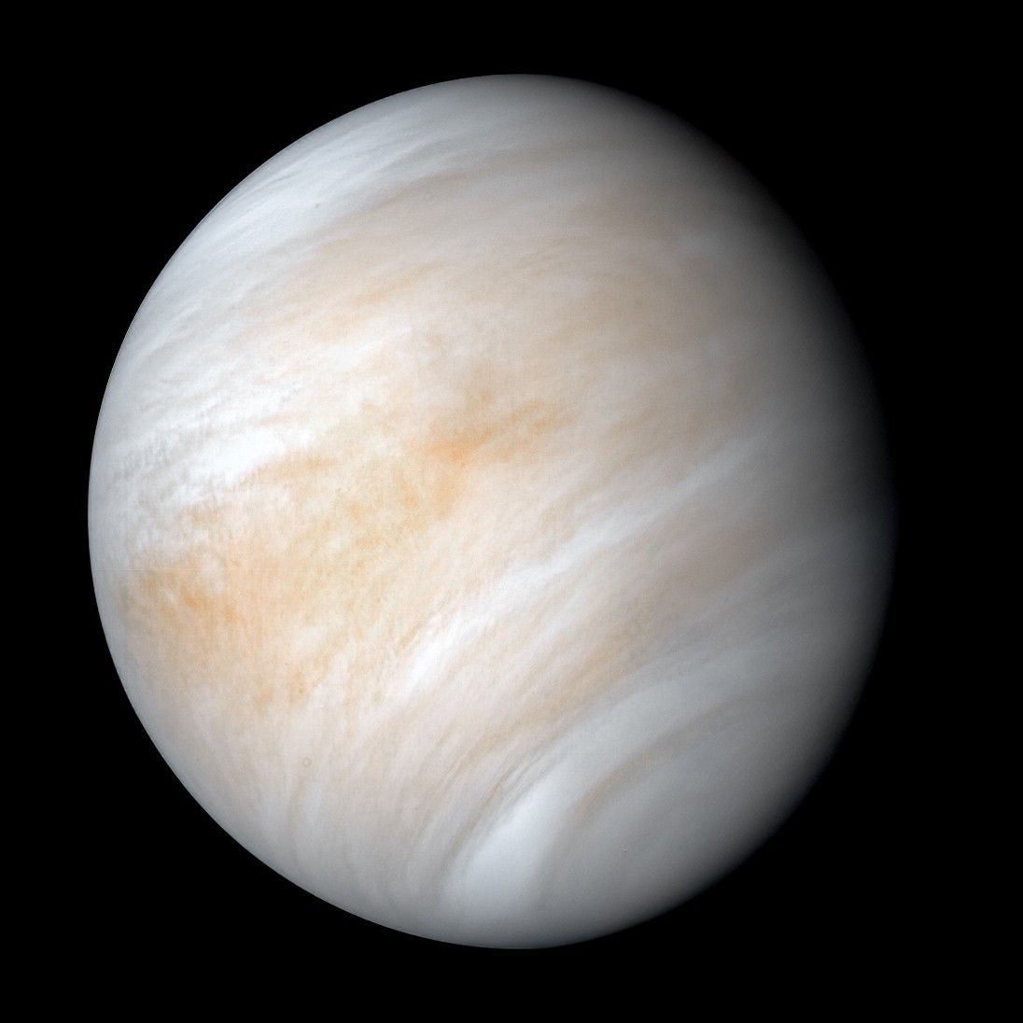
Venus
Mariner 10, 1974

Slide 13
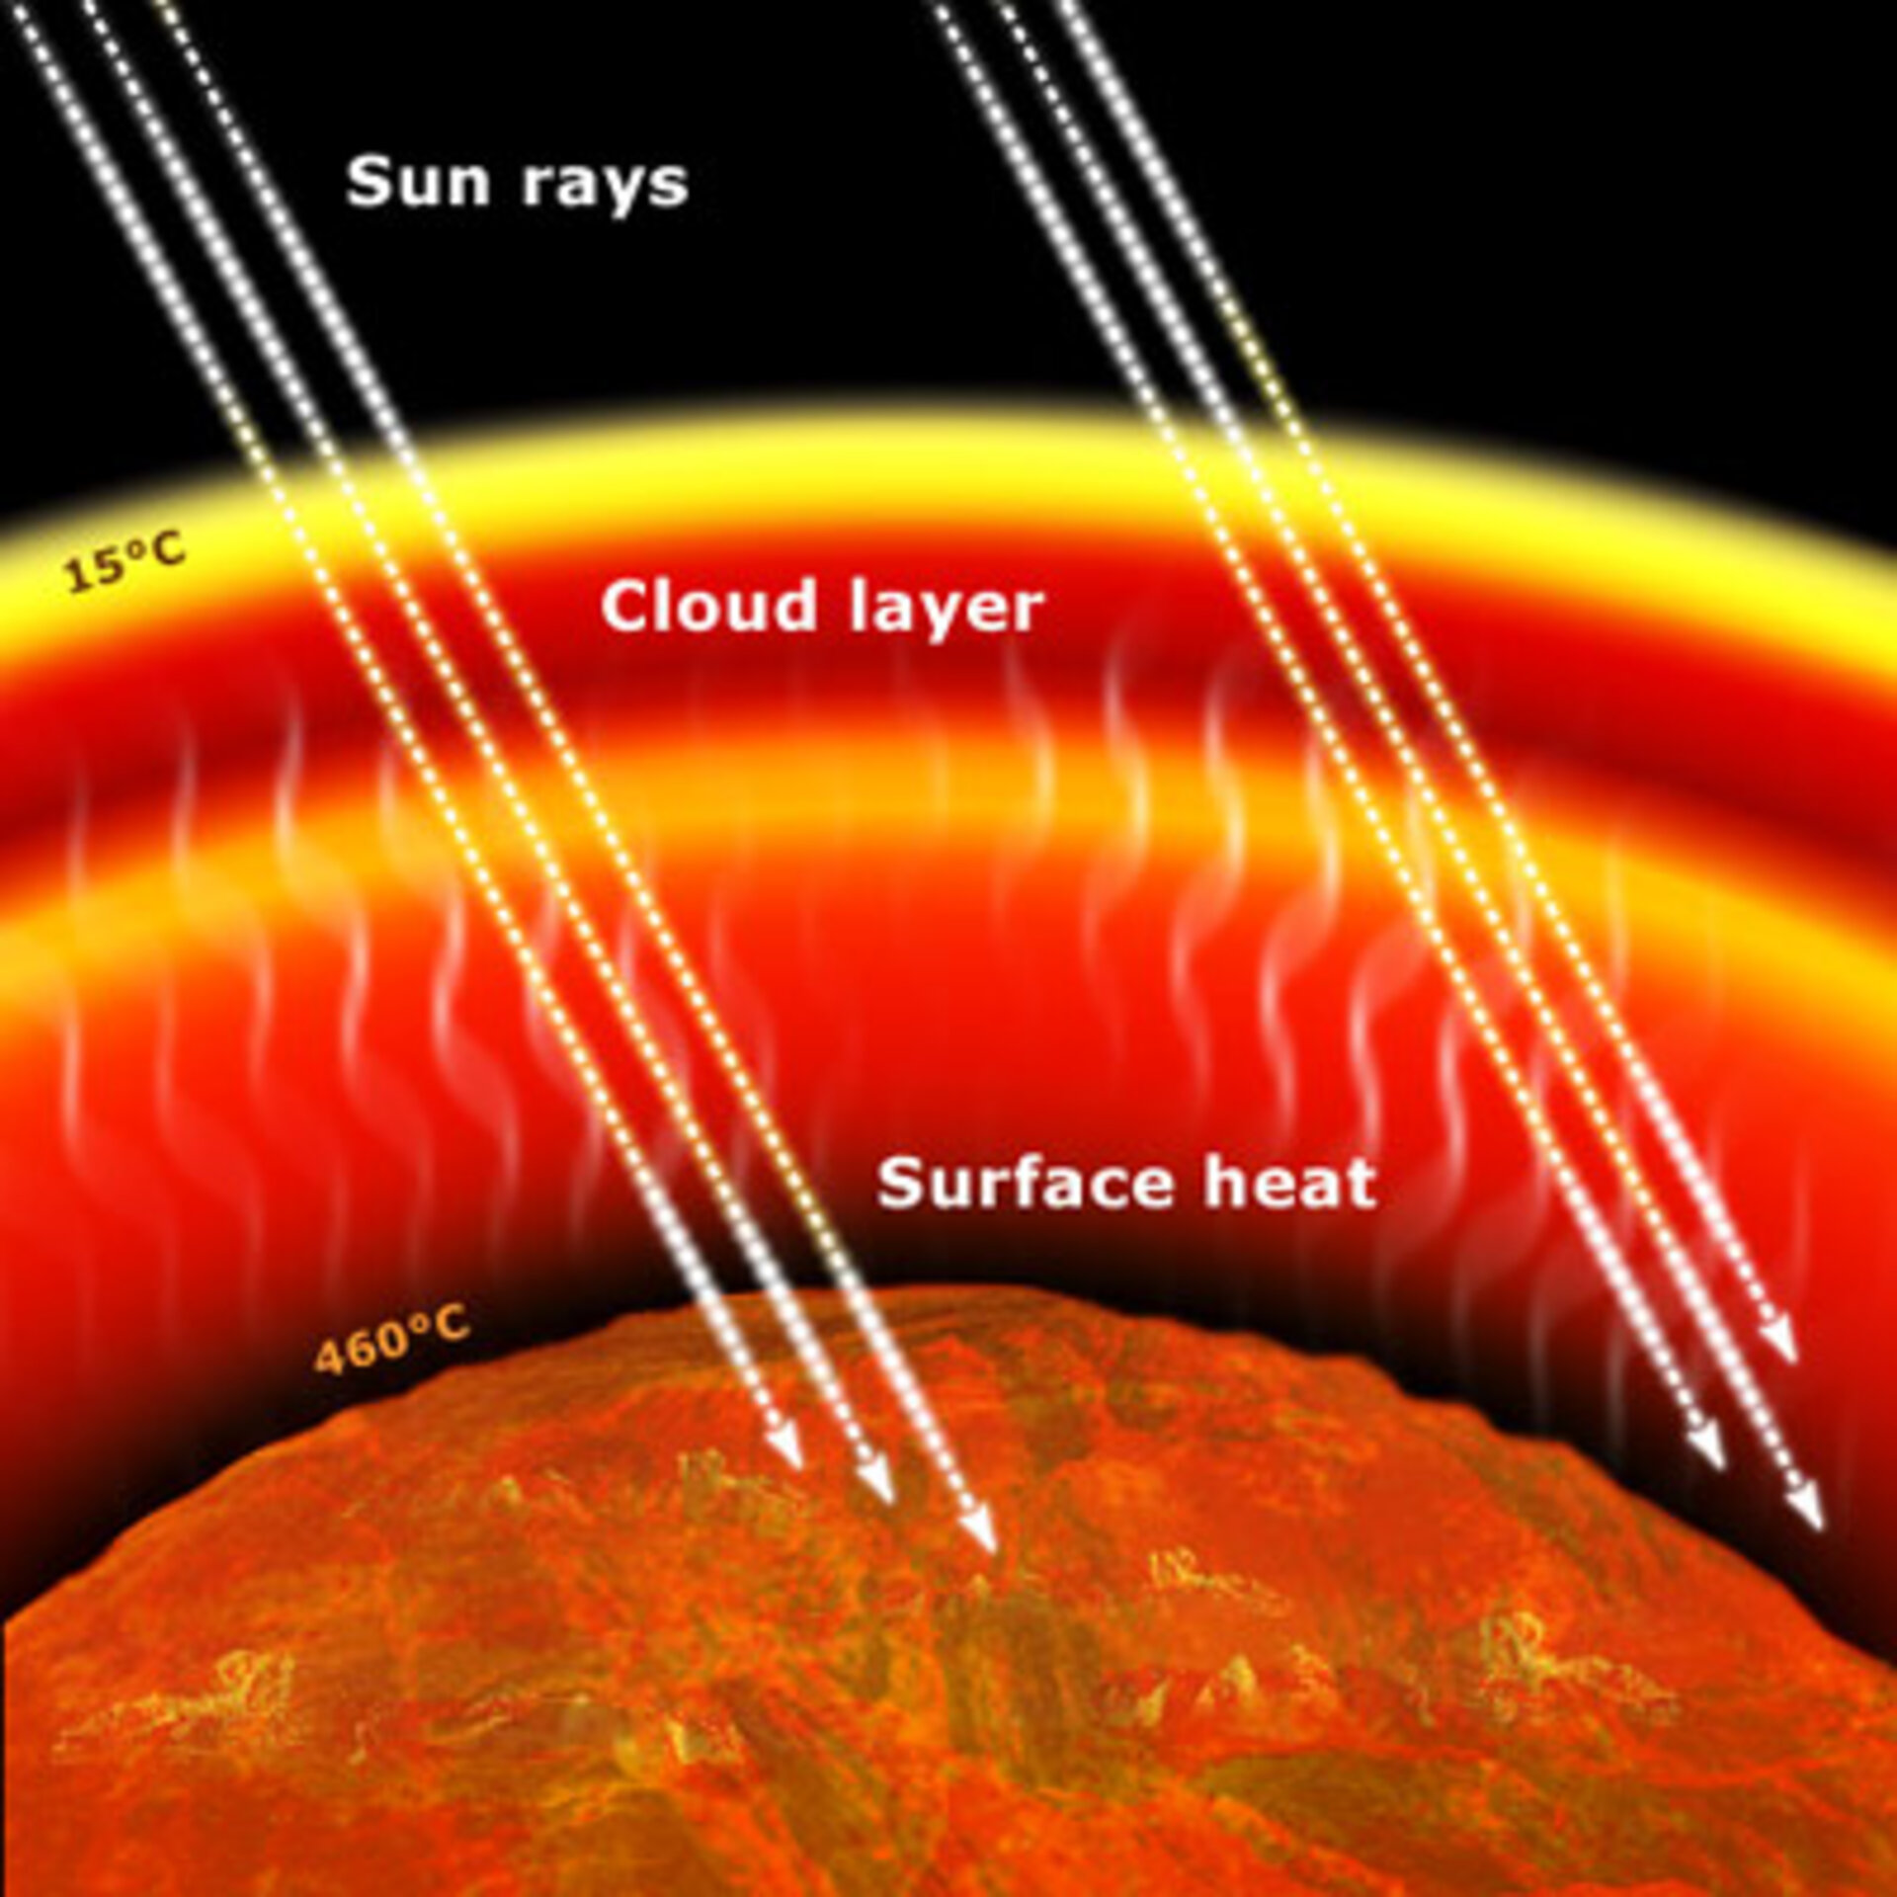
Venus
Atmosphere is 96.5% CO₂
90 times thicker than Earth’s
Runaway Greenhouse Effect
460°C

Slide 14
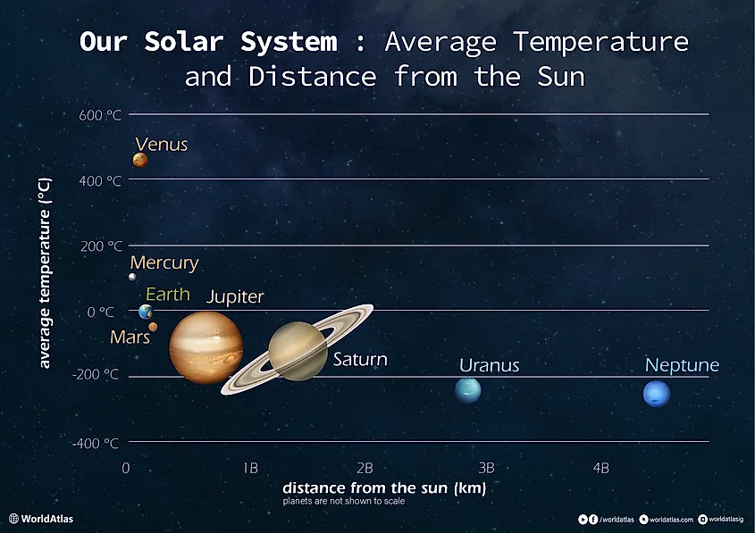

Slide 15
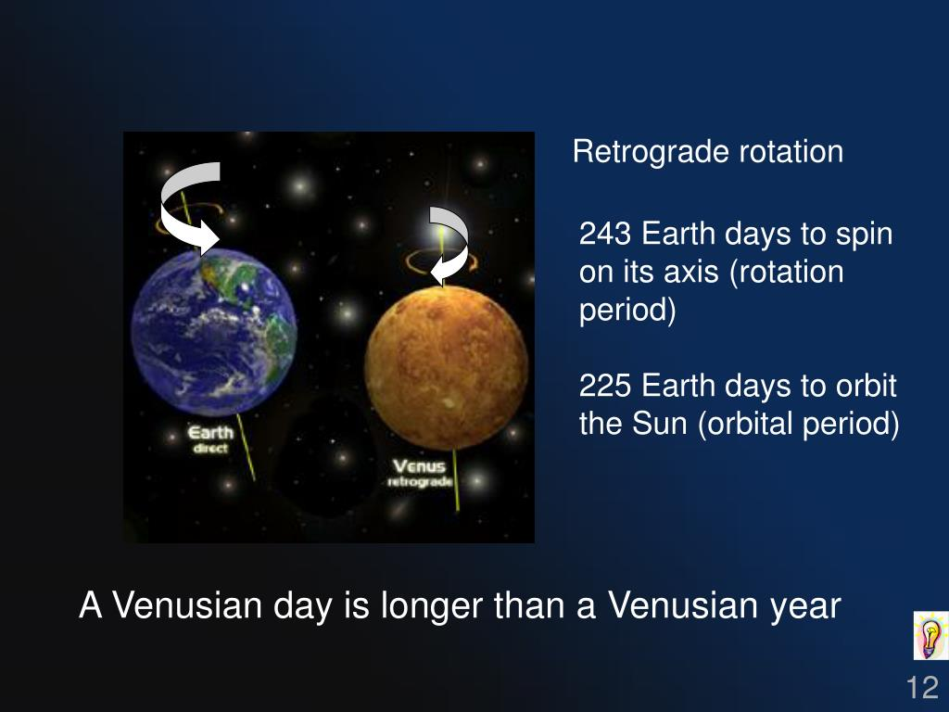

Slide 16
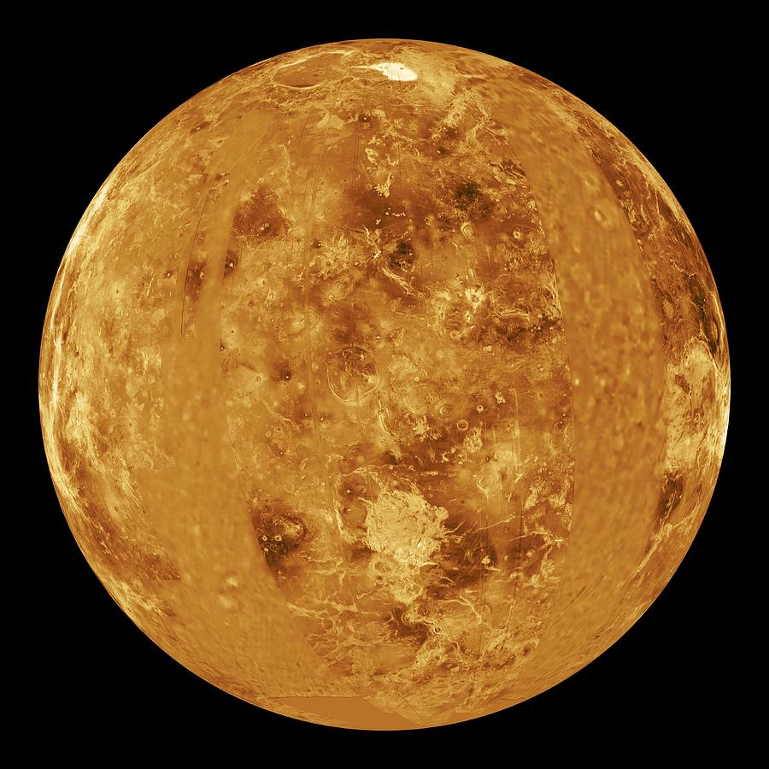
Venus
Surface Radar Map

Slide 17
Transit of Venus
05 – 06 June 2012
https://youtu.be/jJ1CuczGwvk

Slide 18
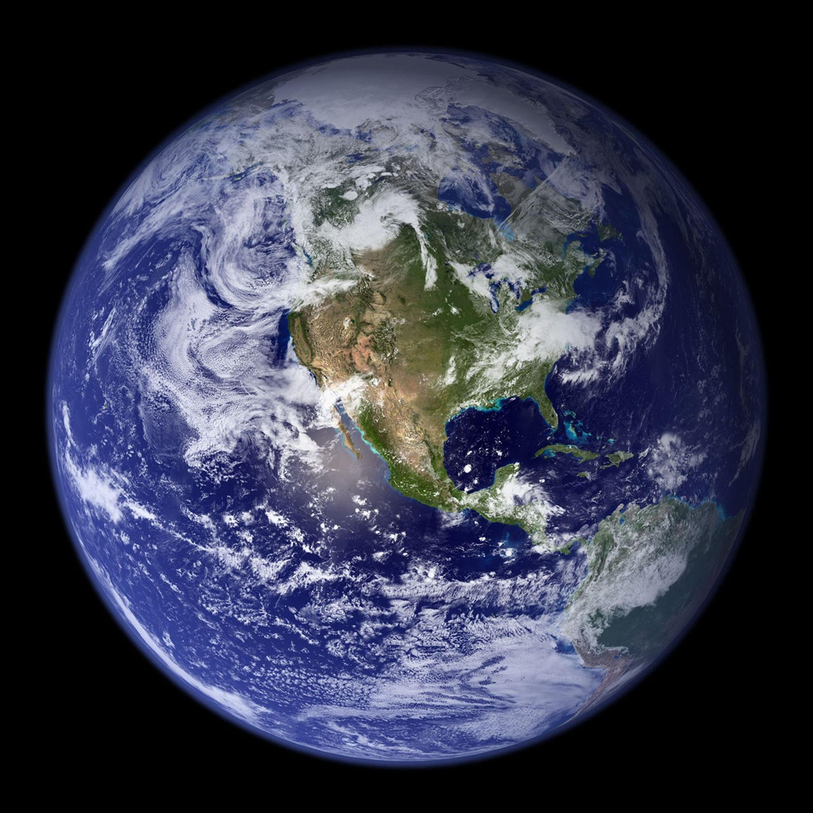
Earth
The Blue Marble

Slide 19
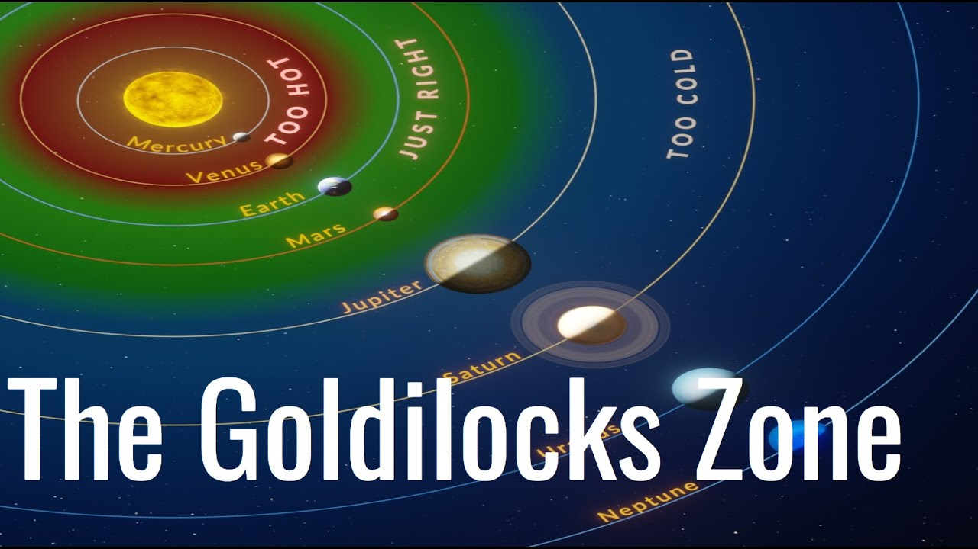

Slide 20
Unique Features of Earth
Stable, liquid water – 70% of the surface, universal solvent
Nitrogen and oxygen atmosphere – protects the surface
Located in the habitable zone – temperatures that allow for life
Active plate tectonics – cycles and regulates carbon and nutrients
Strong magnetic field – shields against solar wind
Stabilizing Moon – prevents drastic climate shifts, generates tides

Slide 21
Life on Earth began approximately 3.5 to 4 billion years ago, likely through abiogenesis, where non-living organic compounds transformed into self-replicating molecular systems.
The RNA World Hypothesis
Deep-Sea Hydrothermal Vents
Chemical Evolution
Alternative Theory (Panspermia)

Slide 22
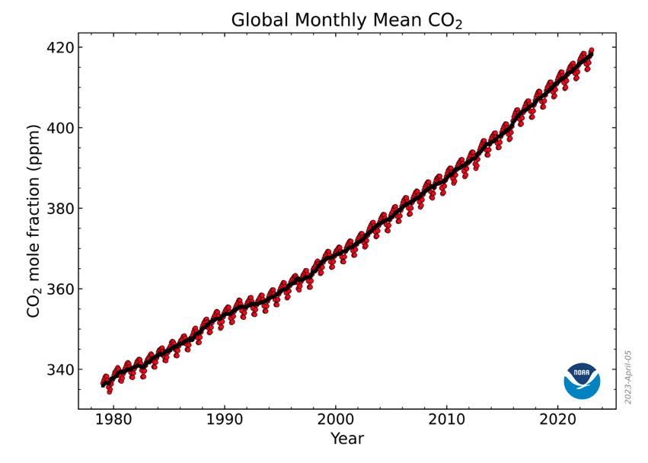
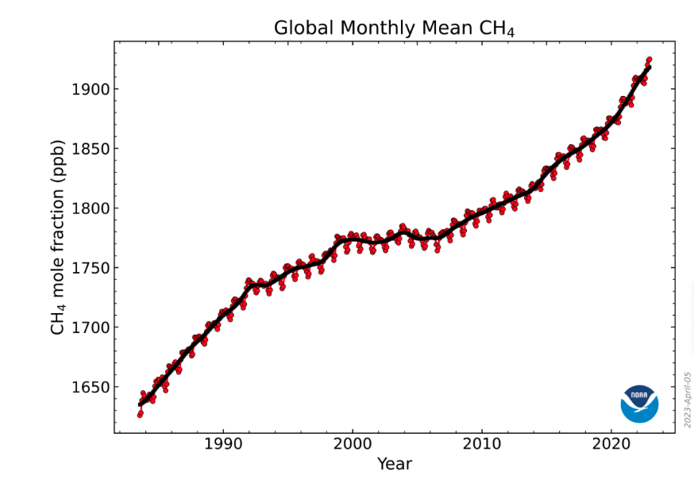

Slide 23
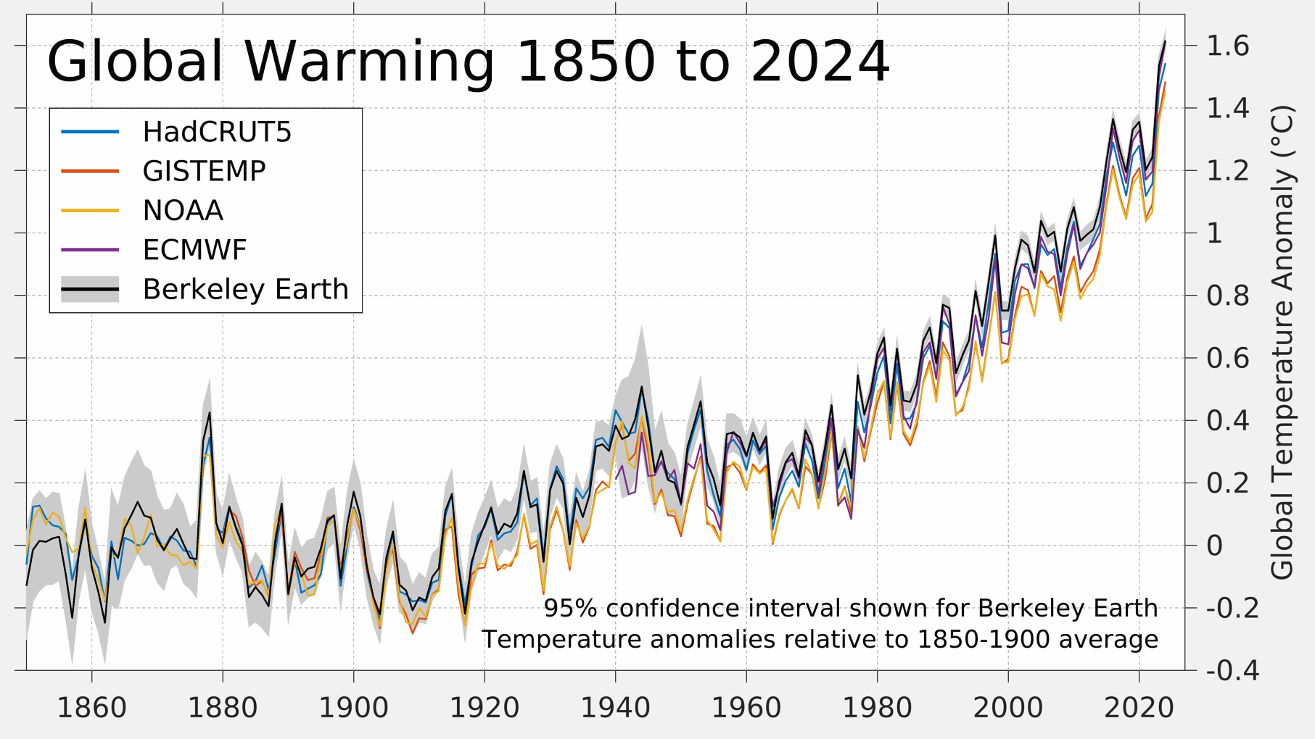

Slide 24
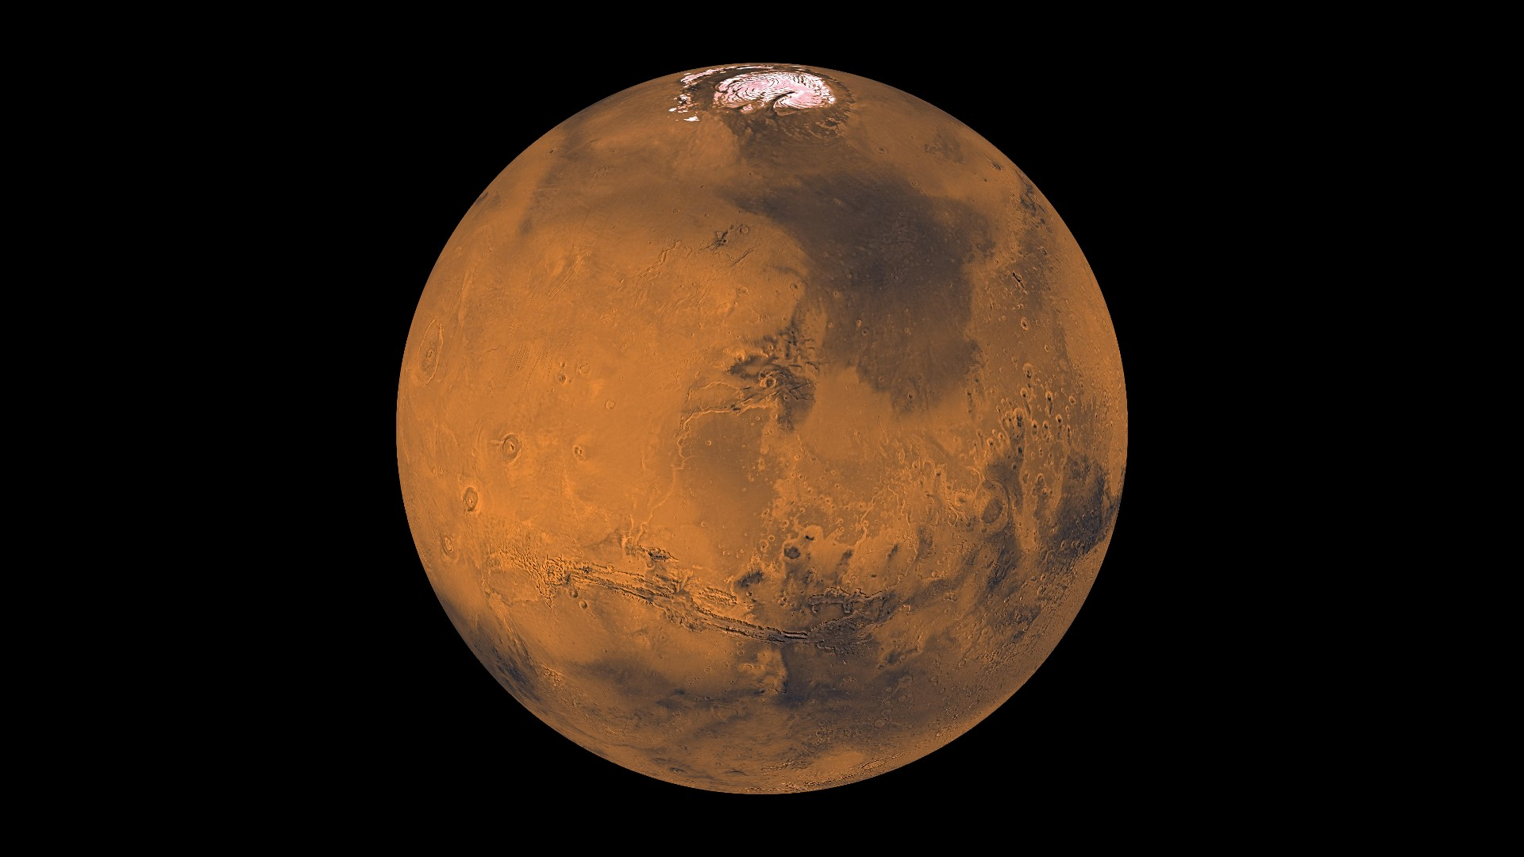
Mars

Slide 25
Mars is red because its surface is covered in a layer of iron oxide, commonly known as rust. While scientists have long attributed this to a mineral called hematite, recent 2025 research suggests the primary culprit is actually ferrihydrite, a water-rich iron mineral
Oxidization: Billions of years ago, iron in Martian rocks reacted with water and oxygen (or other oxidants like hydrogen peroxide) to form rust.
Erosion and Distribution: Over time, these rusted rocks were ground into fine dust by environmental forces.
Global Coverage: Massive dust storms spread this fine reddish dust across the entire planet, coating the darker, grayish volcanic rock beneath it.
Atmospheric Tint: This same dust remains suspended in the thin atmosphere, causing the Martian sky to also appear reddish or butterscotch-colored from the surface.
Beneath this thin oxidized layer, which is sometimes only a few centimeters deep, the actual rock of Mars is often a dark brown or gray.

Slide 26
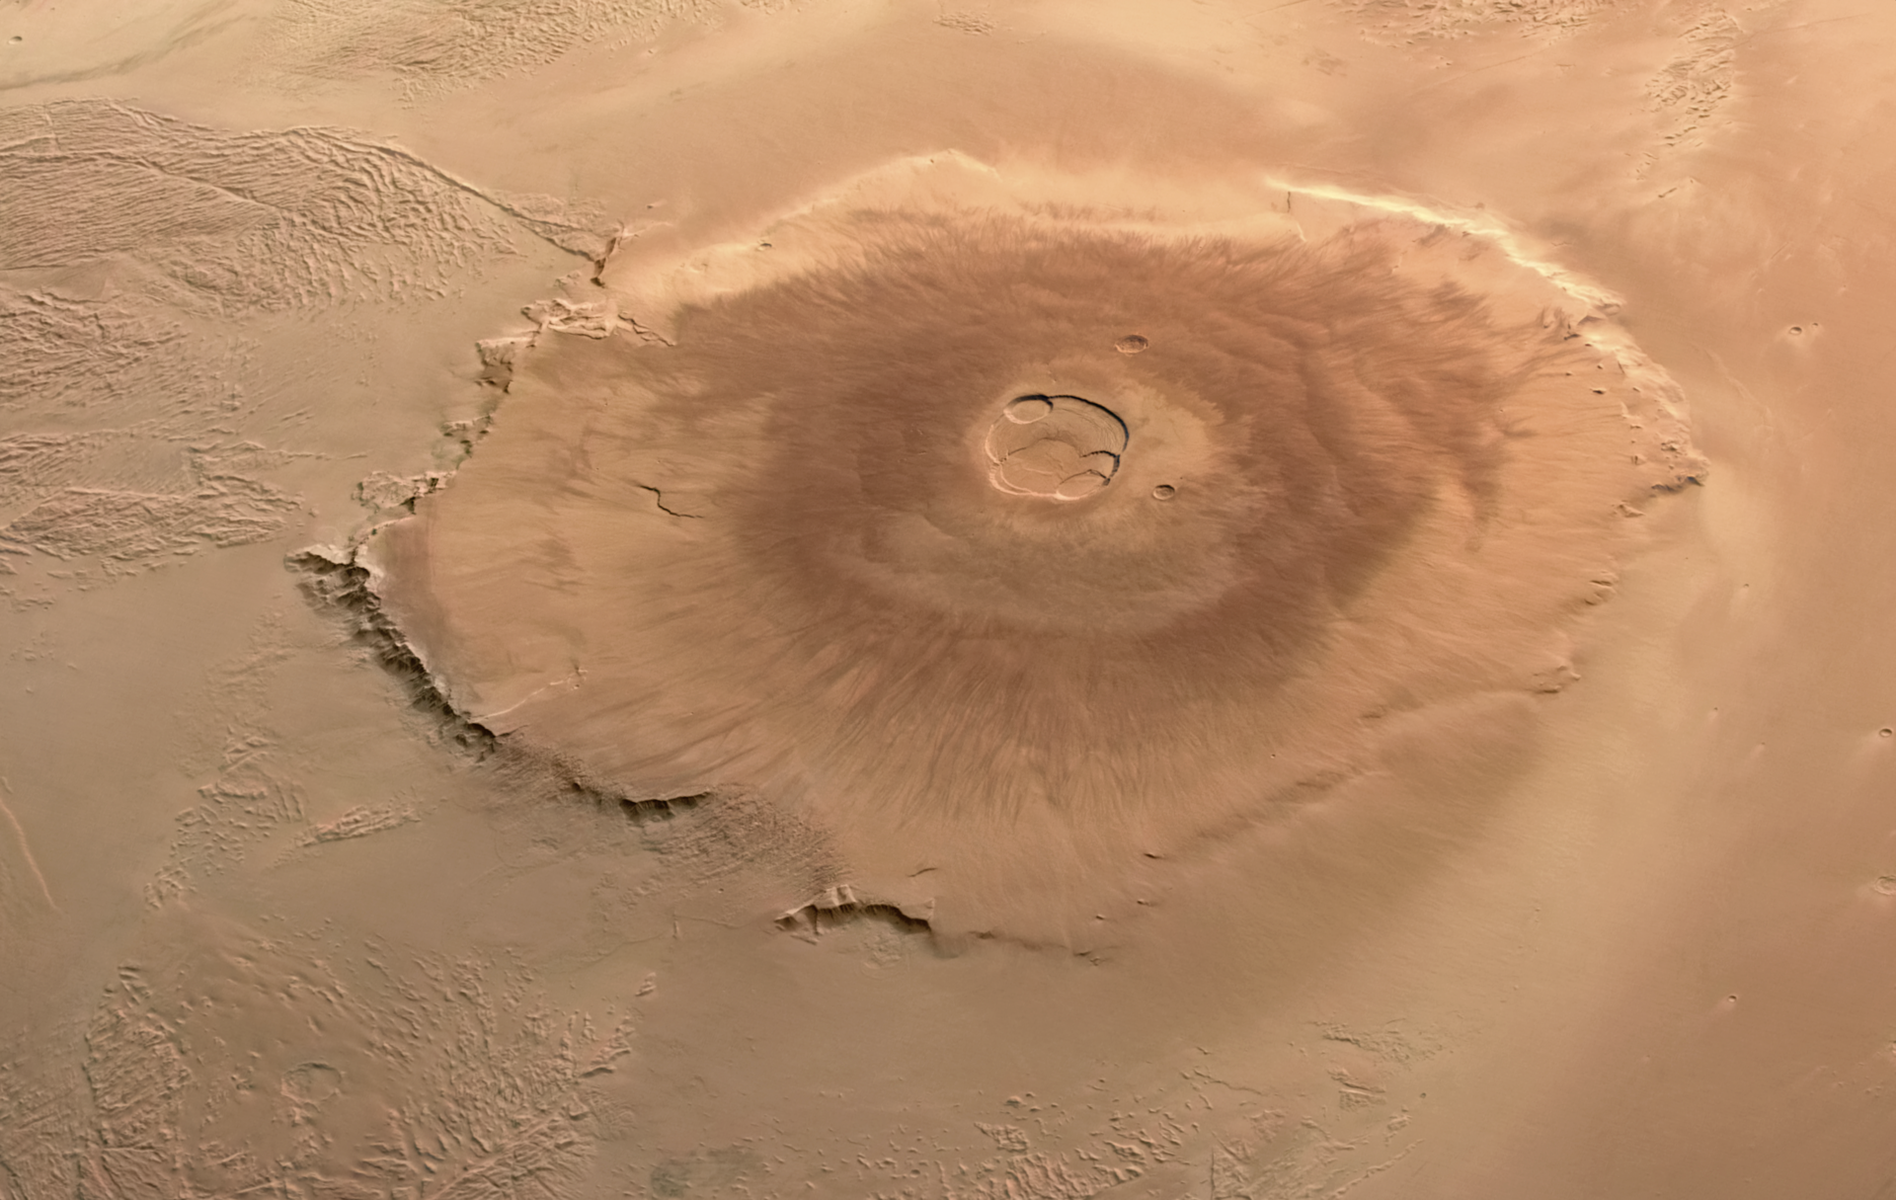
Olympus Mons

Slide 27
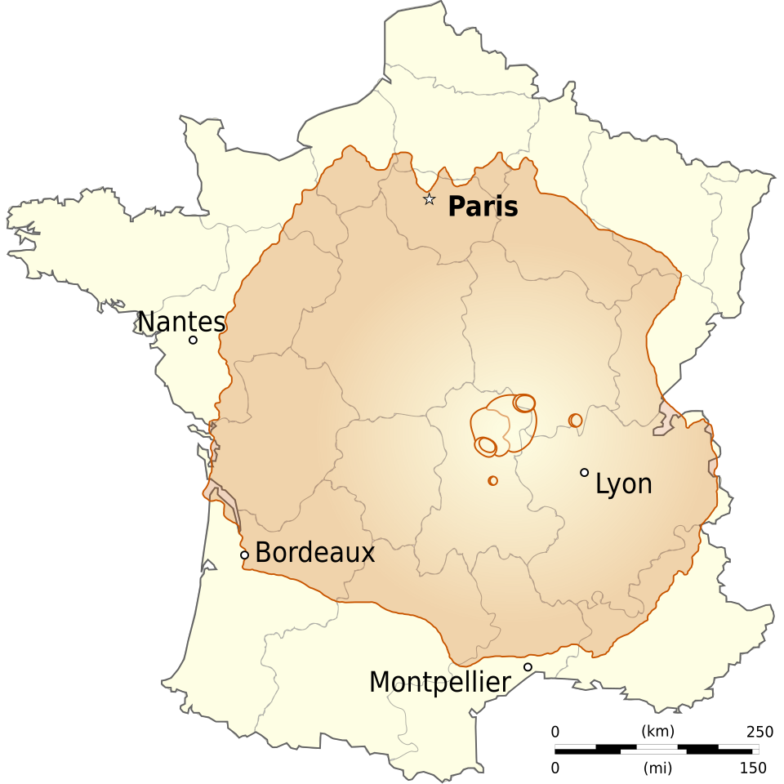

Slide 28
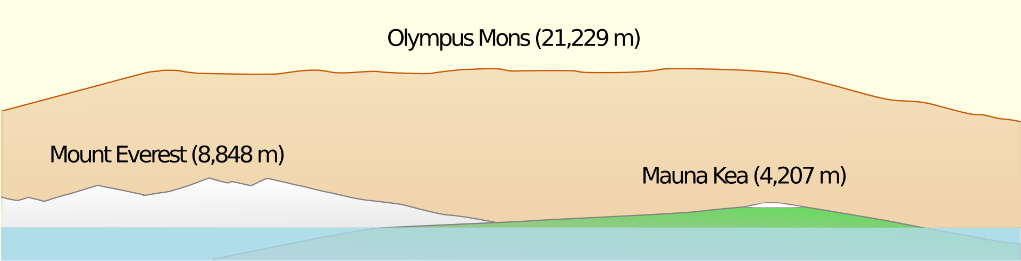

Slide 29
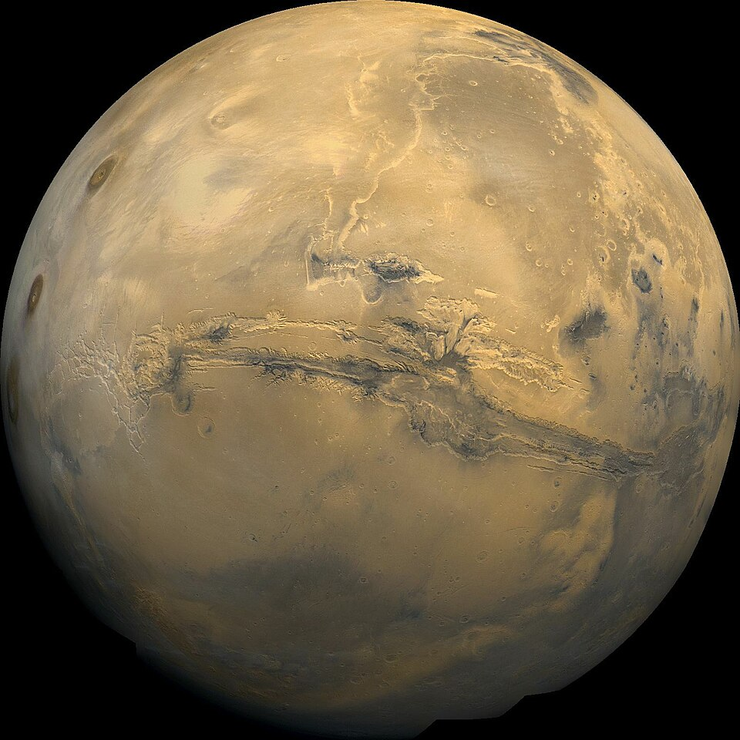
Valles Marineris

Slide 30
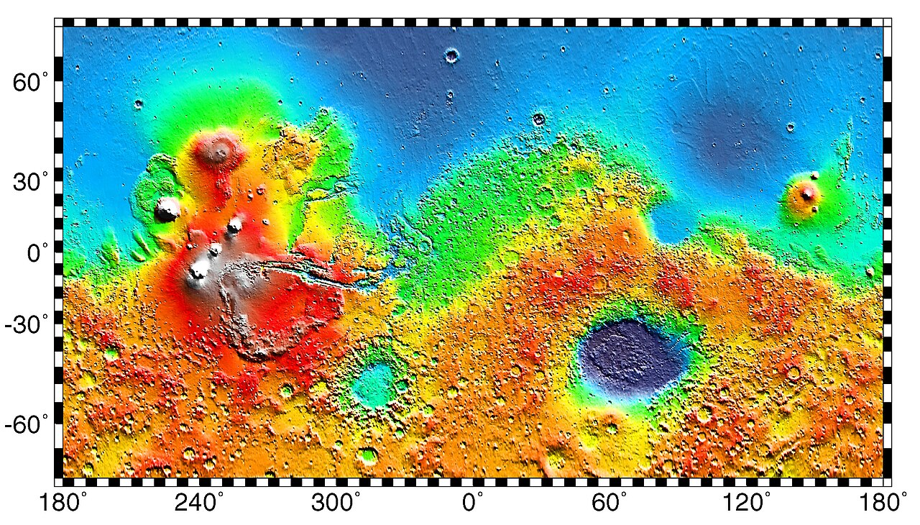

Slide 31
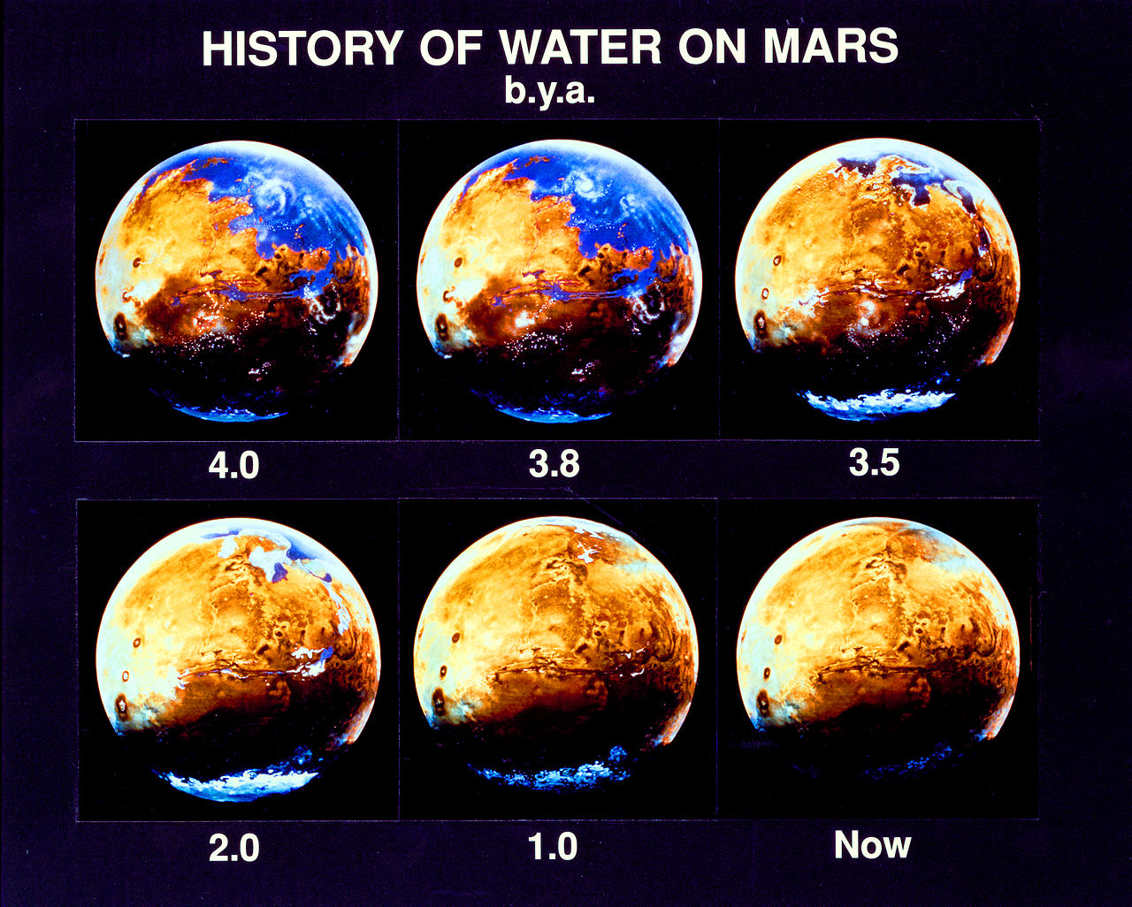

Slide 32
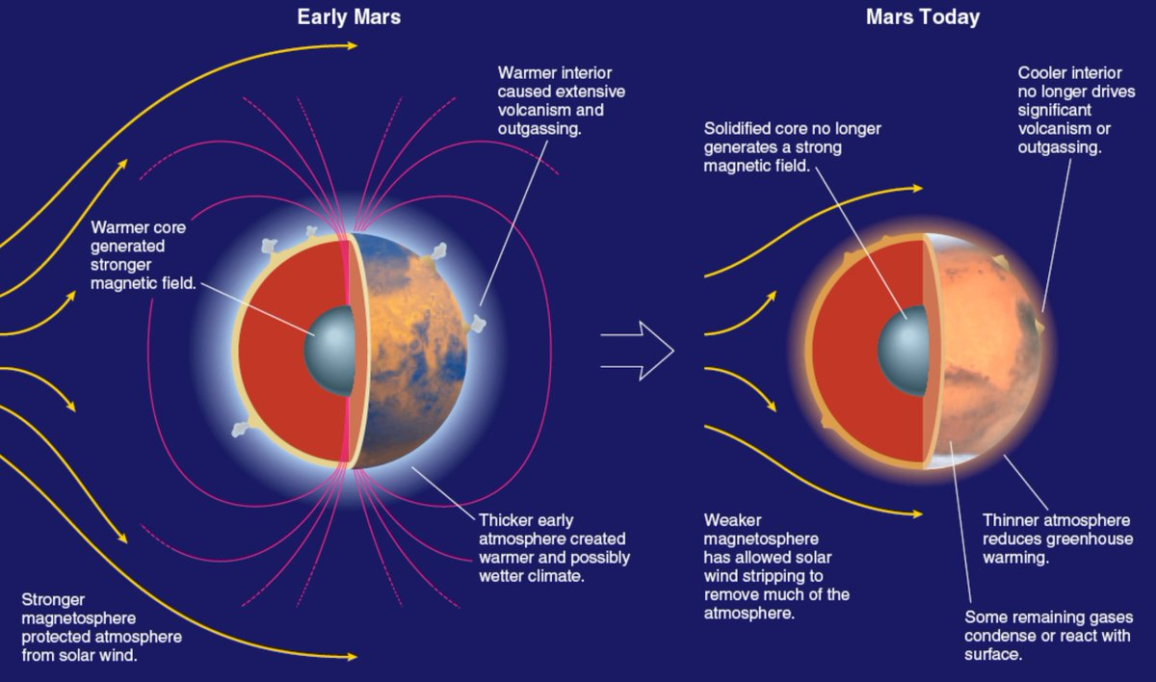

Slide 33
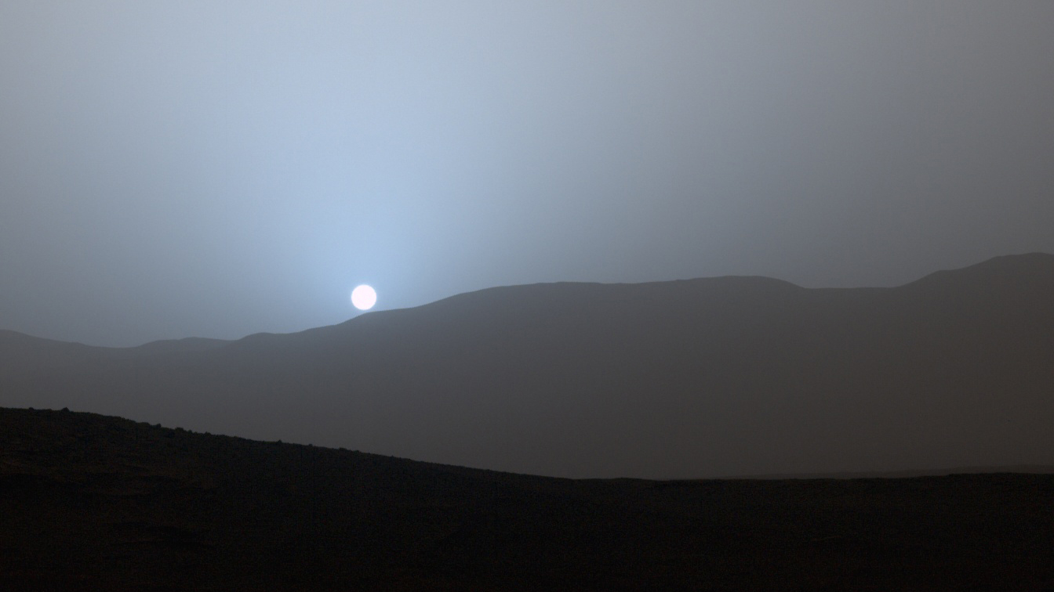
Sunsets on Mars are BLUE!

Slide 34
Mars Rovers
Prop-M 02 Decmber 1971 ???
Sojourner 04 July 1997 27 September 1997
Spirit 04 January 2004 22 March 2010
Opportunity 25 January 2004 13 February 2019
Curiosity 06 August 2012 active
Perseverence 18 February 2021 active
Ingenuity 18 February 2021 18 January 2024
Zhurong 15 May 2021 20 May 2022

Slide 35
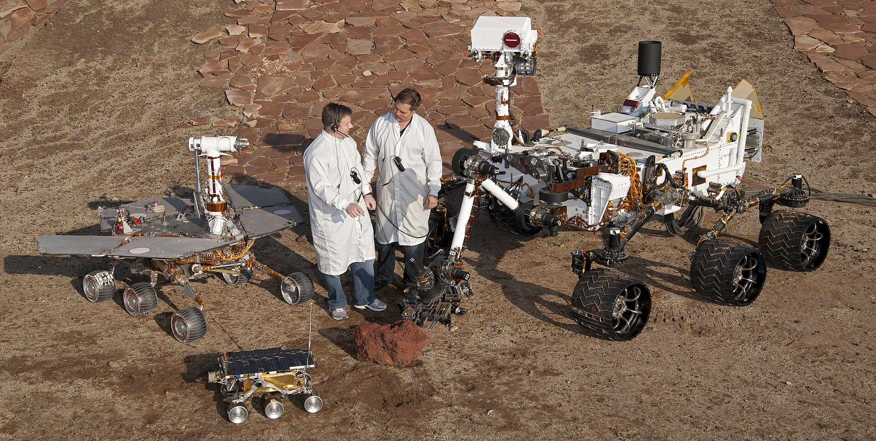
Mars Rovers
Sojourner
Spirit
Opportunity
Curiosity

Slide 36
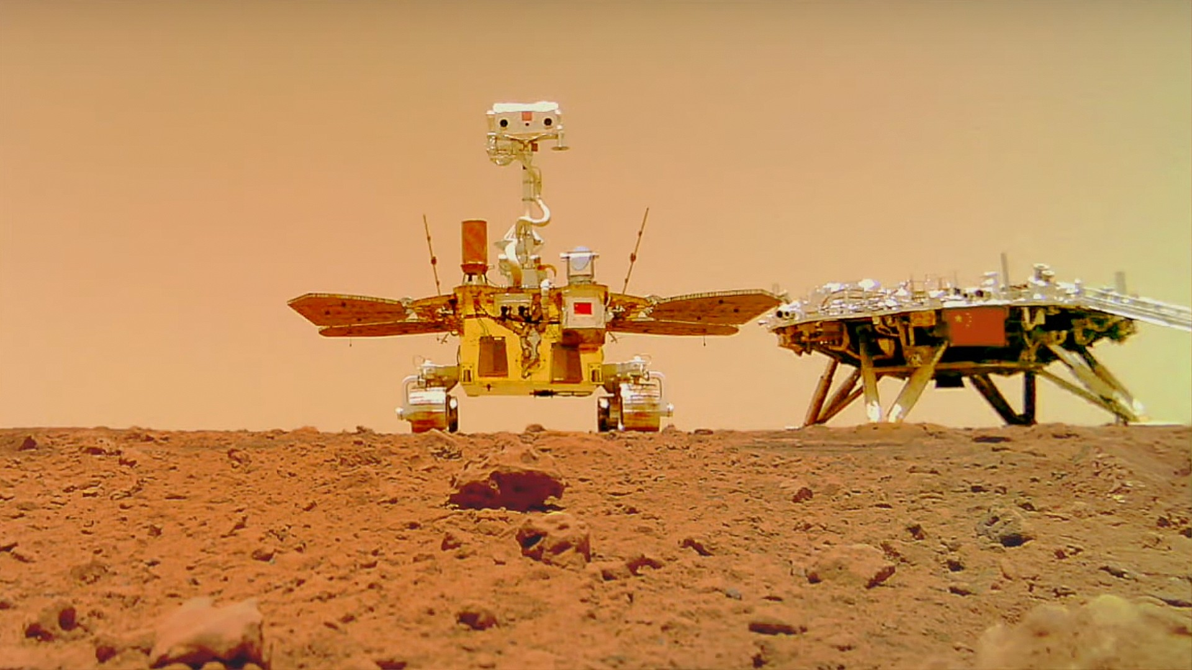
Mars Rover
Zhurong

Slide 37
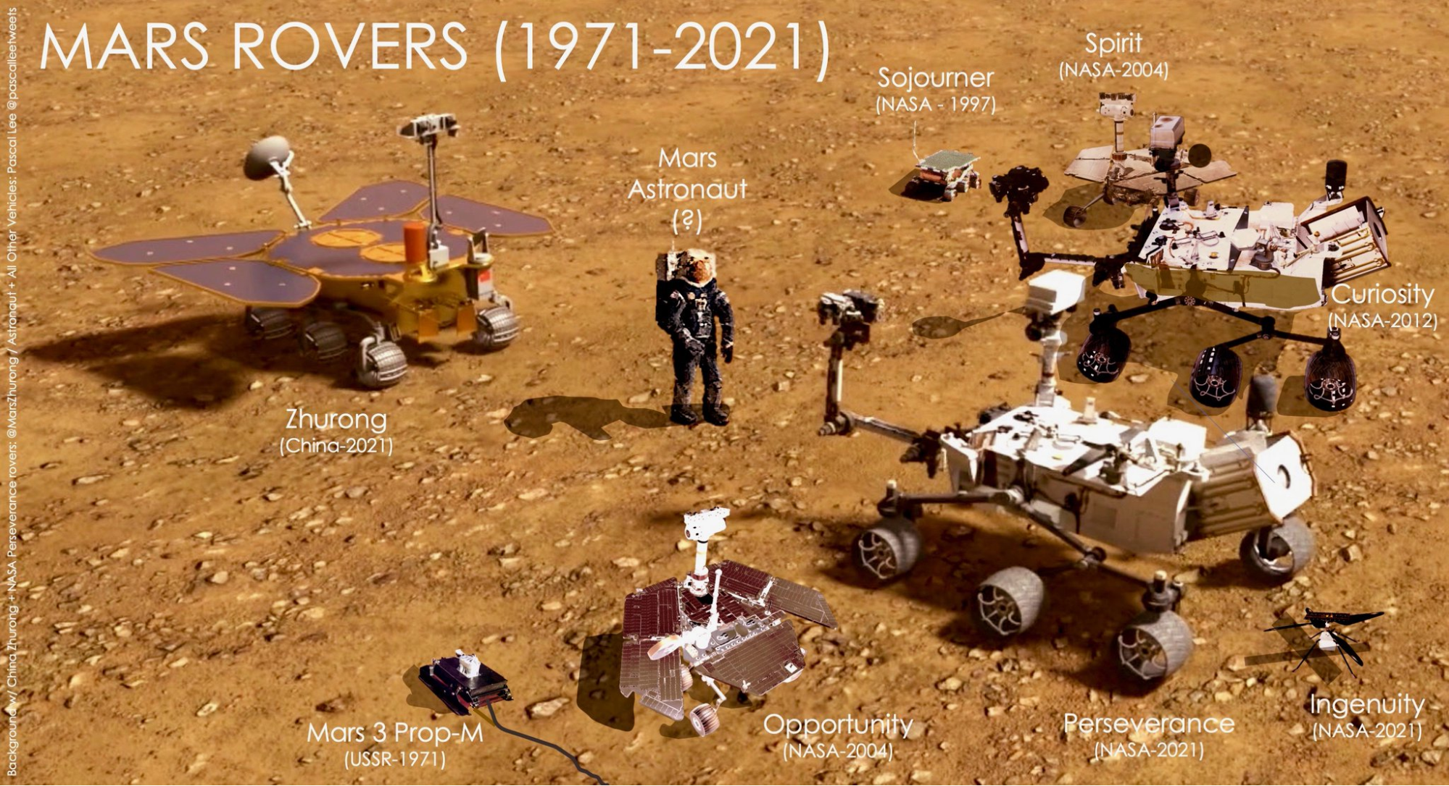

Slide 38
Active Solar System Probes
Mercury
BepiColombo – multiple flybys; orbital insertions 21 November 2026
Venus
Solar Orbiter – December 2026, flyby, en route
Earth
OSIRIS-APEX – 17 March 2027, flyby, en route
OSIRIS-APEX –13 April 2029, flyby, en route
Mars
2001 Mars Odyssey – orbiter
Mars Express – orbiter
Mars Reconnaissance Orbiter – orbiter
Mars Science Laboratory, Curiosity – rover
MAVEN – orbiter
ExoMars Trace Gas Orbiter – orbiter
Emirates Mars Mission – orbiter
Tianwen-1 – orbiter
Mars 2020, Perseverance – rover
Psyche – flyby, en route
ESCAPADE Blue – orbiter, en route
ESCAPADE Gold – orbiter, en route

Slide 39
Comparative Summary
Feature | Mercury | Venus | Earth | Mars
Primary Surface Age | 4 Billion Years (Old) | 500 Million Years (Resurfaced) | < 100 Million Years (New) | 3-4 Billion Years (Old)
Main "Weather" | Micrometeorites | Acid Rain / Heat | Water / Wind | Dust Storms
Magnetic Field | Weak / Global | None | Strong / Global | Localized "Crustal" Fields
Atmosphere | None | Thick | Nitrogen/Oxygen | Thin
Surface Pressure | 0 | 92X Earth | 1X Earth | 0.01X Earth
Main Characteristic | Extreme Temperature Swings | Hottest Surface | Liquid Water / Life | Ancient Volcanism
A

