Slide 1
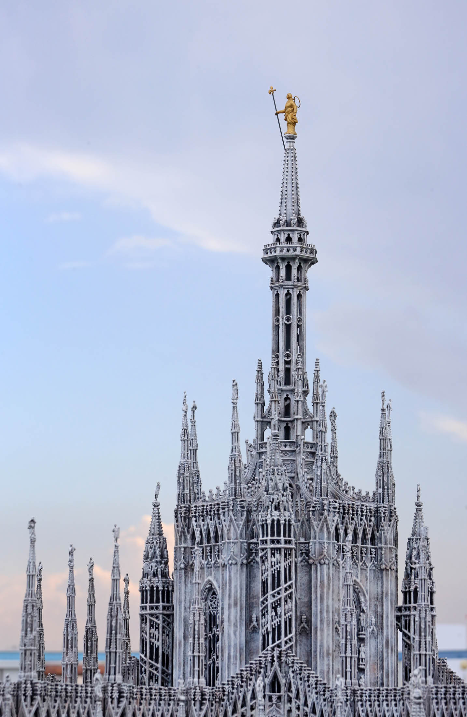
Giovanni Antonio Amadeo & Gian Giacomo Dolcebuono, tiburio,
Duomo di Milano,
1500

Slide 2
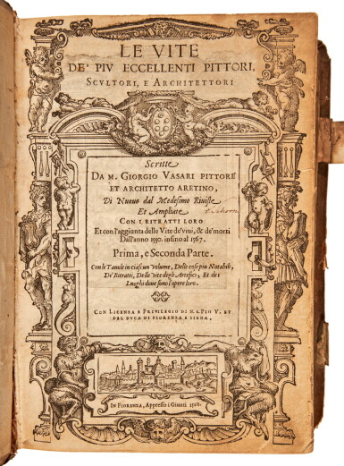

Slide 3
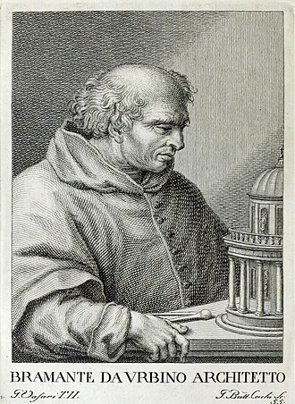
Donato Bramante, 1444-1514

Slide 4
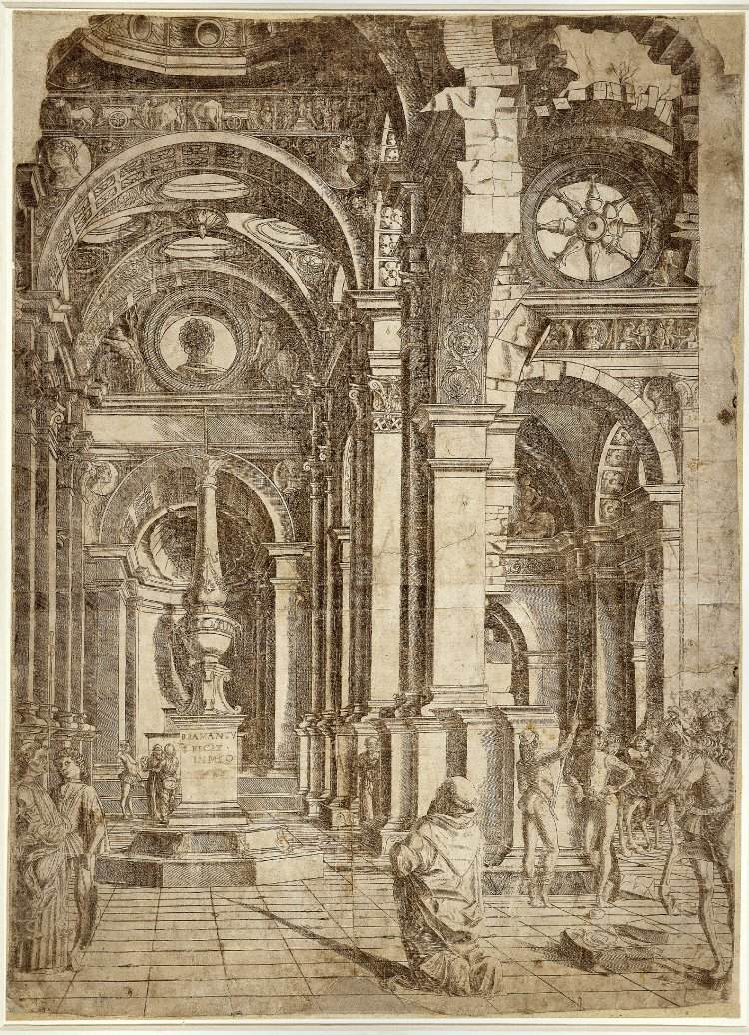
Bramante,
Interior of a Church,
1481

Slide 5
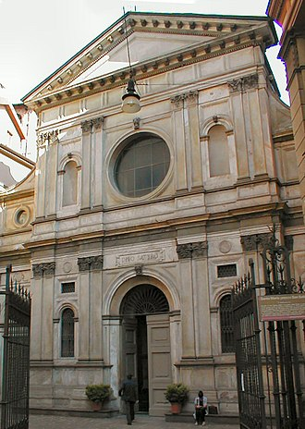
Santa Maria presso San Satiro,
Milano, late 15th C.

Slide 6
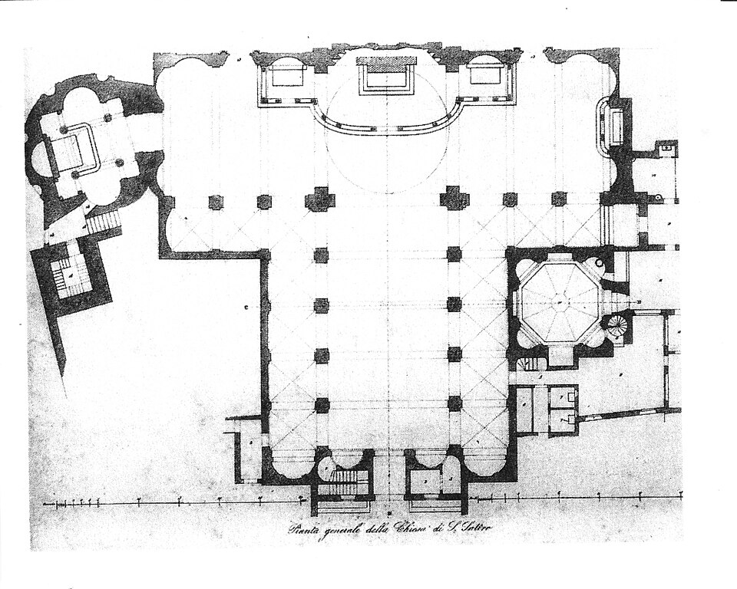

Slide 7
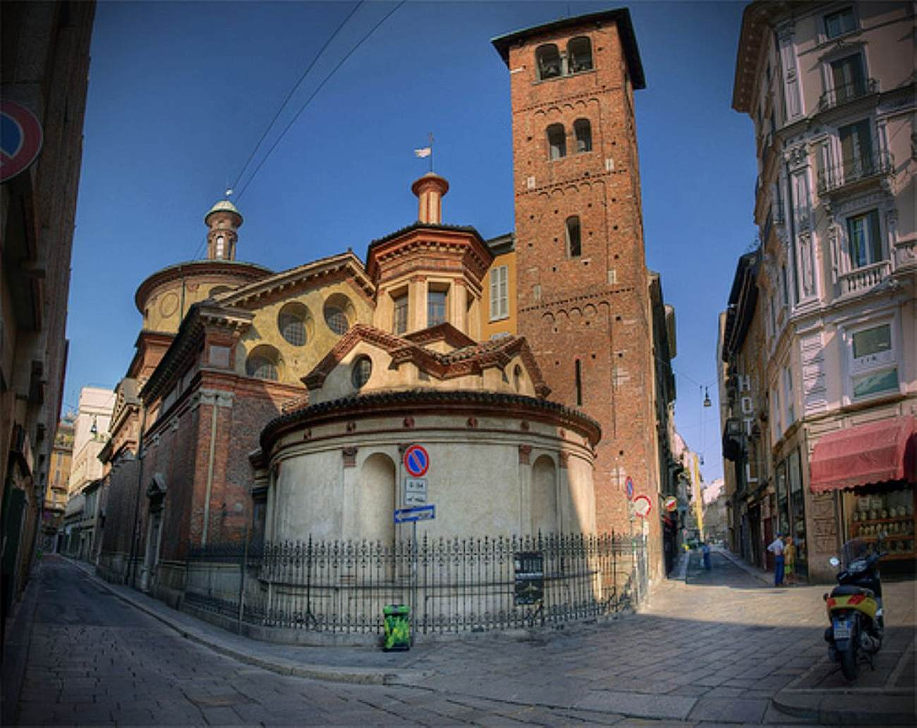
San Satiro, Sacello and tower

Slide 8
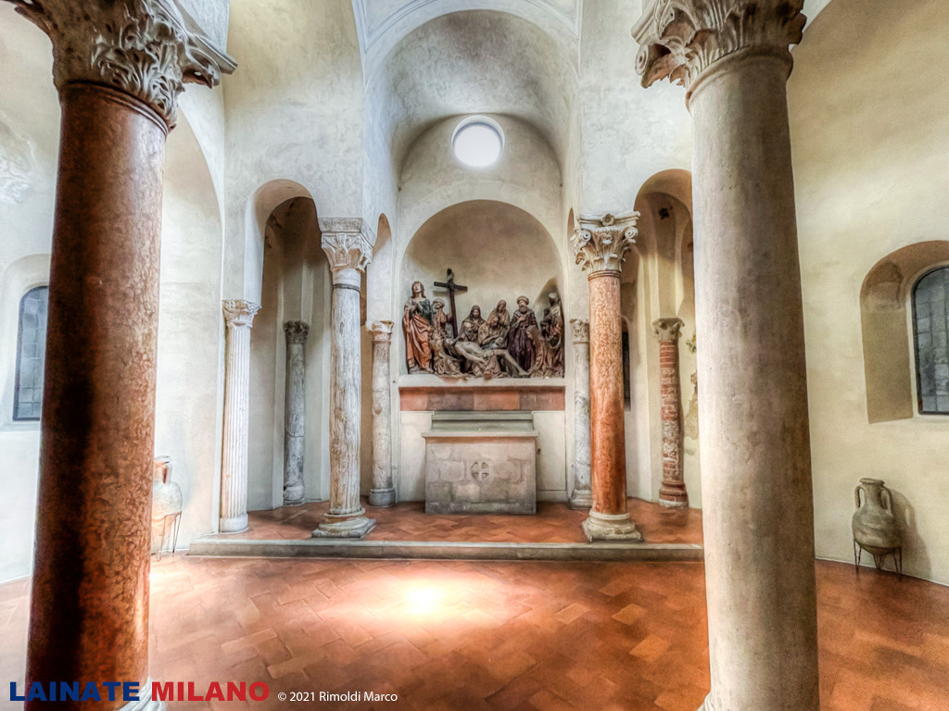

Slide 9
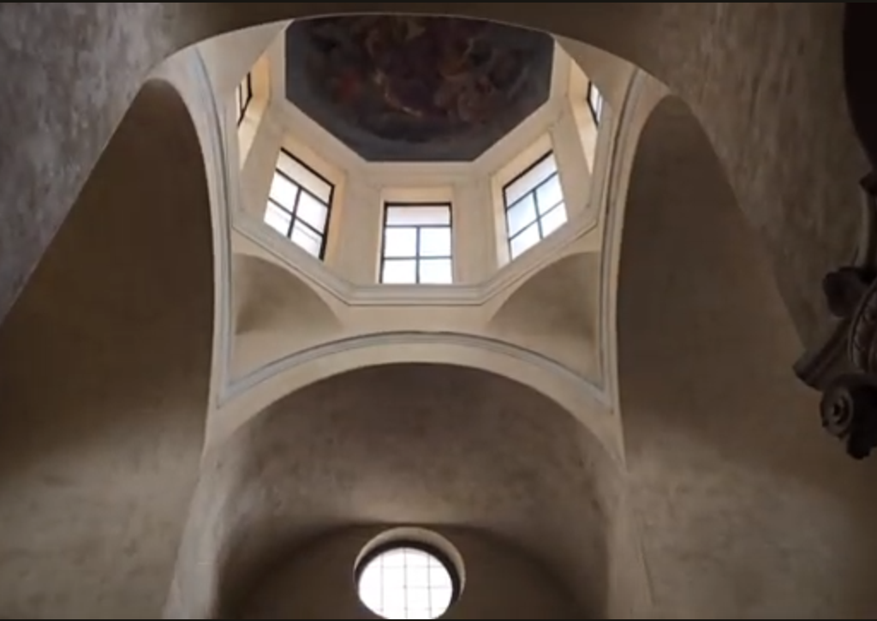

Slide 10
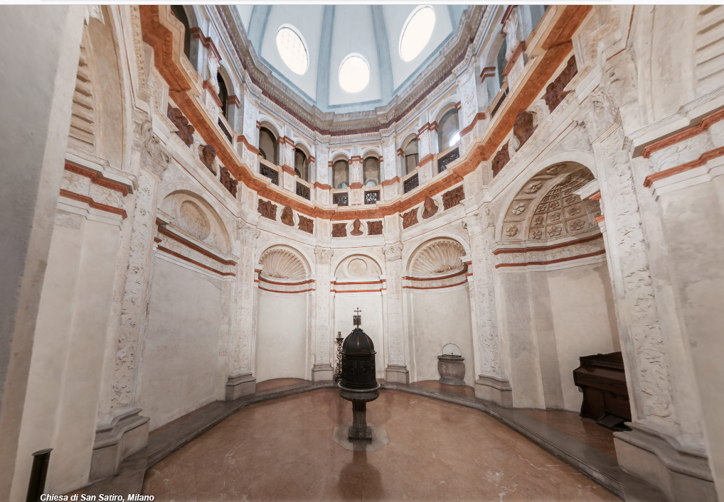
sacristy

Slide 12
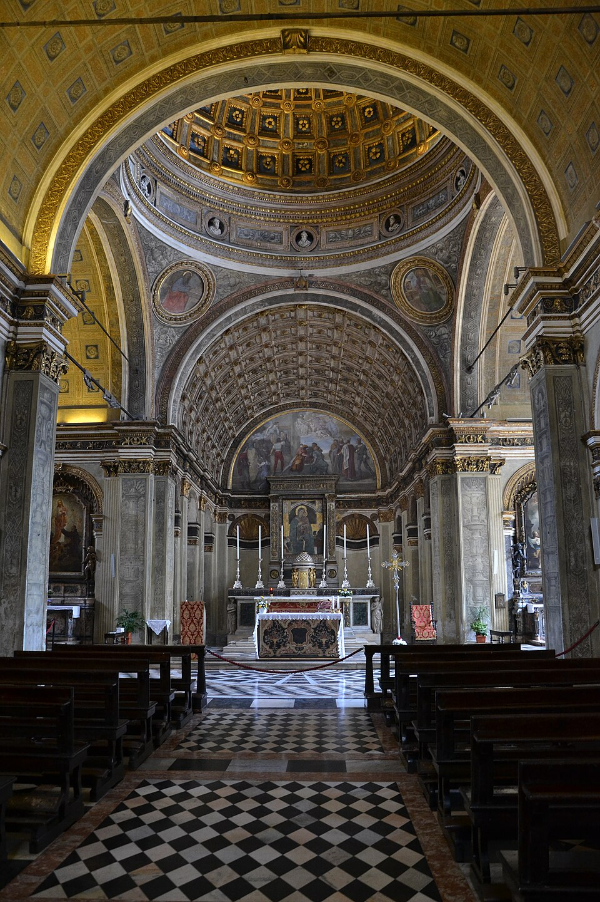

Slide 13
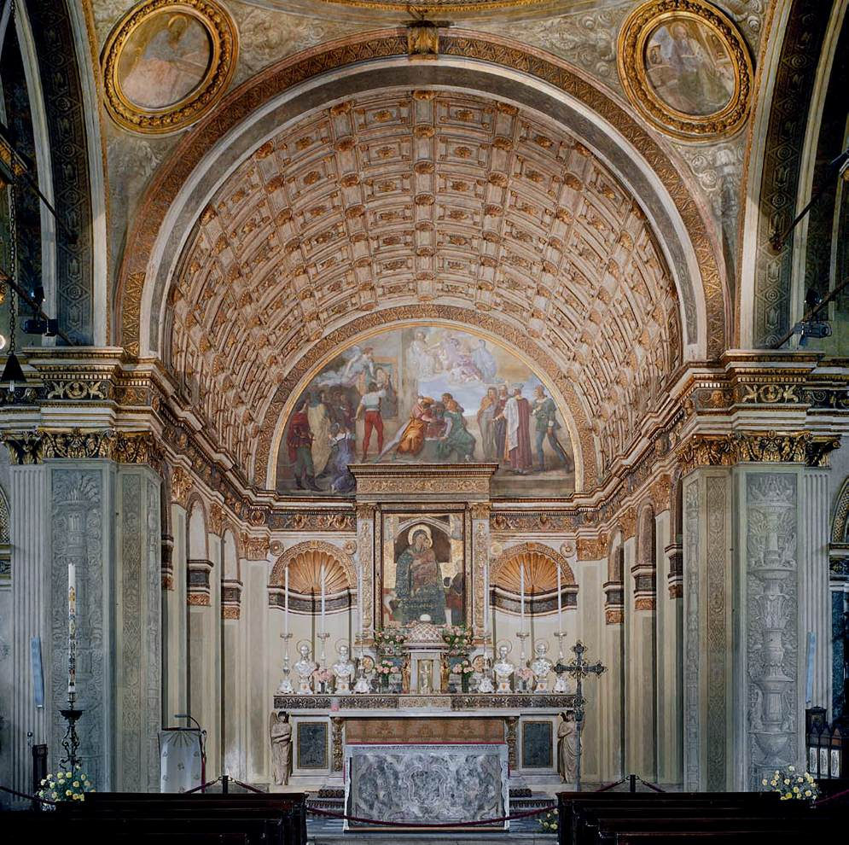

Slide 14
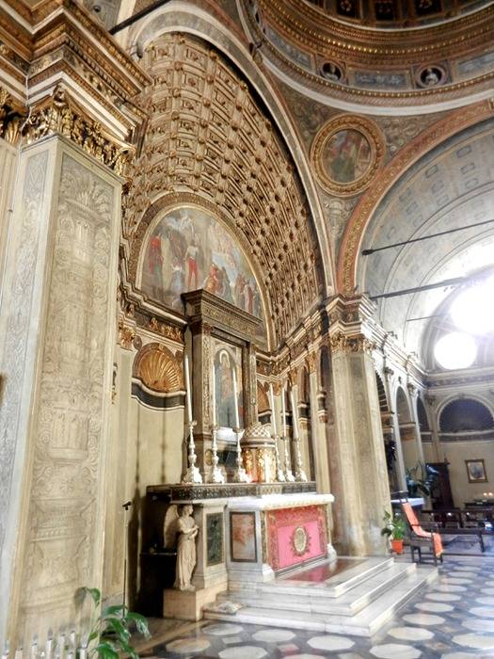

Slide 15
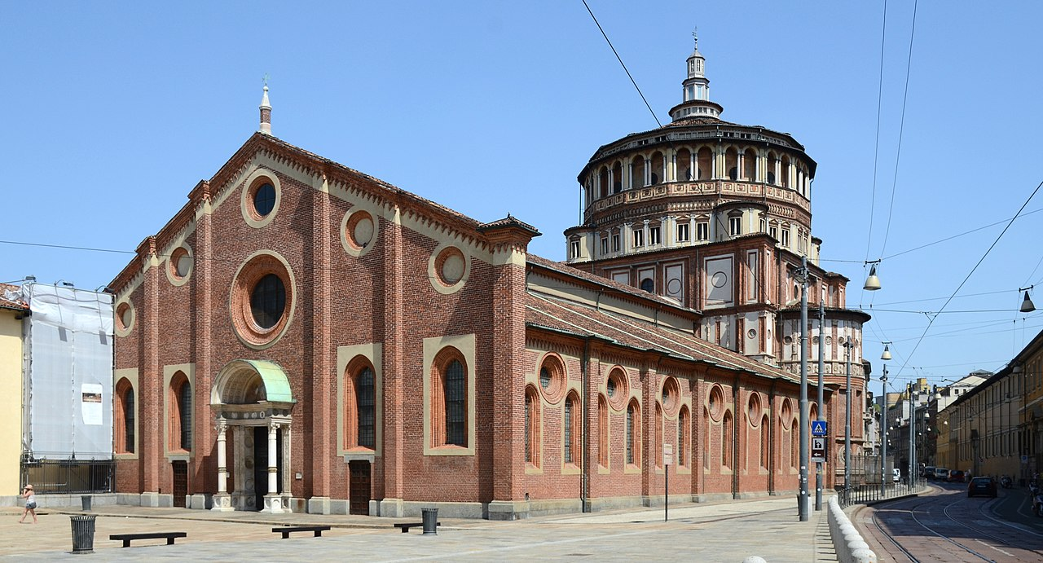
Santa Maria delle Grazie, Milan, c. 1492

Slide 16
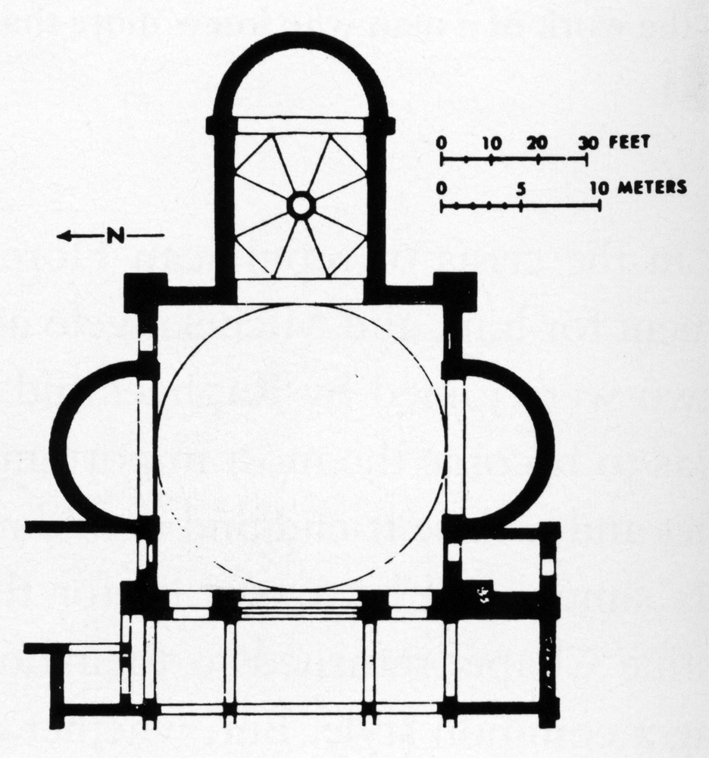

Slide 17
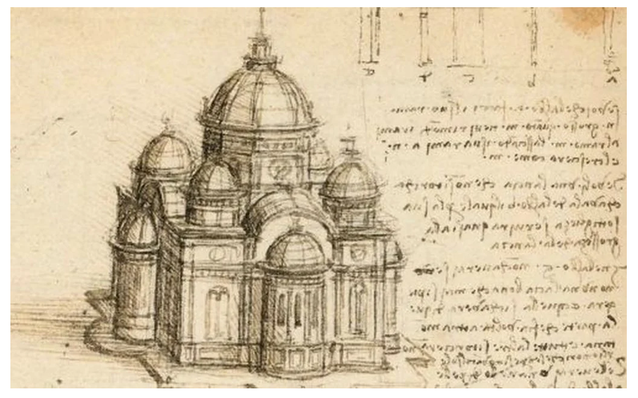
Leonardo da Vinci, Study for a building on a centralised plan, c. 1488

Slide 18
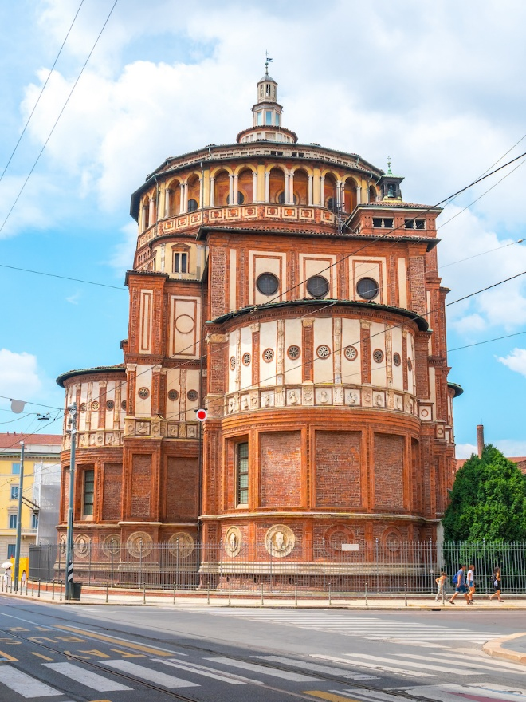

Slide 19
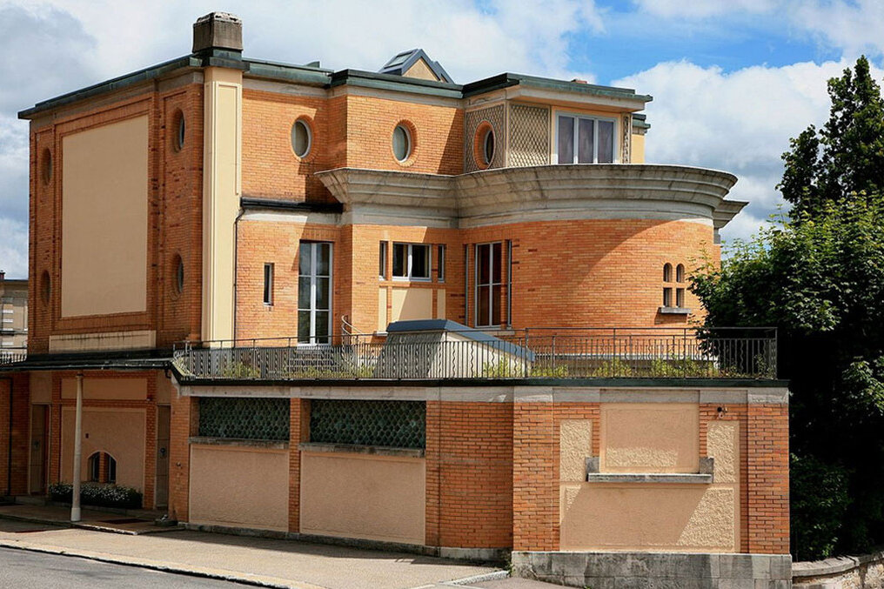
Le Corbusier, Villa Schwob, La Chaux-de-Fonds, 1917

Slide 21
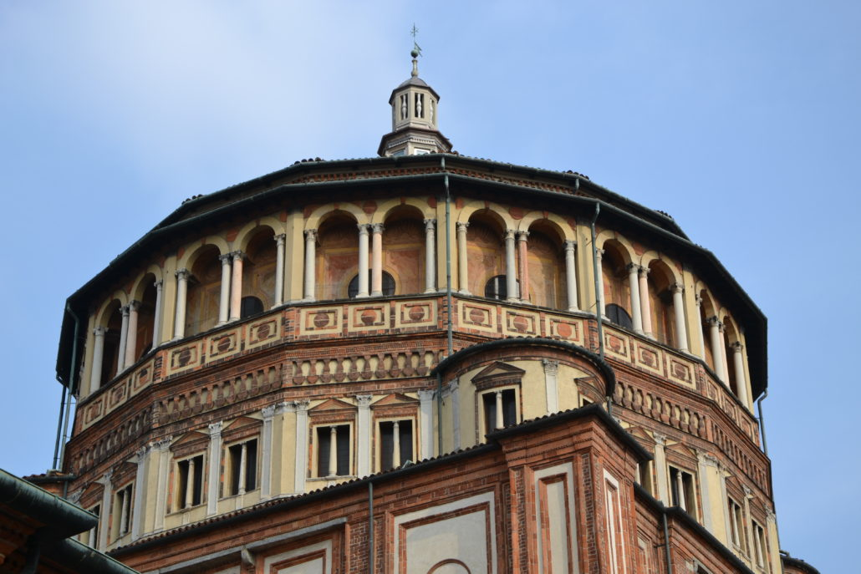

Slide 22
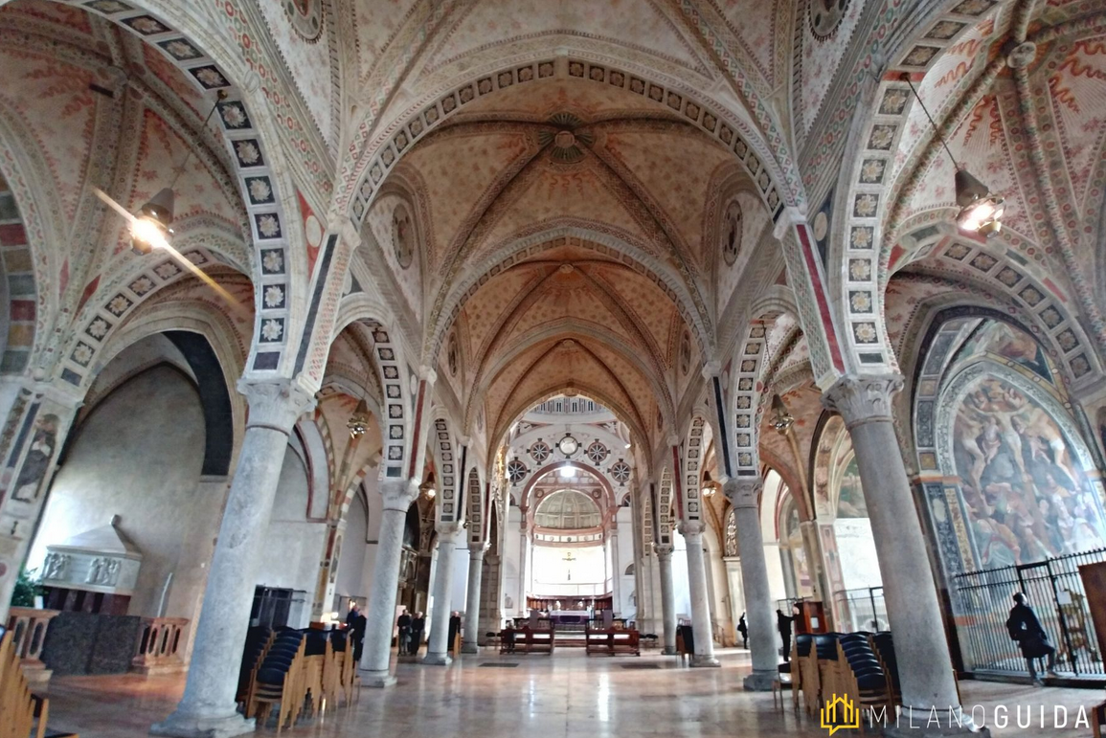

Slide 23
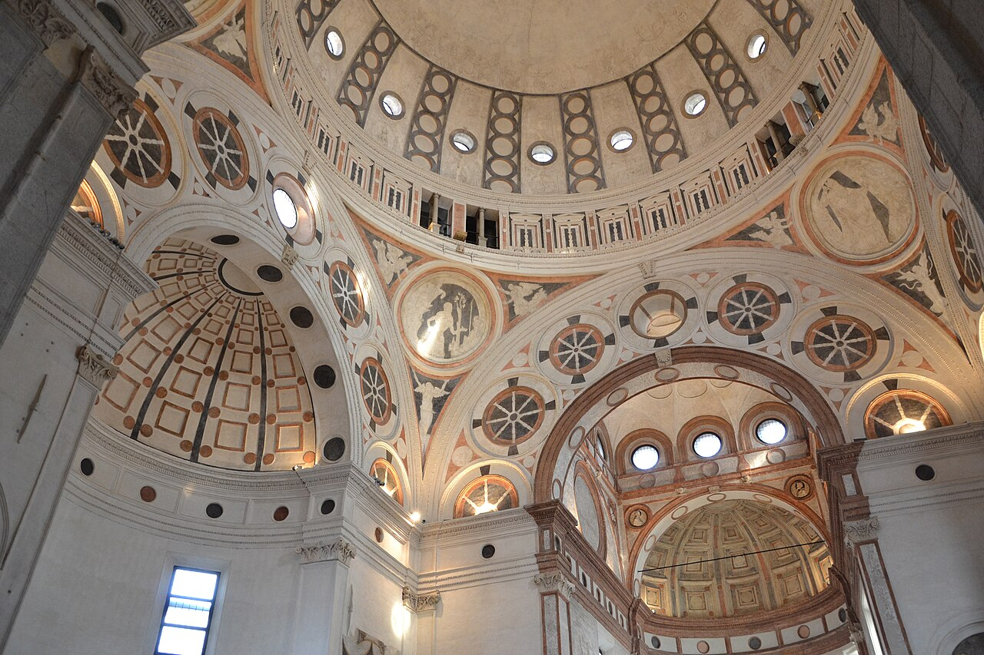

Slide 24
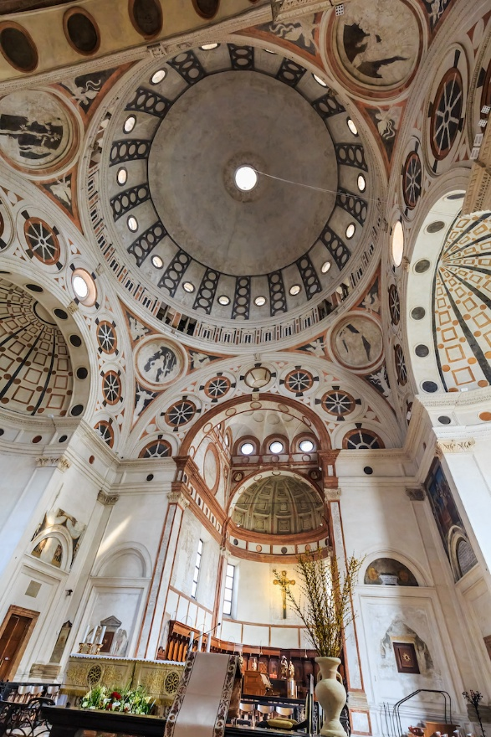

Slide 25
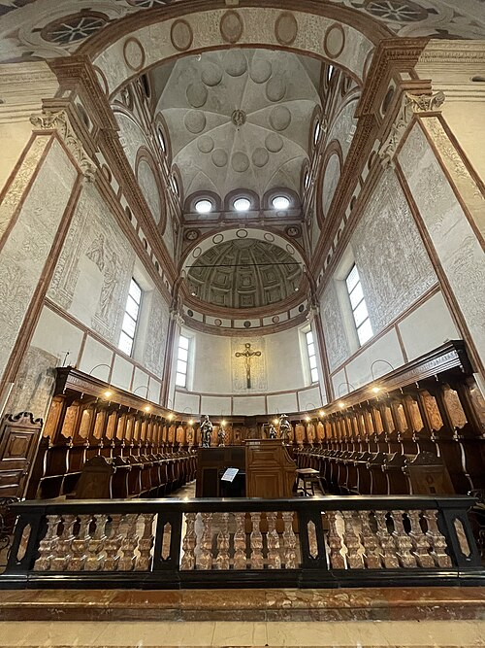
Choir with umbrella vault

Slide 26
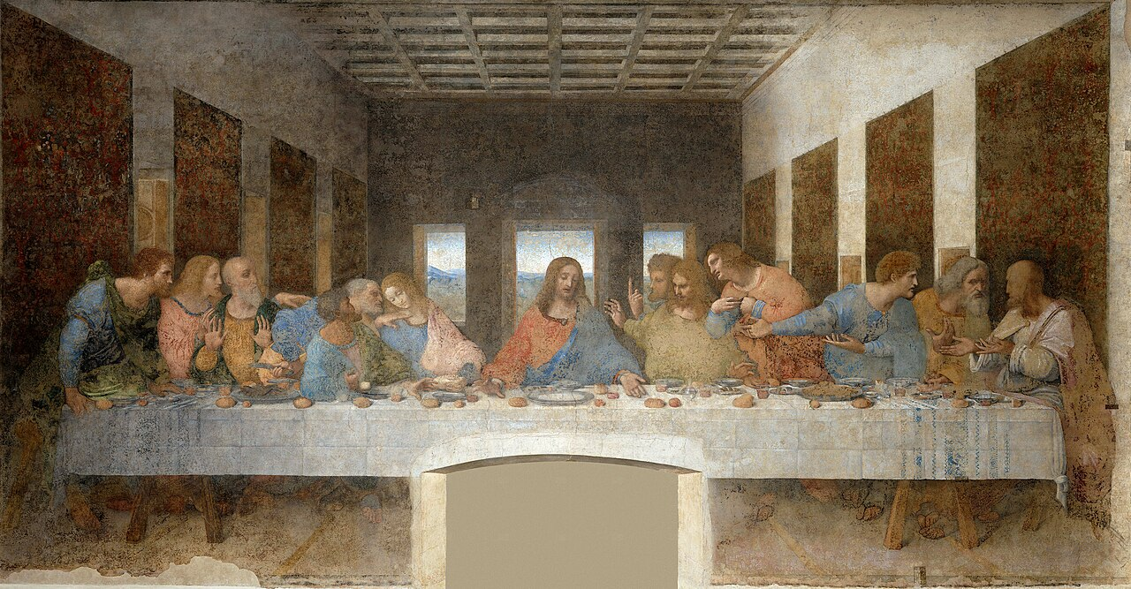
Leonardo da Vinci, Il Cenacolo, 1495-1498

Slide 27
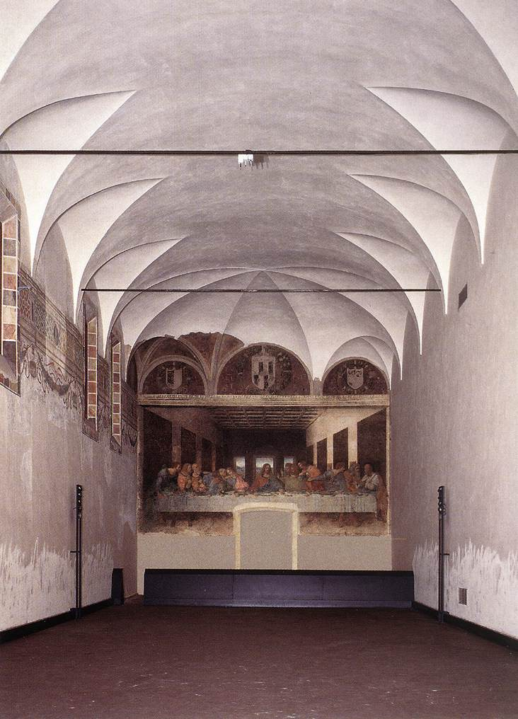

Slide 28
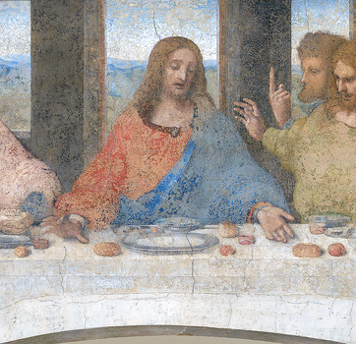

Slide 29
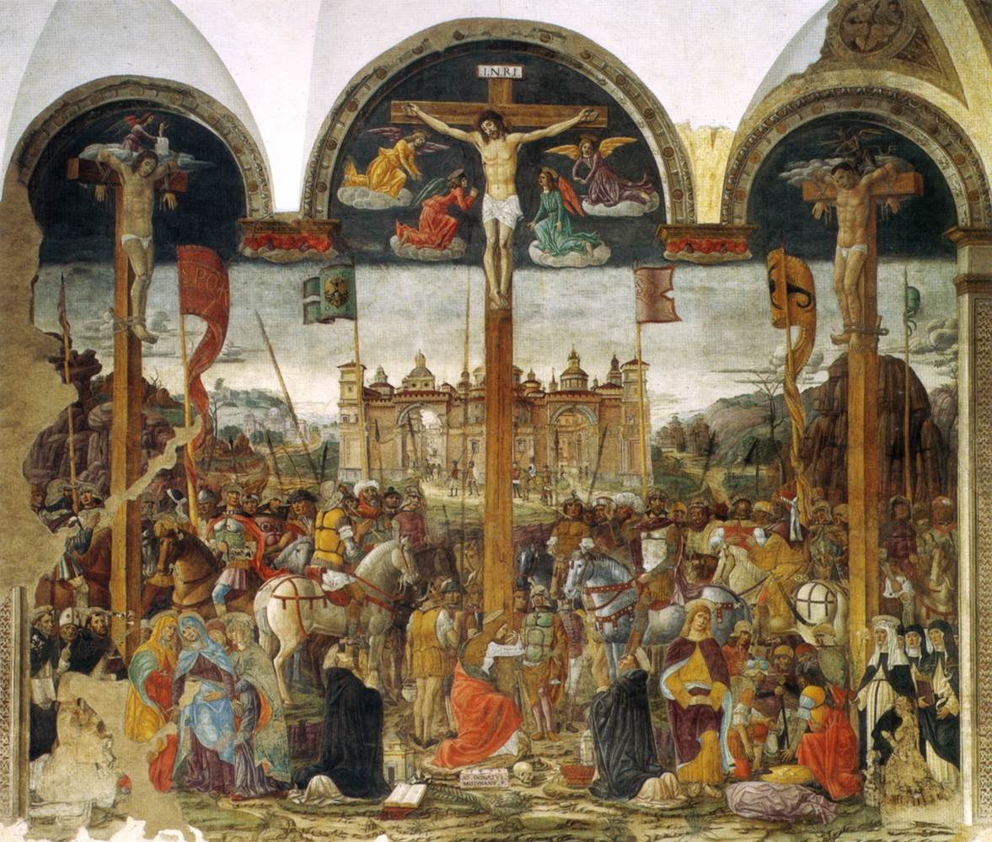
Giovanni Donato da Montorfano, Crucifixion, 1495

Slide 30
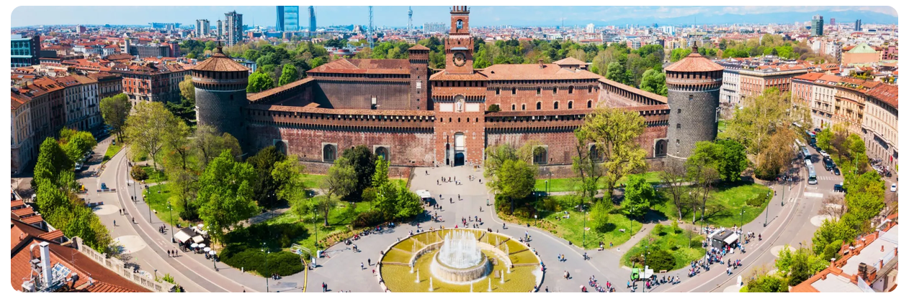
Filarete, Castello Sforzesco, 1450

Slide 31
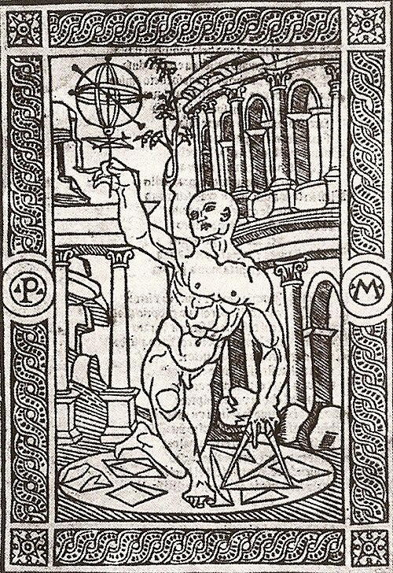
« Prospectivo Melanese, Depictore, » in Antiquario Prospecticche Romane, 1500

Slide 32
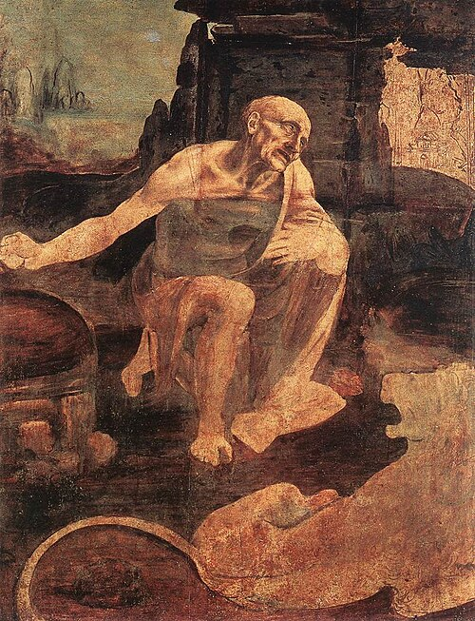
Leonard da Vinci,
San Girolamo, 1480

Slide 33
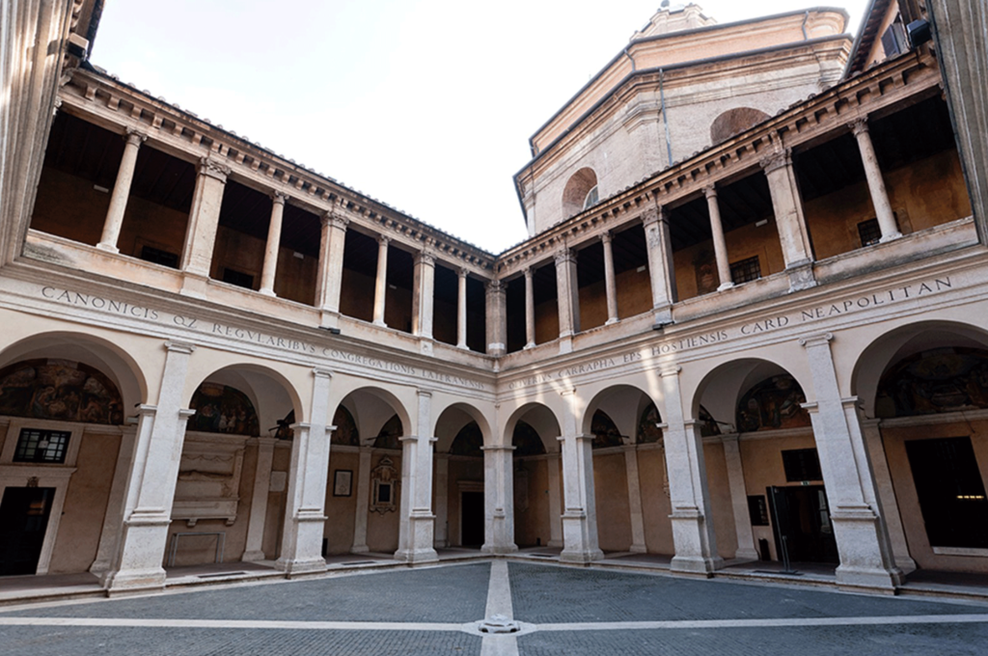
Cloister, Santa Maria della Pace, Rome, 1500

Slide 34
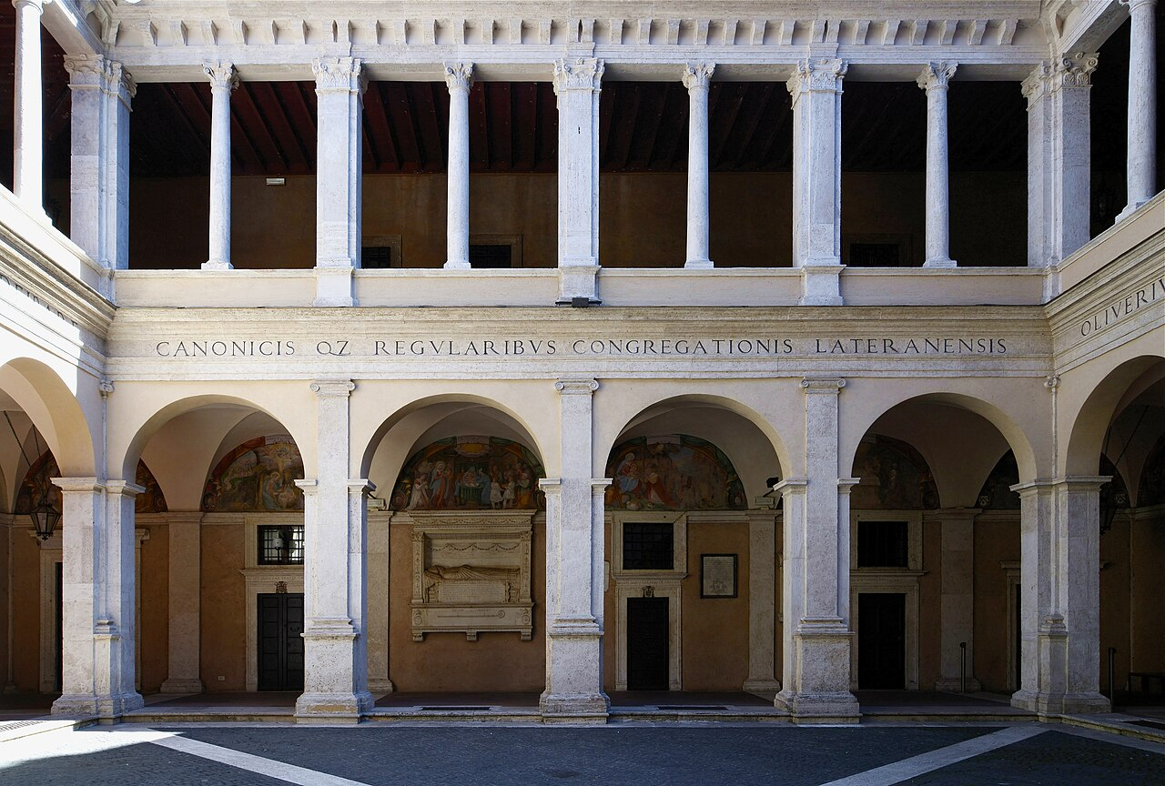

Slide 35
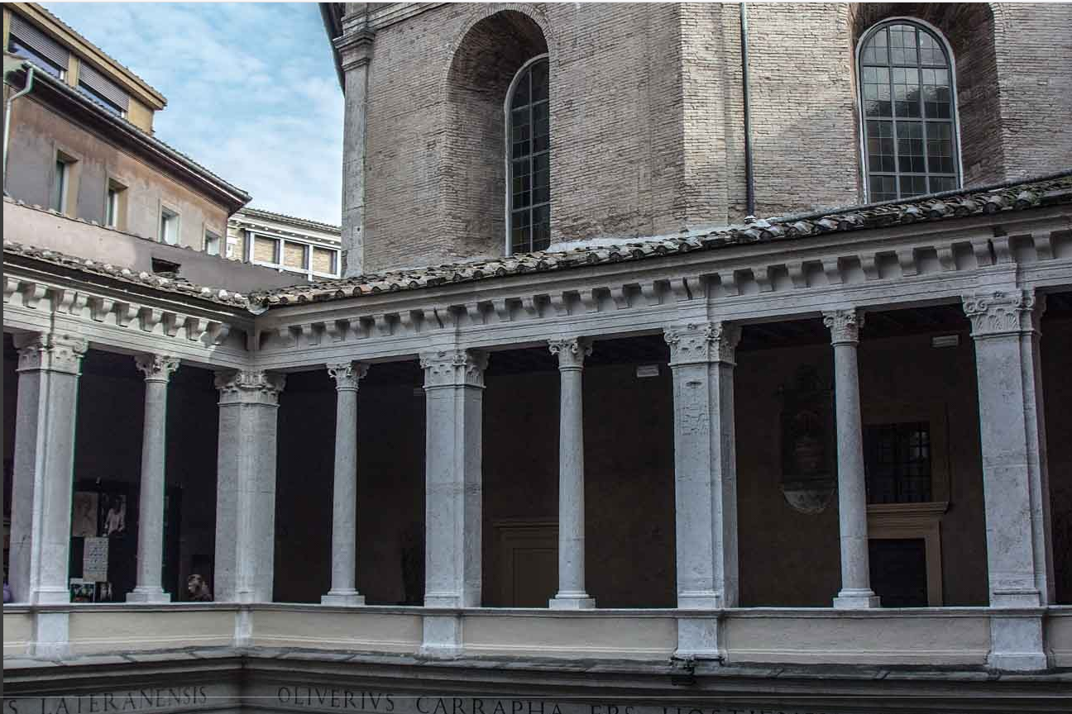

Slide 36
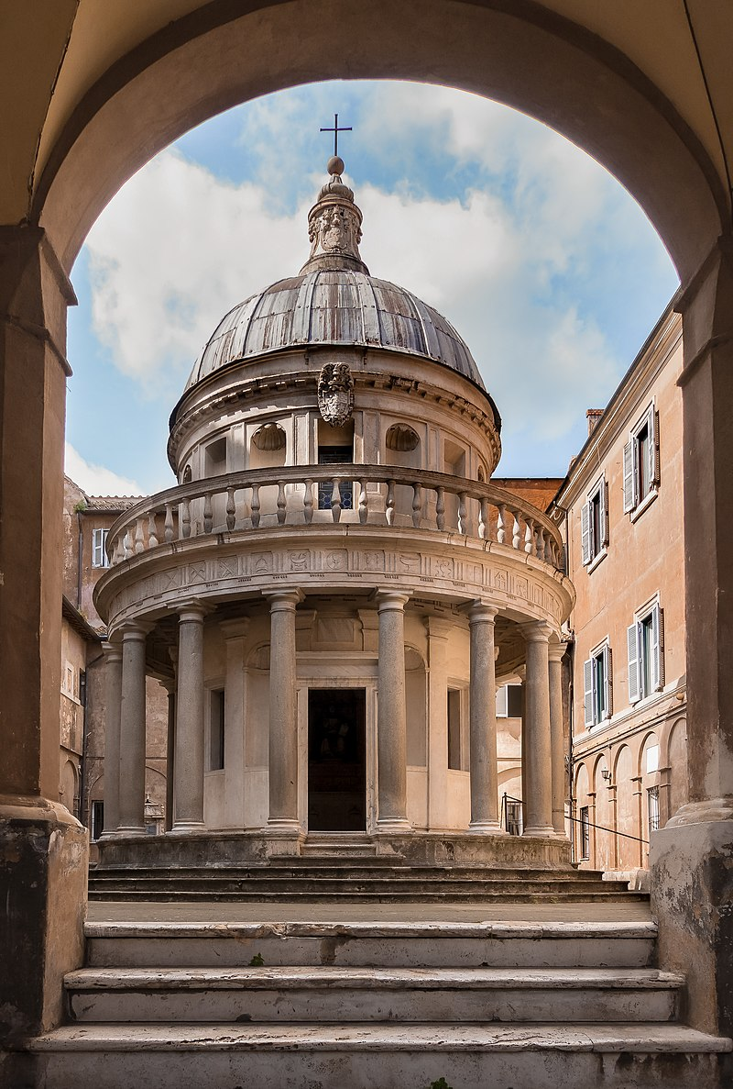
Tempietto,
San Pietro in Montorio, Rome, 1502

Slide 37
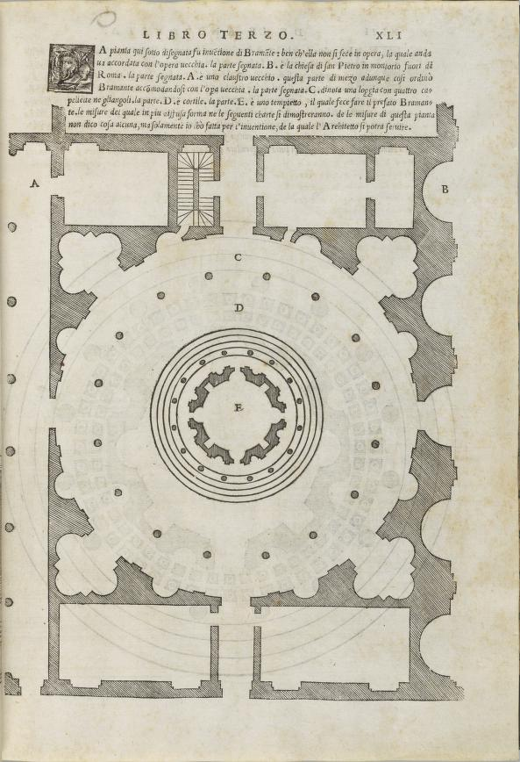
Bramante’s plan for Tempietto and Courtyard, 1503,
In Sebastiano Serlio, Libro Terzo, 1540

Slide 38
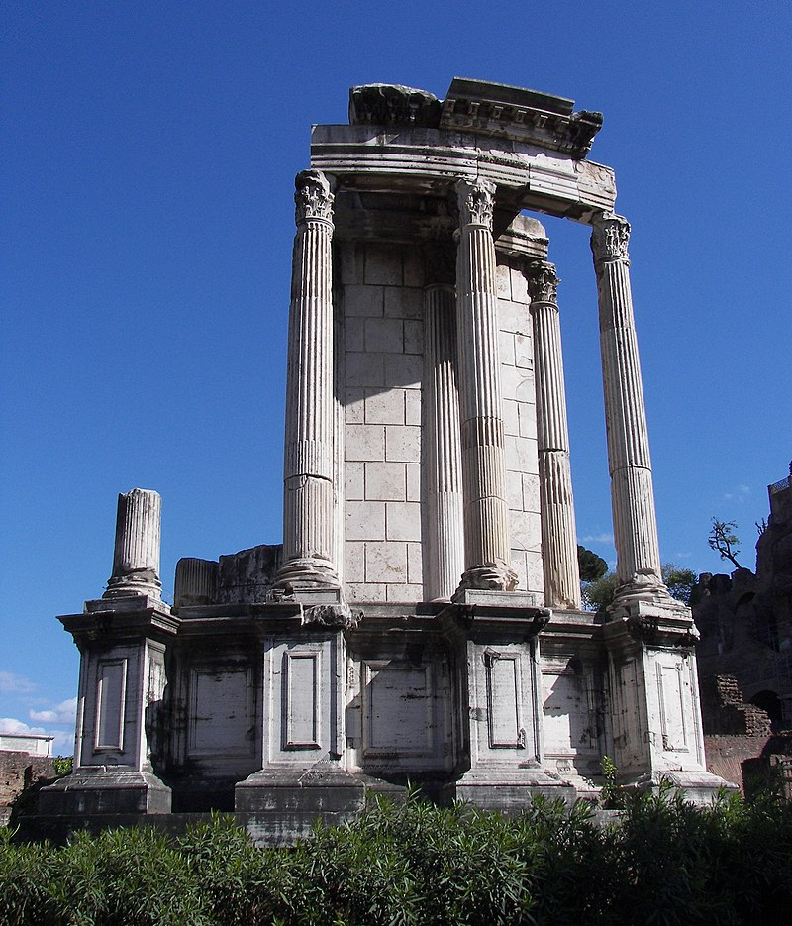
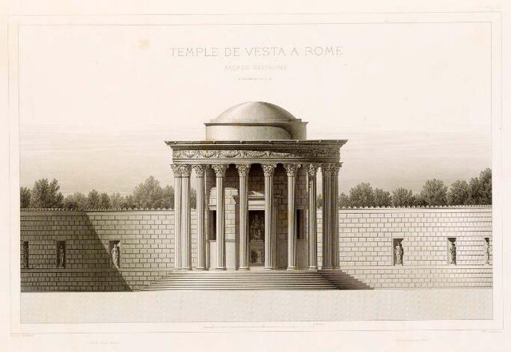
Temple of Vesta, Roman Forum, 2nd C. AD reconstruction

Slide 39
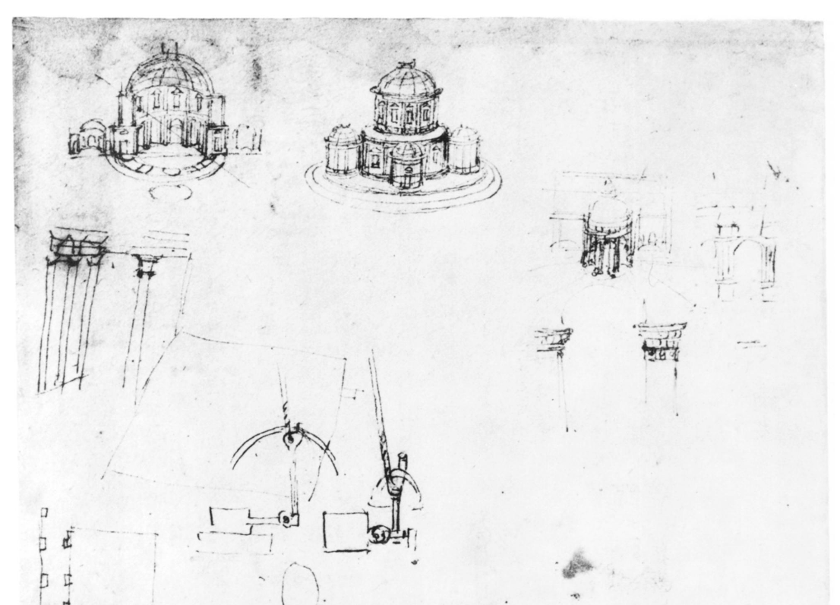
Leonardo da Vinci, sketches of tempietti, Codex Atlanticus, c. 1503

Slide 40
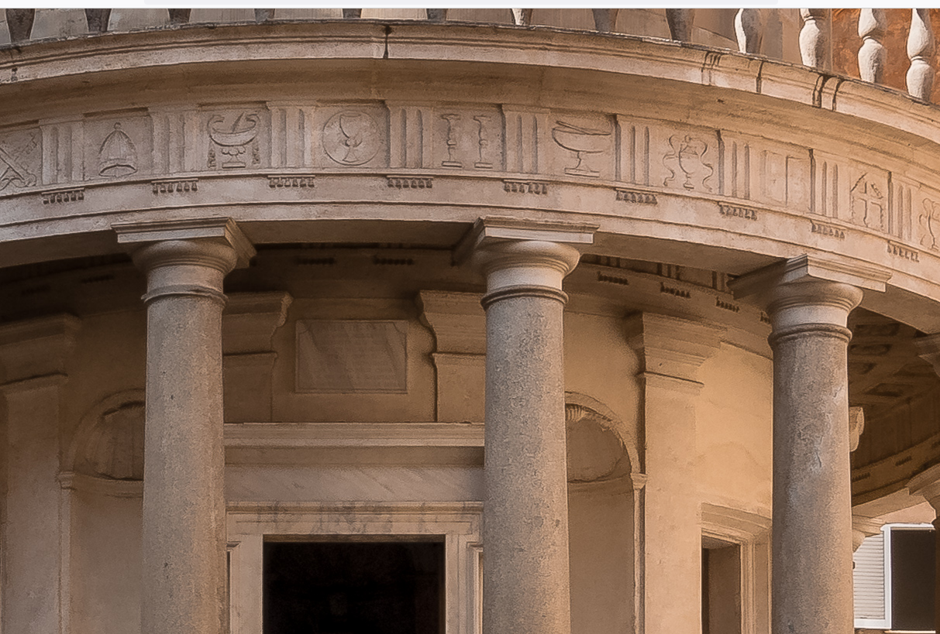

Slide 41
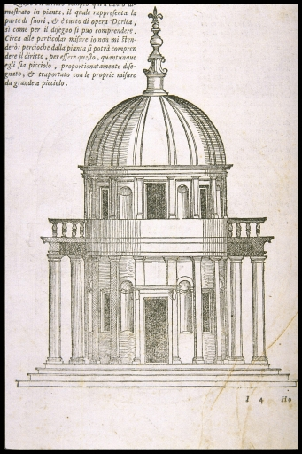

Slide 42
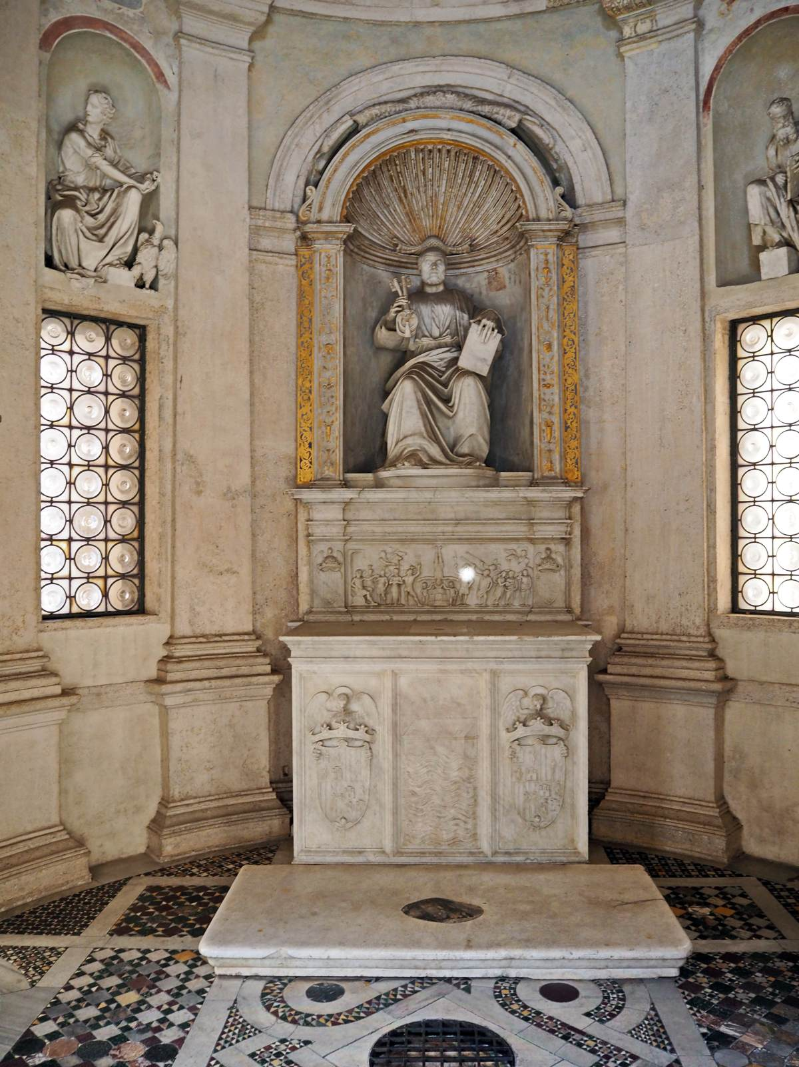

Slide 43
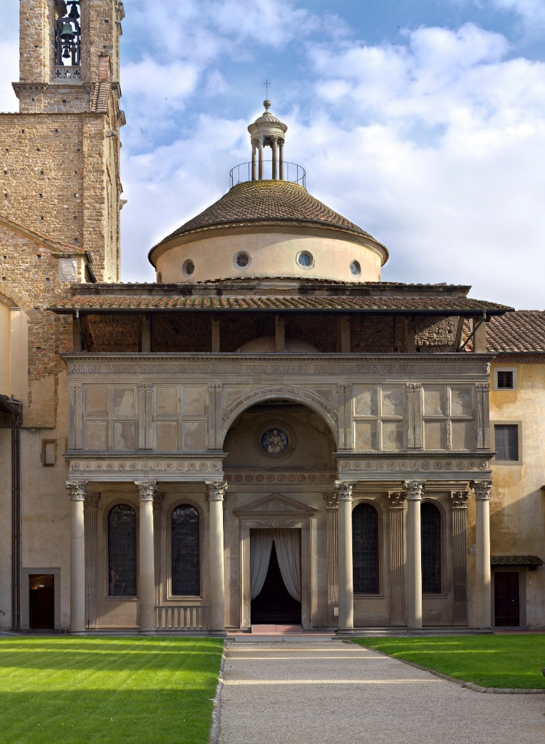
Brunelleschi, Pazzi Chapel, Florence, 1461 Bramante, Tempietto, Rome, 1502

Slide 44
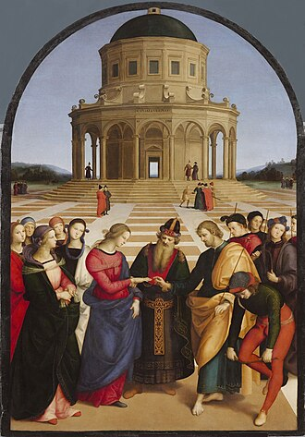
Raphael,
Marriage of the Virgin,
1504, Pinocateca di Brera

Slide 45
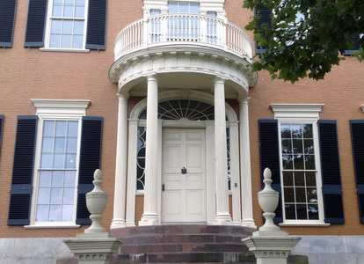
John Kimball, McLellan-Sweat House, Portland, ME, 1800

Slide 46
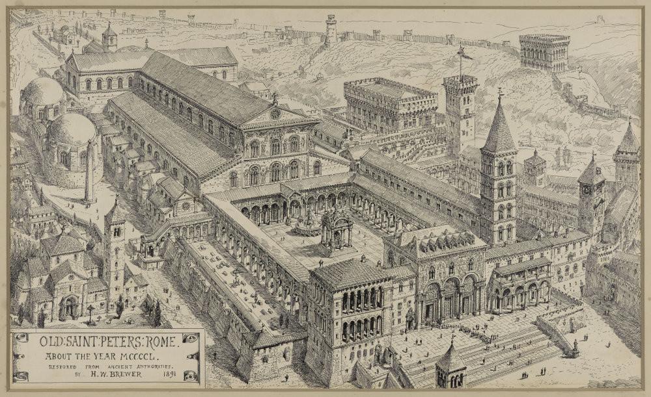
Old St Peter’s Basilica, c. 1450

Slide 47
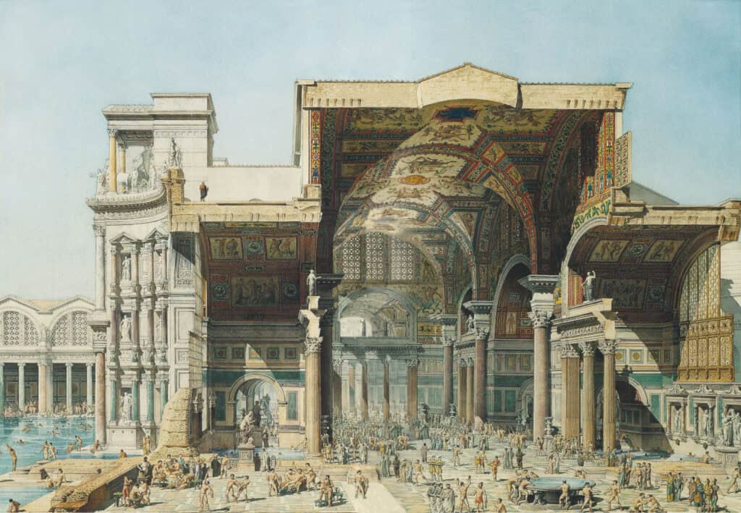
Baths of Diocletian, early 4th C. Section

Slide 48
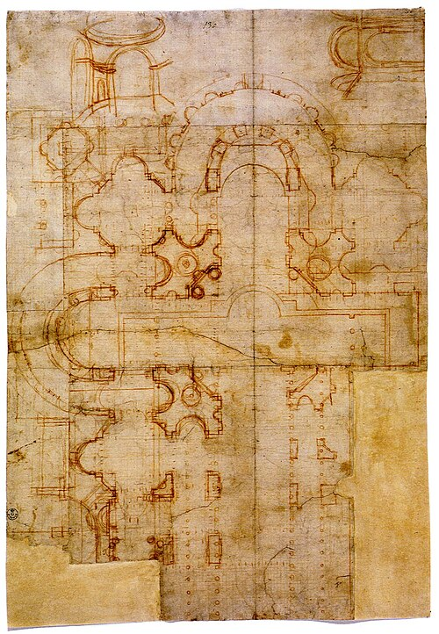
Bramante, plan for
St Peter’s Basilica (sketch),
1505
Florence, Uffizi

Slide 49
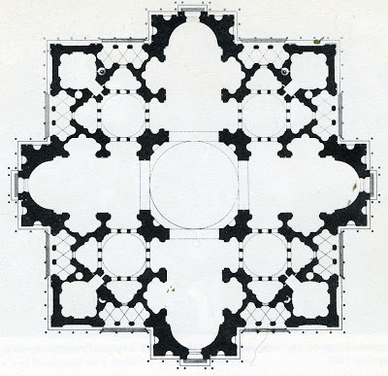
Bramante, plan for St Peter’s Basilica

Slide 50

Santa Maria delle Grazie San Pietro in Montorio

Slide 51
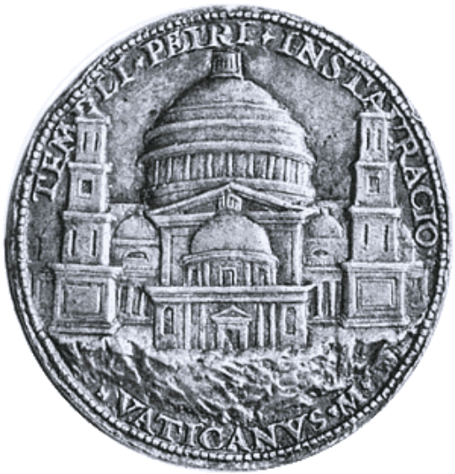
Christoforo Caradosso, medal showing Bramante’s design for St Peter’s, 1506

Slide 52
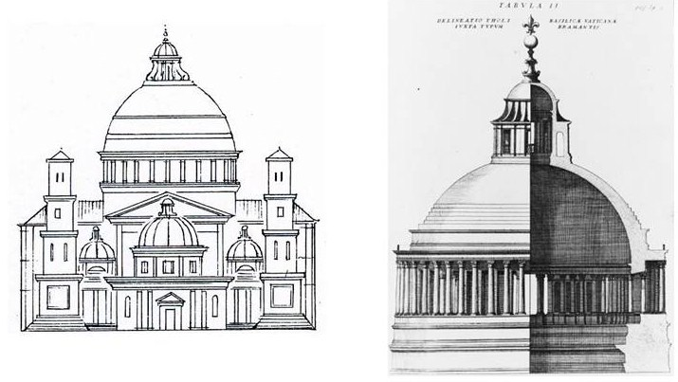
Bramante, elevation and dome of St Peter’s

Slide 53


Bramante, 1506 Raphael, 1514 Michelangelo, 1546

Slide 54


Slide 55


Slide 56

Cortile del Belvedere, original design, 1514

Slide 57

Giovanni Antonia Dosio, drawing of Belvedere Courtyard, c. 1560

Slide 58


Slide 59

Cortile del Belvedere

Slide 60

Cortile della Biblioteca

Slide 61

Great Hall of the Apostolic library, Domenico Fontana, 1587

Slide 62

Belvedere Palace

Slide 63

Staircase, Belvedere Palace, 1505

Slide 64



Slide 65


Slide 66

Staircase, Giuseppe Momo, 1932

Slide 67

Frank Lloyd Wright, Guggenheim Museum, New York, 1959

Slide 69


Slide 70


Slide 71


Slide 72


Slide 73

Palazzo Caprini, Rome, 1510

Slide 75


Slide 76

Michele Sanmicheli, Palazzo Pompei, Verona, c.1540

Slide 77

Palazzo Ugoccioni,
Florence, 1550

Slide 78


Slide 80

Giovanni Antonio Rusconi, Nuova Prigione, Venice, 1566

Slide 81

Claude Perrault, Colonnade du Louvre, 17th C.

Slide 82

William Chambers, Somerset House, London, 1776

Slide 83


Slide 84

Cupola del transetto

Slide 85


Slide 86

Cupola del sacello

Slide 87

Basilica of Maxentius, 4th C.

Slide 88


Slide 89

Pantheon, Rome, 1st C.

Slide 90

Papal audience, Apostolic Palace, San Domaso Courtyard with Bramante loggias

Slide 91


Slide 92


Slide 93

1. St. Peter’s Basilica 3. Dependencies of the Apostolic Palace
2. San Damaso Courtyard 4. Belvedere Courtyard.

Slide 94


Slide 95

Portrait of Chilon, Palazzo del Podestà,
Bergamo, 1477

Slide 96

Palazzo del Podestà, Bergamo, 12th C.

Slide 97


Slide 98


Slide 99

Cortile di San Damaso, Vatican, 1512

Slide 101

Maerten van Heemskerck, view of Basilica, c. 1535

Slide 102


Slide 103

Cortile del Belvedere, 1565

Slide 104


Slide 105


Slide 106


Slide 107


Slide 108

Loggias of the
Apostolic Palace, 1512

Slide 109

Raphael, The Separation of Land and Water, Gen. 1:10, 1519

Slide 110

Raphael, Jacob’s Dream, Gen. 28:12, 1519

Slide 111

Raphael, The Last Supper, John 13, 1519

Slide 112

Sketch by
Andrea Palladio

Slide 113


Slide 114

Bramante, Nymphaeum,
Genazzano, early 16th C.

Slide 115

Sebastiano Serlio,
Regole generali di architettura, 1537

Slide 116

Giulio Romano, Palazzo del Te, Mantua, 1524-1534

